Slide 1
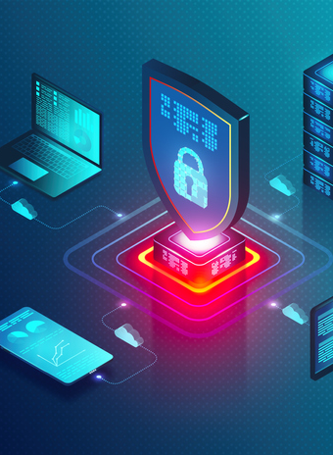
Comcast Business
Advanced Security
Solutions
Rich Korn
Senior Security Solutions Specialist
Notes:
Introduction of my background
Years in industry
What I have sold
Published
Educational, not sales pitch…but need to hit a few things or they won’t let me do events

Slide 2
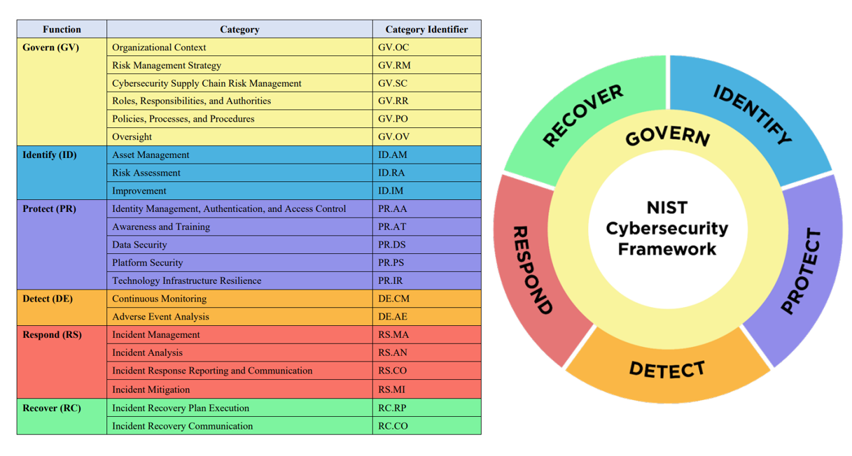
NIST Cybersecurity Framework
Comcast Business Cybersecurity
Notes:
Three segments with checks/balances
Detect/Respond combined for a reason

Slide 3
Comcast Business Cybersecurity
Comcast Business Managed Security Services
Threat Monitoring and Response
TMR
Endpoint Detection and Response
EDR
Managed Detection and Response
MDR
Fortinet Edge
Devices
Monitors FW and UTP Components
24/7 Detect and Response
Laptops, desktops, and servers
Malware and Ransomware Prevention
Device Security
24/7 Detect and Respond
Monitors Entire IT Environment
Covers Endpoint, Servers, Network and Cloud
24/7 Detect and Respond
EDGE SECURITY & VISIBILITY
Adds security monitoring and response for
SD-WAN sites
DETECT & MINIMIZE IMPACT
Next-gen endpoint threat detection and response capabilities for users and server assets
PREVENT & DETECT
Designed to monitor the entire IT environment with multiple layers detection & response in a single solution
Notes:
Everyone knows we sell networks (Versa with Palo Alto, Meraki now, and Fortinet) This is for Fortinet—62% of all breaches occur at the perimeter
EDR—We use S1—92% of all compromises are the result of human error (phishing, misconfigurations, etc.)
MDR—holistic approach…only company authorized for Rapid7

Slide 4
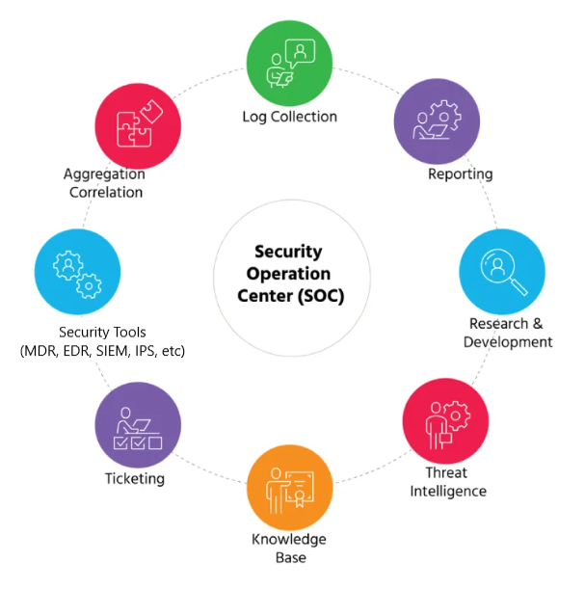
How the Security Operations Center (SOC) Works
Core Responsibilities
24/7 Prevention and proactive security monitoring with fast incident response for identified threats with remediation advice based on business impact [CONTEXT MATTERS!!!]
Continuous data enrichment with rule curation, AI/ML automation and integration combined with SOAR
End-to-End MDR & EDR analysis with reporting to identify threats with remediations, KPIs for top threats, risk categorization, with MITRE ATT&CK
Threat intelligence, collect & curate intel, identify suspicious behaviors and detect existing IoCs
Threat hunting - proactively search for IOCs, retroactive searching, curate new threat detections, and internal investigations
Notes:
Across all three areas is the SOC
Staffed with analysts/engineers, not ticket takers
Pod structure vs a dedicated analyst (24x7 job)
Tuning assistance vs out of the box (use awareness training numbers)
Customized response procedures
Provide alerts with all supporting documentation
What happened
How it happened
Supporting documentation showing that conclusion
Risk tied to MITRE
What we did to mitigate, if possible
Detailed steps to follow to remediate
Save staff time on research (We do the research so the customer can focus on resolving issues, not finding them)
Guidance on future security investments for best value on those investments
Partnership and Operational Efficiency

Slide 5
Protecting the Endpoint
Anti-Virus vs. EDR​
Anti-Virus
Signature-based
Reactive
File scanning
Warnings
EDR
Real-time threat detection
Behavior-based
Automated remediation
Forensic capable
Notes:
AV Going away
Mark Goodman Future Crimes estimated 1 million new malware daily
Light switch vs dimmer
Best value in the industry (93% of all issues are human error related)

Slide 6
MDR Features
Log Management and Search |  | Analyze the most complex data and find insights faster with InsightIDR’s cloud-native data lake, diverse log collection capabilities, custom log parsing, and flexible search and reporting.
Dashboards and Reporting |  | Access pre-built dashboards and reports out-of-the-box or create your own custom ones to best suit your organization’s needs.
Investigation Console |  | View your aggregated alert data in InsightIDR’s ​​investigations console to quickly search your active investigations and gather the context you need to effectively prioritize, sort, and respond to alerts.
File Integrity Monitoring (FIM) |  | Collect File Integrity Monitoring events with the Insight Agent so InsightIDR can attribute users to file modification activity. You can then create alerts based on certain file log events to notify you when one of your users modifies a critical file or folder. Compliments existing FIM Tools.
Intrusion Detection System (IDS) & Network Traffic Monitoring |  | Monitor for malicious activity and policy violations on your network with an Intrusion Detection System (IDS) device.
Curated Threat Detections Library |  | Leverage InsightIDR’s curated threat detections managed by Comcast & Rapid7’s threat intelligence teams. Capitalizing on our open-source community engagement, spanning known and unknown threats, and utilizing advanced attack surface mapping and proprietary machine learning, InsightIDR offers you wide threat coverage across your environment.
Attacker Behavior Analytics (ABA) |  | Hunt for unique attacker behavior with ABA detection rules. With our ever-growing detection library, you’ll be covered against even the newest of threats.
User and Entity Behavior Analytics (UEBA) |  | Identify compromised credentials, lateral movement, and other malicious behaviors with User Behavior Analytics detections.
Deception Technology |  | Deploy deception technology in the form of honeypots, honey files, honey users, and honey credentials to learn how attackers are attempting to access your systems.
Enhanced Endpoint Telemetry |  | Unlock comprehensive attack details, proactively hunt for threats, and tailor custom alerts to align your specific security policies and standards with Enhanced Endpoint Telemetry.
Enhanced Network Traffic Analysis |  | Access raw network flow data and rich metadata collected by the Insight Network Sensor with Enhanced Network Traffic Analysis. This metadata includes IP addresses, ports, content-based application recognition, and metadata attributed to specific users and devices.
Core Automated Response Workflows |  | Respond quickly and confidently with automated out-of-the-box workflows, including endpoint containment, Insight Agent containment, and more.
Notes:
Comprehensive approach, targeting system
Compliments EDR, not replaces it, as two primary functions are different
Hit on specialization in security and importance of working with security vendors that understand their niche and can work with others in partnership to improve joint customer security posture

