Slide 1
IT - Cybersecurity - Compliance
Herb Miner
B.S. Computer Systems Engineering
MBA
Co-Founder and Chief Operations Officer
Silicon Plains, LLC
siliconplains.net - 877-287-7762 - herb@siliconplains.net

Slide 2
About
35 Space Shuttle missions
16 satellite missions
Instrument-rated with a private pilot’s license
Lockheed Martin
NASA
Department of Defense
National Oceanic and Atmospheric Administration
Silicon Plains, LLC - founded in 2009
Virtual Chief Information Officer services
Cyber Security and Compliance services
Consulting
Prior Experience
Transportation and Logistics
Retail
Service industries

Slide 3
Why Should I Care?
Cybersecurity and Compliance

Slide 4
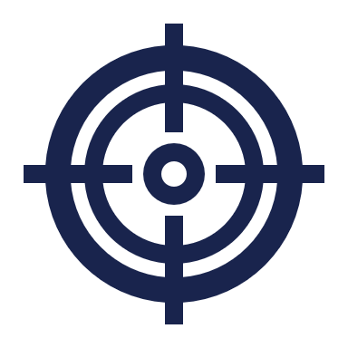
Your Business is At Risk!
Hackers have 1 Goal
Steal Your Data
Make
Money!
Force You Or Your Practice
To Pay A Ransom
Sell Your
Data

Slide 5
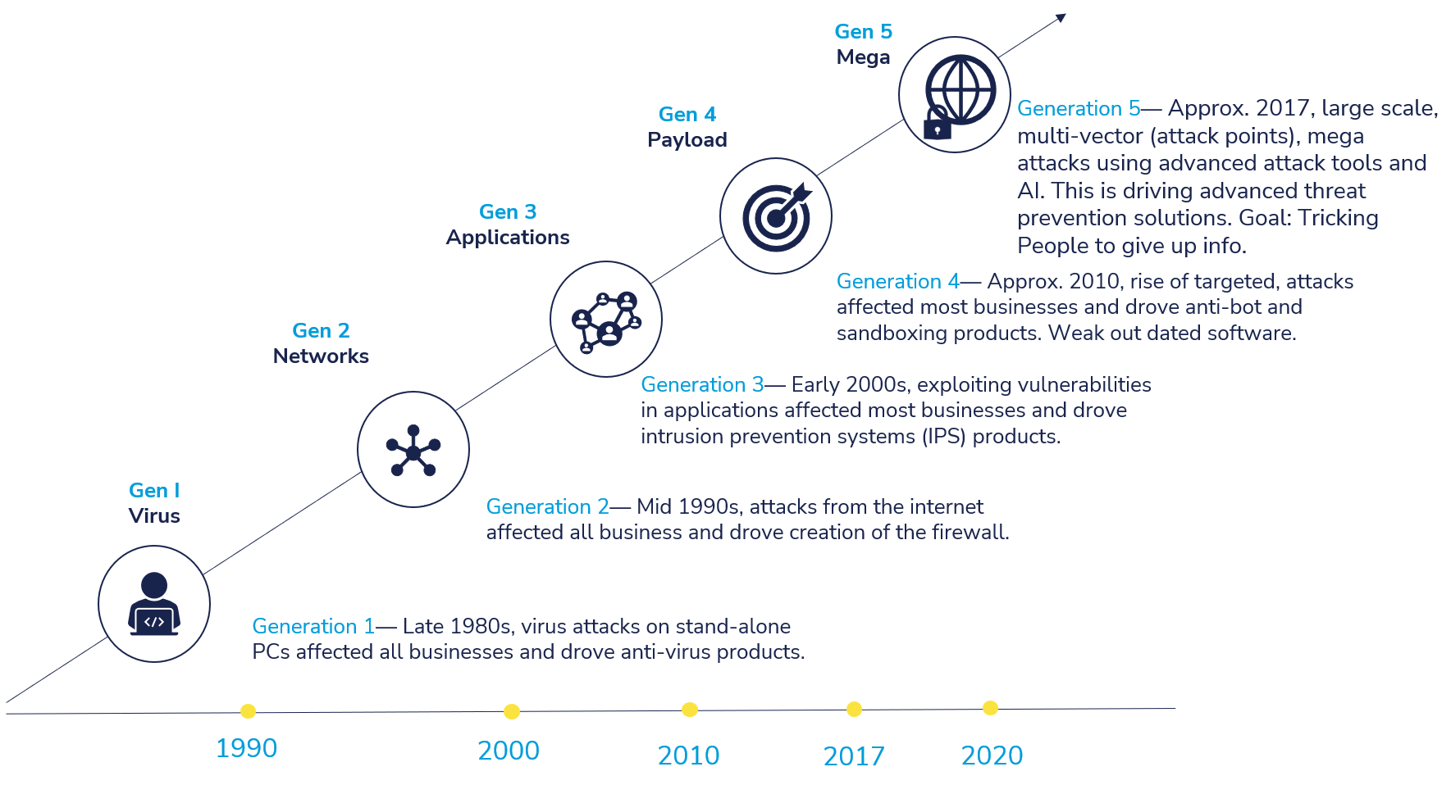
Current Cybersecurity Threats

Slide 6
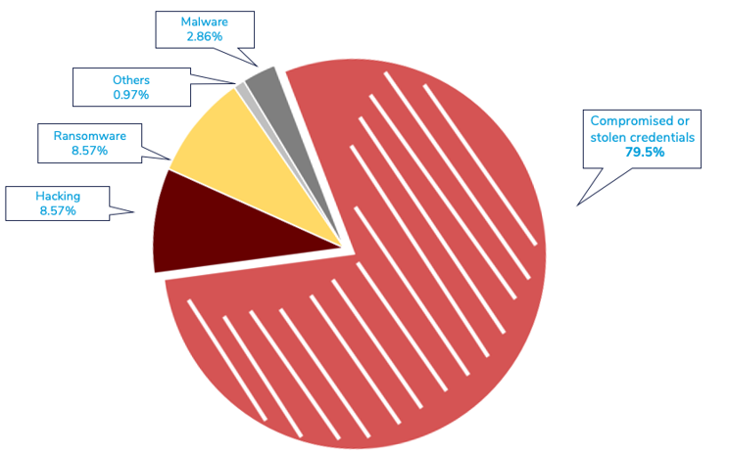
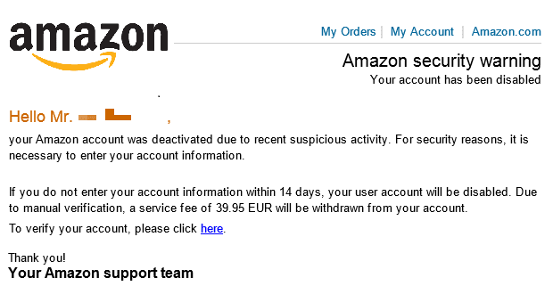
How are breaches happening?
91% of all cyber attacks begin with a phishing email to an unexpected victim
32% of all successful breaches involve the use of phishing techniques
147,000 session token replay attacks were detected by Microsoft in 2023, a 111% increase year-over-year
Stealing session tokens bypasses authentication controls like MFA
People + Email

Slide 7
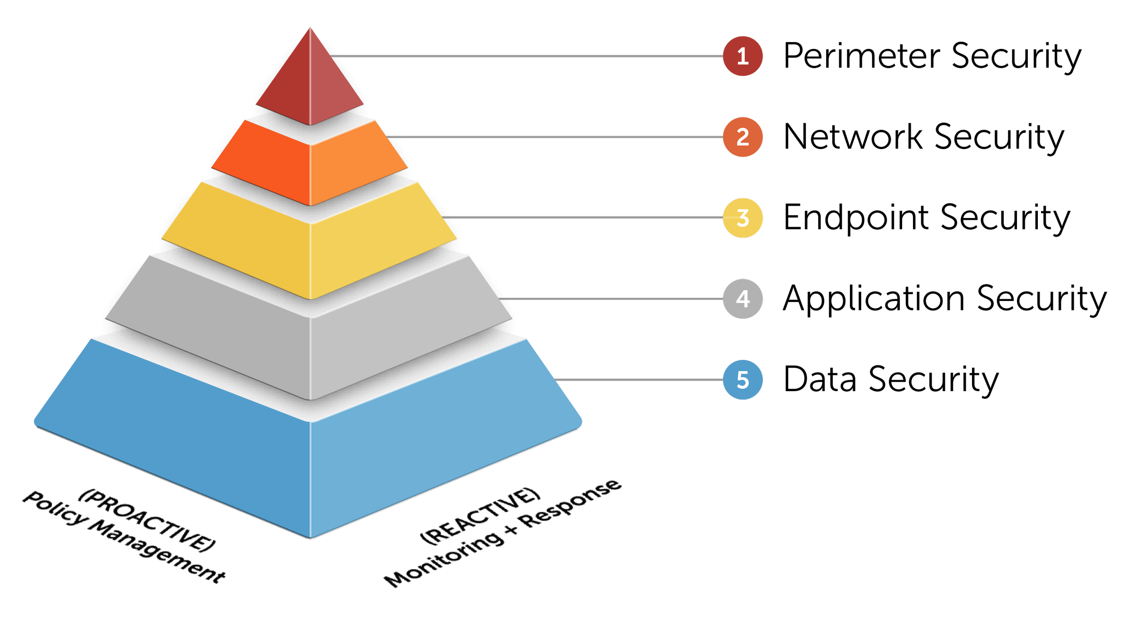
Layers of Cybersecurity
We implement 35 controls to protect clients and keep them compliant
Some are Technical Controls
NGAV
Zero-Trust
Some are Administrative Controls
Physical Security
Regular Audits
Company Policies

Slide 8
What should I do next?
Cybersecurity

Slide 9
Top 4
Phishing Training
Implement Zero-Trust
MFA/2FA
Eliminate Saved Sessions

Slide 10
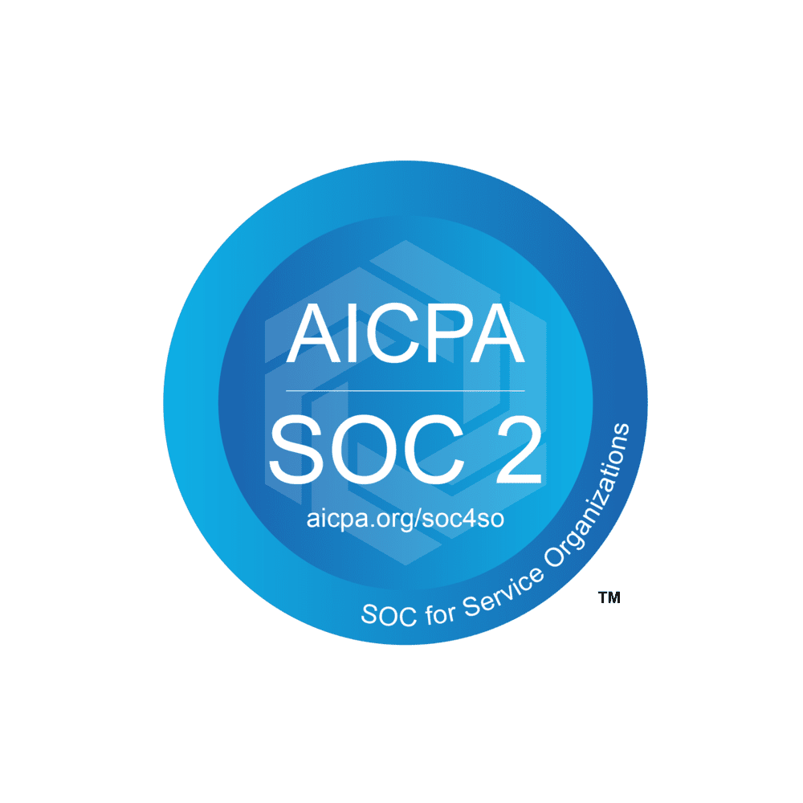
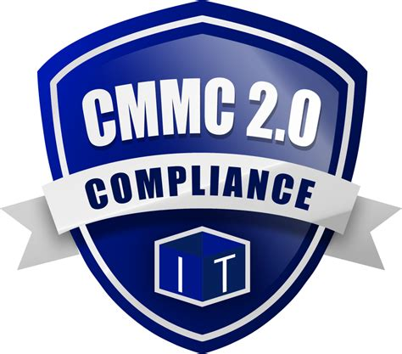
Compliance
Most Common
SOC 2 – SaaS Companies, Cloud Providers
ISO 27001 – Very rigorous, 114 controls
PCI-DSS – Credit Card requirement
FedRAMP – Cloud Service Providers
StateRAMP
TX-RAMP
CMMC – DoD – Comprehensive
HITRUST – Health-related organizations
ISO/IEC 42001 – AI Systems
DORA – European Union

Slide 11
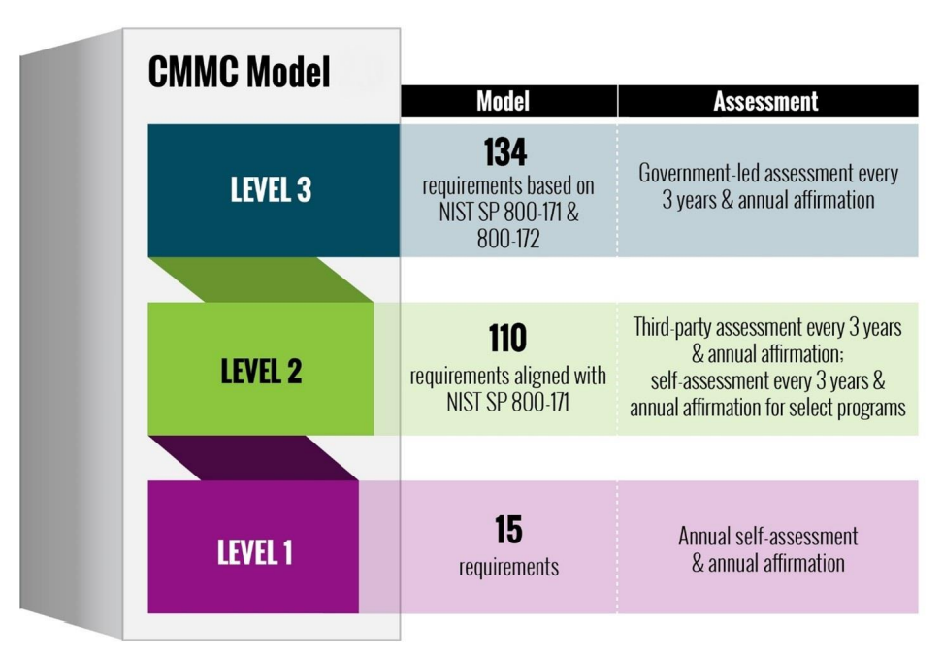
CMMC
Notes:
Level 2 is most common because it already aligns with NIST SP 800-171 which DoD already required to be followed

Slide 12
CMMC Compliance Domains
Access Control (AC) - All Levels
Awareness & Training (AT) - Level 2, 3
Audit & Accountability (AU) - Level 2, 3
Configuration Management (CM) - Level 2, 3
Identification & Authentication (IA) - All Levels
Incident Response (IR) - Level 2, 3
Maintenance (MA) - Level 2, 3
Media Protection (MP) - All Levels
Personnel Security (PS) - Level 2, 3
Physical Protection (PE) - All Levels
Risk Assessment (RA) - Level 2, 3
Security Assessment (CA) - Level 2, 3
System and Communications Protection (SC) - All Levels
System and Information Integrity (SI) - All Levels
Notes:
Level 2 is most common because it already aligns with NIST SP 800-171 which DoD already required to be followed

Slide 13
What should I do next?
Compliance

Slide 14
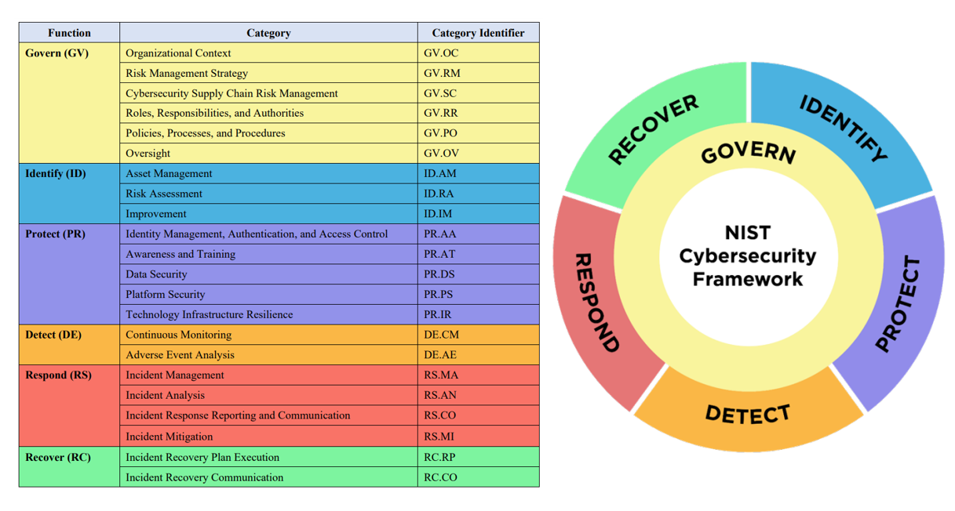
NIST CSF 2.0
Notes:
At least, implement NIST CSF 2.0.

Slide 15
IT - Cybersecurity - Compliance
Herb Miner
B.S. Computer Systems Engineering
MBA
Co-Founder and Chief Operations Officer
Silicon Plains, LLC
siliconplains.net - 877-287-7762 - herb@siliconplains.net

