Slide 1
Mikron Automation - Denver
Creating value with passion for precision

Slide 2
The Mikron Group Mission
As a global, leading supplier of high-volume, high-precision machining and automation solutions, we help our customers to achieve and keep the leading position in their business and to increase industrial productivity and quality.

Slide 3
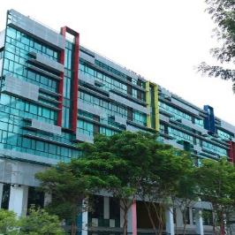
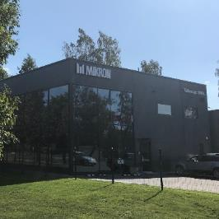
Mikron Automation
your partner for scalable and customized assembly systems –
from the first idea to the highest performance solutions
Mikron Switzerland AG, Boudry HQ
450+ employees
Mikron Denver
260+ employees
Mikron Singapore
60 employees
Mikron Shanghai
50 employees
Mikron Kaunas
35 employees
231 million CHF
Sales(2023)
100+
years of experience
4’100
systems installed
Notes:
Part of Mikron Group founded in 1908 with 3 divisions: Machining, Tool, Automation
Mikron Automation
260 customers
50-60 projects per year
4-12 months to delivery
USD 0.2 to 20mio order value
With our presence on 5 sites, we are with you from the start of the sales process, to the manufacturing up to the Customer Service _ For the full life cycle of your products

Slide 4
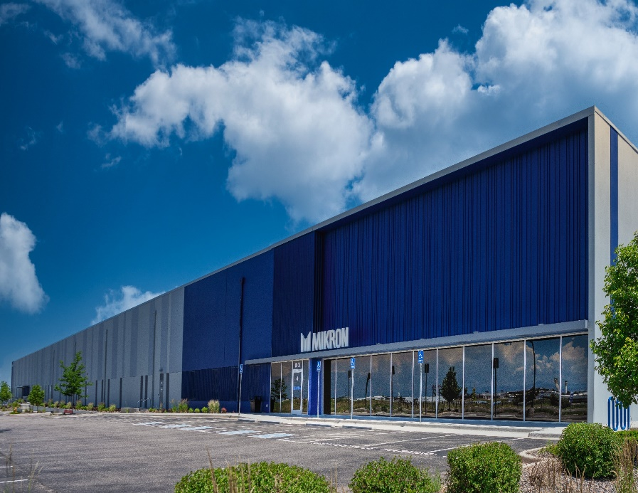
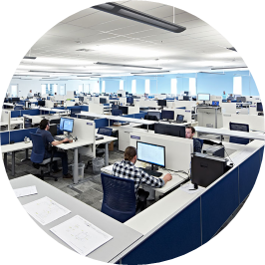
Mikron Corporation Denver
North America competence center
11 project teams
+ validation, vision and customer services teams
Design, build and commissioning
Training and Service support
260+
employees
136,000 sq.ft.
(10,000 sq. m.)
building
92%
technical employees
14
apprentices

Slide 5
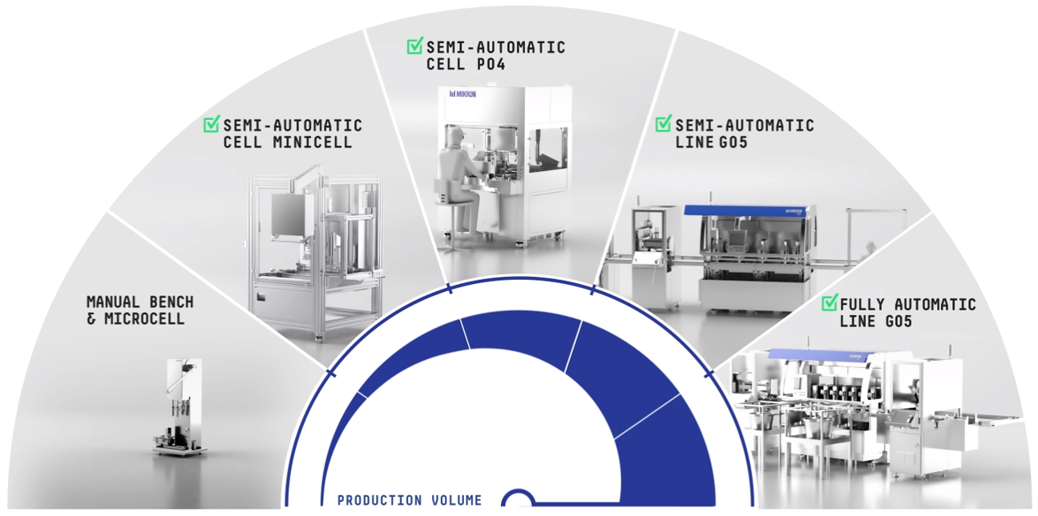
Standardized Equipment
Pre-validated mechanics and controls allows Mikron to focus our engineering on your specific application. Standardization allows Mikron to use process equivalency for ramp up without needing to revalidate with the NDA
Development Systems
2-10 parts per minute
Automation for clinical trials
Flexible system for future device evolution
Validated assembly process
Low Volume Systems
10-30 parts per minute
Entry level volumes into the market
Scale up pre-validated processes
Reduce FTE staffing
Benchtop Systems
1 part per minute
Automating manual processes
Product design for automation
De-risk automation efforts
Develop process parameters
High Volume Systems
30-200 parts per minute
Producing quality product
High efficiency equipment
Minimal FTE required
Long term investment

Slide 6
Medical Device and Pharma Manufacturing Expertise
Regulated
Product
Development
Verification & Validation
(IQ, OQ)
Manufacturing Process Validation
Production Ramp-Up
Process Qualification
Volume Manufacturing
Continuous Improvement
Automation Solutions
Mikron
Pre-Production Services
Customer Services
Solutions
Accelerate Development
Rapid Deployment
Sustainment
Helping accelerate through development into production

Slide 7
Thank you
Making complexity accessible

