Slide 1
South Metro Water Supply Authority
A Plan for the Future
Denver South Partnership Meeting
Lisa Darling, Executive Director
South Metro Water Supply Authority
June 1, 2023
Notes:
Going to talk about our 2016 master plan, progress that we have made, and outlook for the future…
But before jumping into all of that, I will need to provide some context because historically we have been one of the state’s most challenged regions when it comes to water.

Slide 2
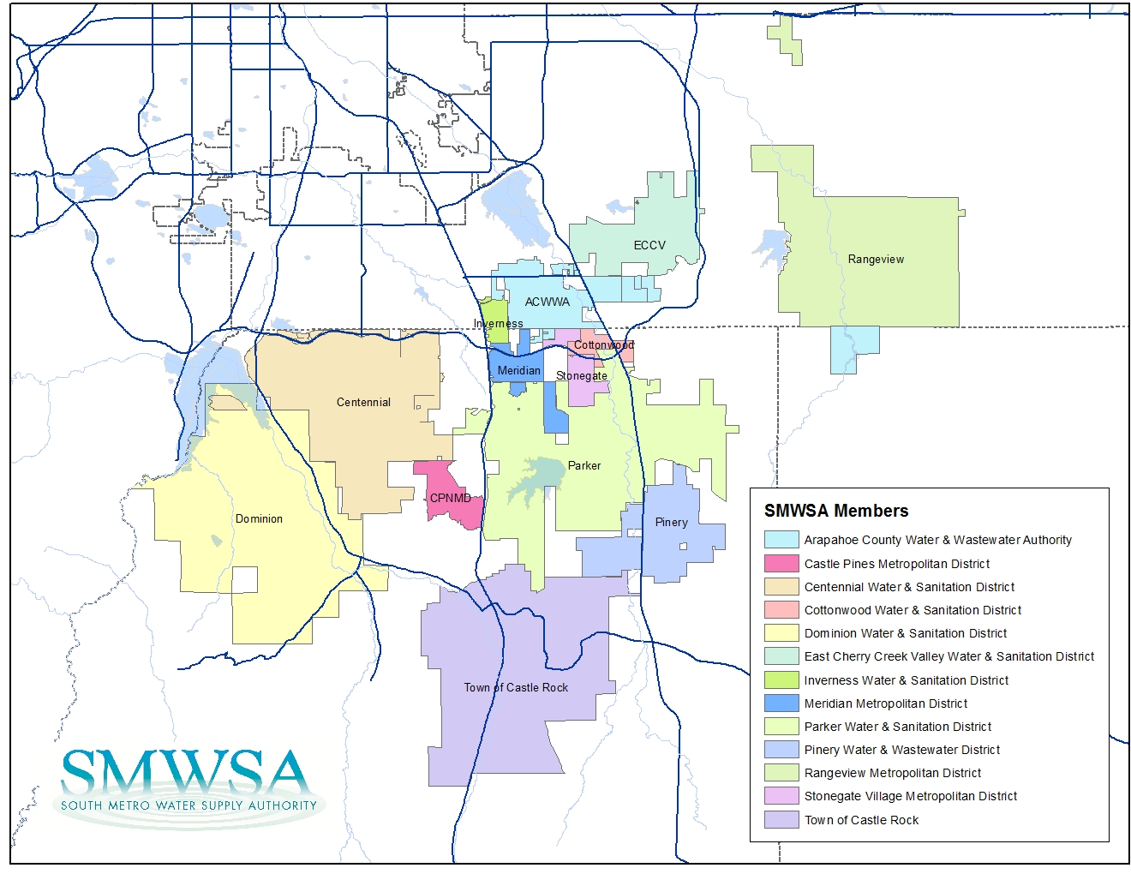
Who We Are
14 Members
Serve 350,000 people
Projected to serve 600,000 people by 2050
80% of Douglas County
10% of Arapahoe County
Notes:
We are an association of 13 water providers in the South Metro region.
Serve about the same population as City of Aurora
Our providers serve 80% of the population of Douglas County and 10% of Arapahoe County residents.
Majority of the states fortune 500 companies
Go over map

Slide 3
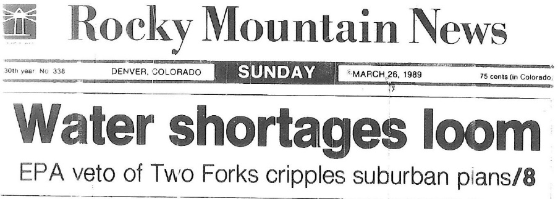
Flashback
“We don’t even know where to begin,” Pena said –Rocky Mountain News, March 25 1989
“We’re not able to meet our infrastructure needs.” –Metropolitan Water Providers
Notes:
How many of you have heard of the Two Forks project?
-Two Forks was a proposed new water supply project in the 1980’s. It was going to be built southwest of Denver and much of the metro area, including the South Metro region, was counting on that proposed project for our future water supplies.
-The project was vetoed by the EPA in 1989, sending water providers throughout the metro area into a tailspin. Where were we going to get more water to meet our growing needs?
These are a few of the headlines that showed the level of panic that arose.

Slide 4
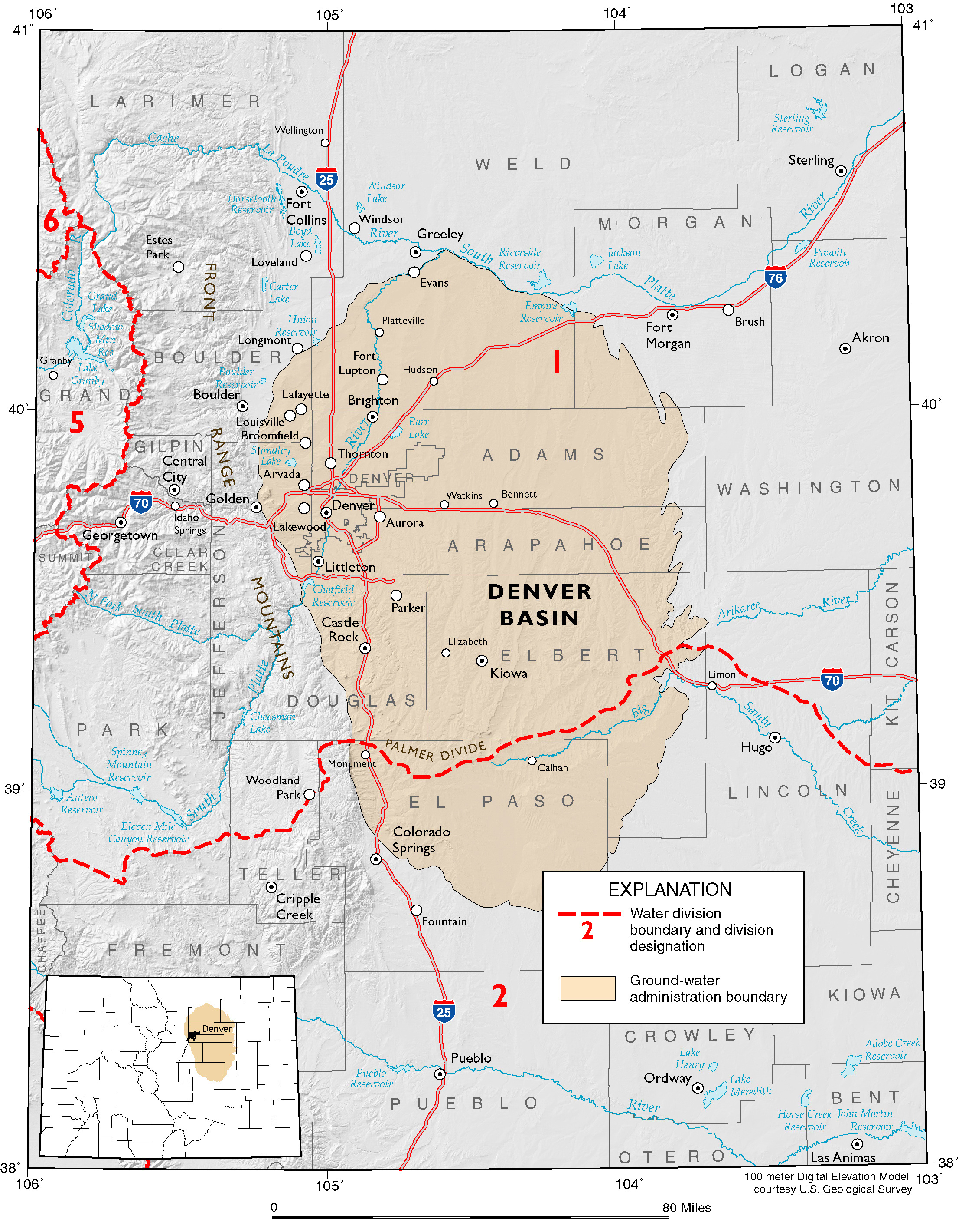
Denver Basin
Aquifer System:
Great water quality
But….
Notes:
This was a particular problem for our region.
The 1990s was a decade of unprecedented economic growth for Colorado, and our region was the epicenter. Douglas County was the fastest growing county in the nation during this period.
Without 2 forks – relied upon the Denver basin Aquifer system. SHOW where we are on map
This water was great quality water and it was thought to be abundant. The problem is it wasn’t, and it doesn’t renew itself like supplies from rivers and streams that get replenished with snowmelt every year.
less than 30% of our region’s water supply came from renewable sources at the time and we were depleting the aquifer at an unprecedented rate – an average of 30 feet per year across the region, more in some areas.
Our region was home to 5% of the state’s population and 30% of the states earned income, and following the Two Forks veto we were dangerously close to running out of water.
OLD notes
The Denver Basin Aquifer covers this geographic region. On one hand this aquifer has a huge amount of water in it – as much water as Lake Erie. On the other hand, it isn’t the amount of water as much as it is the pressure. These graphs show the declining production of different wells. --explain multiple well drilling—
On the other hand, this aquifer is a tremendous resource as it is completely drought proof. It is there in basically the same quantity and same pressure regardless of whether area is flooding or in severe drought.
So it is a tale of two aquifers. As a base supply it is a liability; as a drought supply it gives our region one of the most drought proof supply’s in the front range if not the entire state. However, in order to be used the way it should be used, as a drought supply, our members need a renewable surface water supply that they can jointly use, or use conjunctively, with their groundwater resource.

Slide 5
Flashback
“Should we put a warning on the front door (of new homes relying on non-replenishable groundwater) like we do cigarettes?”
– Gov. Roy Romer
Series from the 2003 Rocky Mountain News
Notes:
The issue really came to a head again in the early 2000s. The Rocky Mountain News and other papers were running headlines like these. And there were editorials scolding the south metro region for being in denial and not having a plan.
-At one point in the mid-1990s Governor Romer was publicly calling for signs to be placed in front of new home projects warning buyers that the water was unreliable.
This galvanized support among the water providers, business leaders, and community leaders to do something.

Slide 6
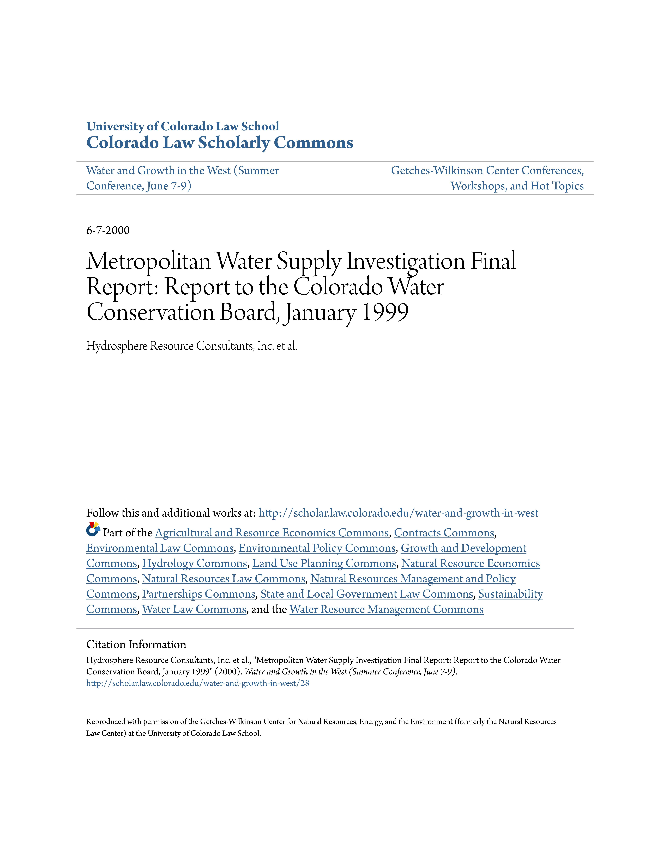
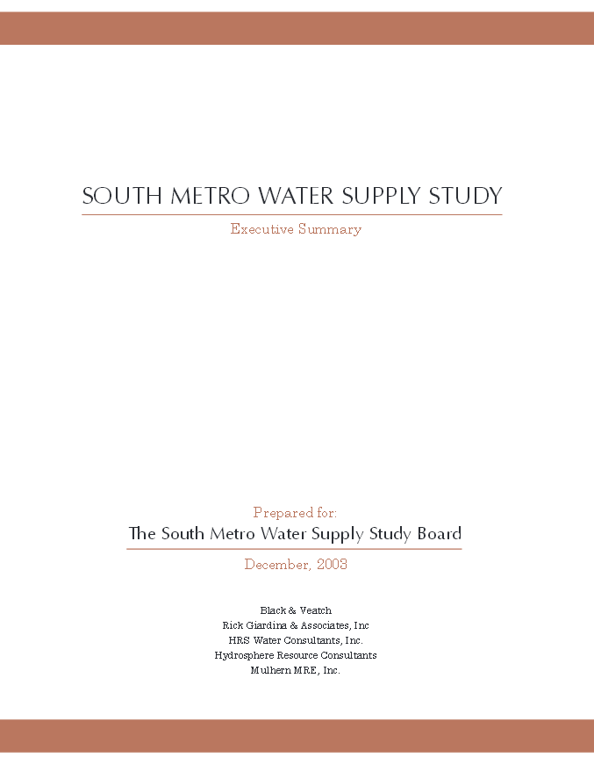
1999
Metropolitan Study
2003
South Metro Water Supply Study
Notes:
1999 Metropolitan Water Supply Study was the first look at this issue from a regional perspective
The 2003 South Metro Water Supply Study was funded by South Metro entities, but also funded by DW, the State, & west slope entities which showed that this was not just a regional issue but a water issue of statewide concern.
It was this study that led to the formation of SMWSA

Slide 7
2004:
South Metro Water Supply Authority
Goal: Shift away from nonrenewable sources of water
Plan based on three pillars
Partnerships – Leverage relationships with each other, local governments in the region, and other water providers
Investment – In supply and storage projects, individually and collectively
3. Efficiency – Become a leader in conservation and the efficient use of water
Notes:
It quickly became clear that rather than each of the water providers in the region addressing this challenge on their own, we would be far stronger, effective and efficient if we could join forces.
To the tremendous credit of the water providers and the business and elected leaders in the area, the region embarked on an unparalleled effort really beginning with this study and encompassing all of the projects and programs the region invested in over the past 13 years!
In 2004, the South Metro Water Supply Authority was formed with the goal of shifting away from non-renewable sources of water
We quickly went to work and developed a plan based on three pillars:
Partnerships: we would leverage relationships with each other, with local governments in the region and with other water providers
Investment: we would invest in new supply and storage projects. Some of these would be made by individual members and others would be where South Metro members joined together to make the investment.
And efficiency: we were going to become statewide leaders in conservation and the efficient use of water.
It was a tall order.

Slide 8
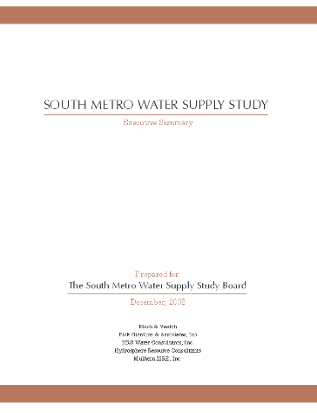
2016
Master Plan Update
2003
South Metro Water Supply Study
1999
Metropolitan Study
2007
Master Plan
2011
Master Plan Update
Notes:
We have been doing a lot of planning since 2004, but let’s fast forward to today, 12 years later. How are we doing?
We recently hired CH2M to do a study to help us answer this question. Our 2016 Master Plan Update did 2 things
It looked at how much progress that has been made. We knew that we were making progress but we didn’t know exactly how much.
It looked at our remaining needs
Here is what we learned.
_______
In 2004 SMWSA formed and the region embarked on a series of Master Plans that looked at member’s projects and regional opportunities.
Our 2007 Master Plan set the path for many of these projects and programs
Our 2011 Update refined the regional plan
Our Master Plan Update from this year did 2 things
It looked at how much progress has been made. We knew that tremendous progress had been made over the past 10-15 years, but we didn’t know exactly how much.
It looked at our remaining needs
So I’ll step through the high level details of this progress.

Slide 9
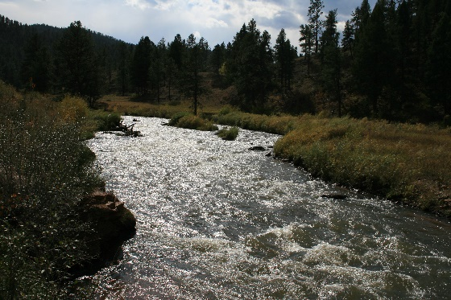
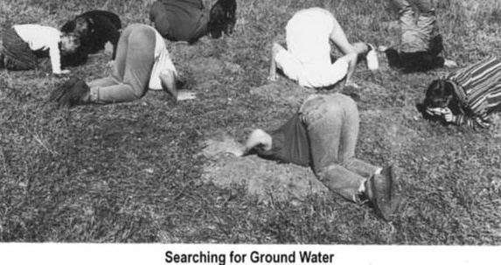
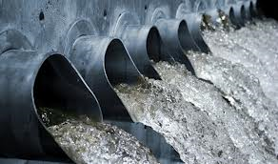
Tremendous Progress
Shift to Renewable Supply
Early 2000’s: 60% nonrenewable; Many of the region’s largest water providers were 100% nonrenewable
By 2020: 22% nonrenewable
By buildout (2065) it will be down to 15%
Some entities are already almost
completely renewable on average
Notes:
The report found that we had made tremendous progress. In terms of supply, we had made great progress in shifting to renewable supplies.
In the early 2000’s many of the region’s largest water providers relied on nonrenewable groundwater aquifers for almost all of their water supply.
Today, less than half of the region’s water is from nonrenewable groundwater and by 2020, it will fall even further to 22 percent.
We project that by build-out in 2065, only 15 percent of the region’s supplies will come from nonrenewable sources.
Notably, this progress is being made despite a projected 130 percent increase in total water demand over the same period.
We never want to rely completely on renewable surface water. 15% reliance on groundwater is our long-term goal because we will always rely on groundwater and underground water storage in times of drought when lack of snow reduces the amount of supply from renewable sources. Since we have much the infrastructure in place for GW supplies, if managed conjuctively with surface supplies, we will have one of the most robust supplies in the region.

Slide 10
Tremendous Progress
Conservation and Efficiency
Reduced per capita water demands across the region by 30%
The region currently averages about 120 GPCD.
The region is set up to reuse all of the supplies that are legally able to be reused.
Notes:
And we have also made tremendous progress in becoming a statewide leader in conservation and water stewardship.
Conservation
Between 2000 and 2010, we saw a reduction in per capita demands of over 30%. Our region averages about 120 gallons of water per capita per day, one of the lowest per capita rates in the state. The state plan includes a goal for our region of 129 gallons per capita per day. At 120, we have already surpassed that.
All members have a conservation plan.
We’ve developed a conservation committee dedicated to developing smart water solutions.
Our Water Ambassadors program enlists high school volunteers to teach elementary students about water conservation and water supply.
Providers serving Highlands Ranch and Castle Rock are two of only three in the state to put water customers on a water budget that tracks use by household.
Sterling Ranch and Castle Rock are leaders in the state in integrating water efficiency and conservation into real estate development plans.
Our region has the only rainwater harvesting pilot study in the state
Reuse
Many members already make the most out of reuse by using return flows.
The region is set up to reuse all of the supplies that we are legally allowed to reuse.
Meridian and Inverness have a 100% reuse program with zero discharge.
By buildout, 28% of our region’s total demands will be met through reuse. I don’t have the numbers for other utilities, but I’m guessing that meeting over ¼ of total demands with reuse is quite high.

Slide 11
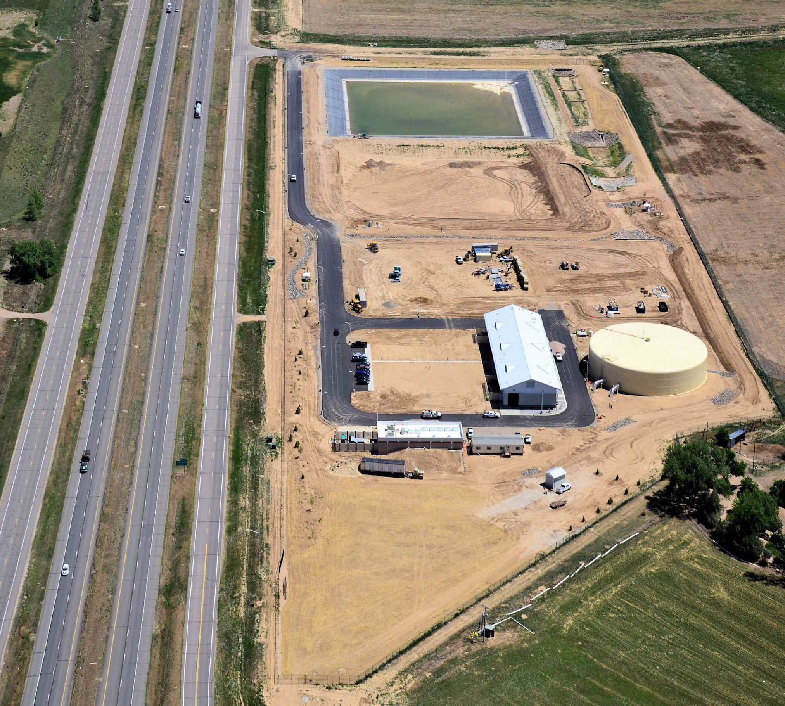
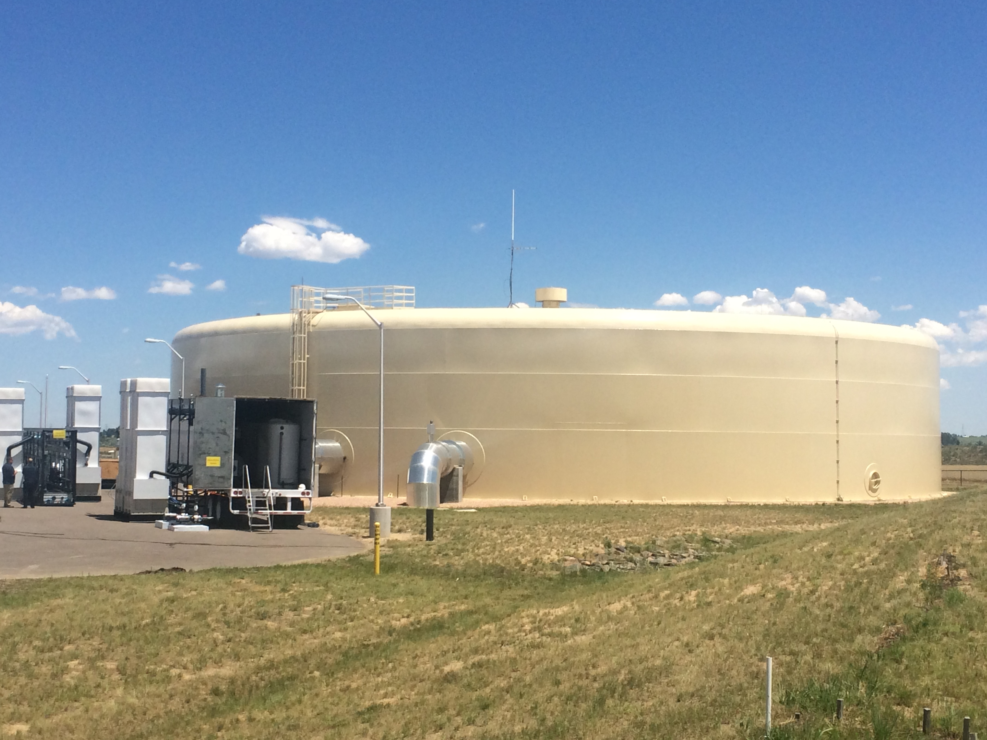
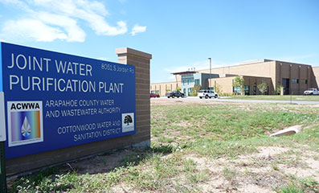
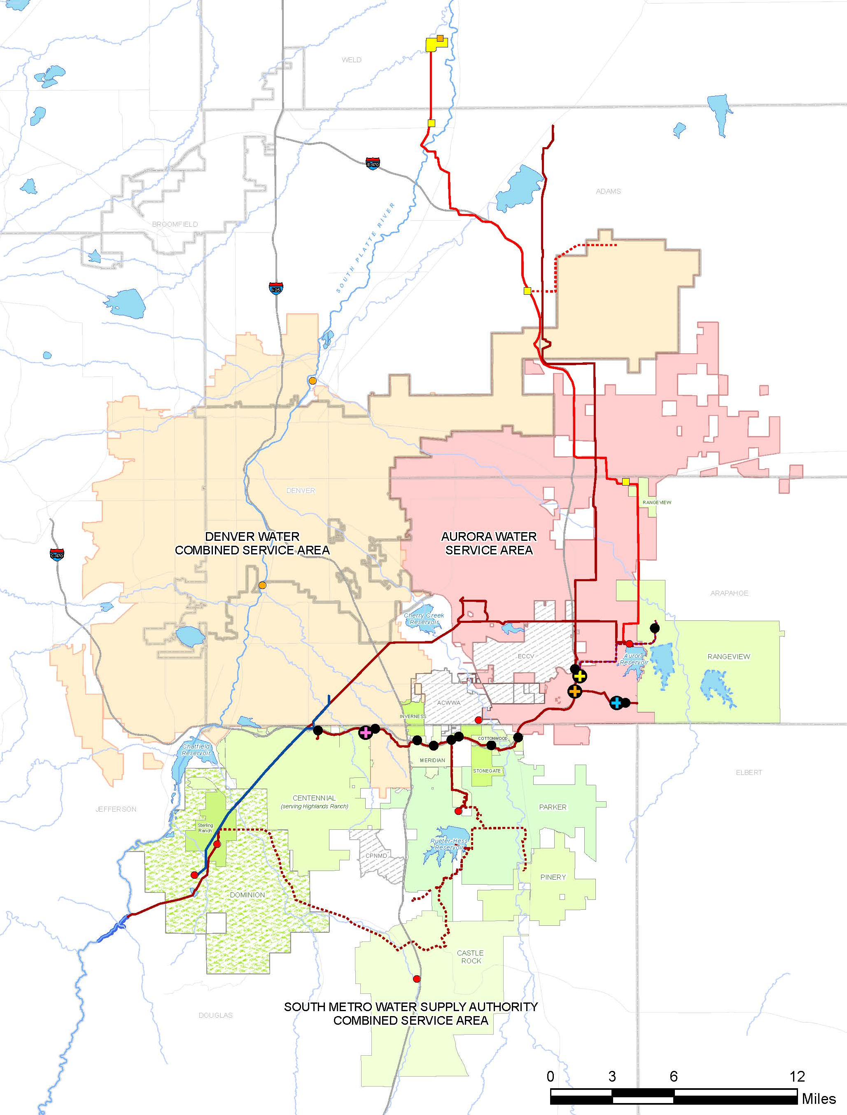
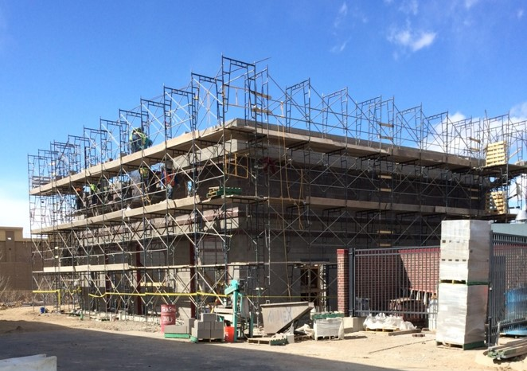
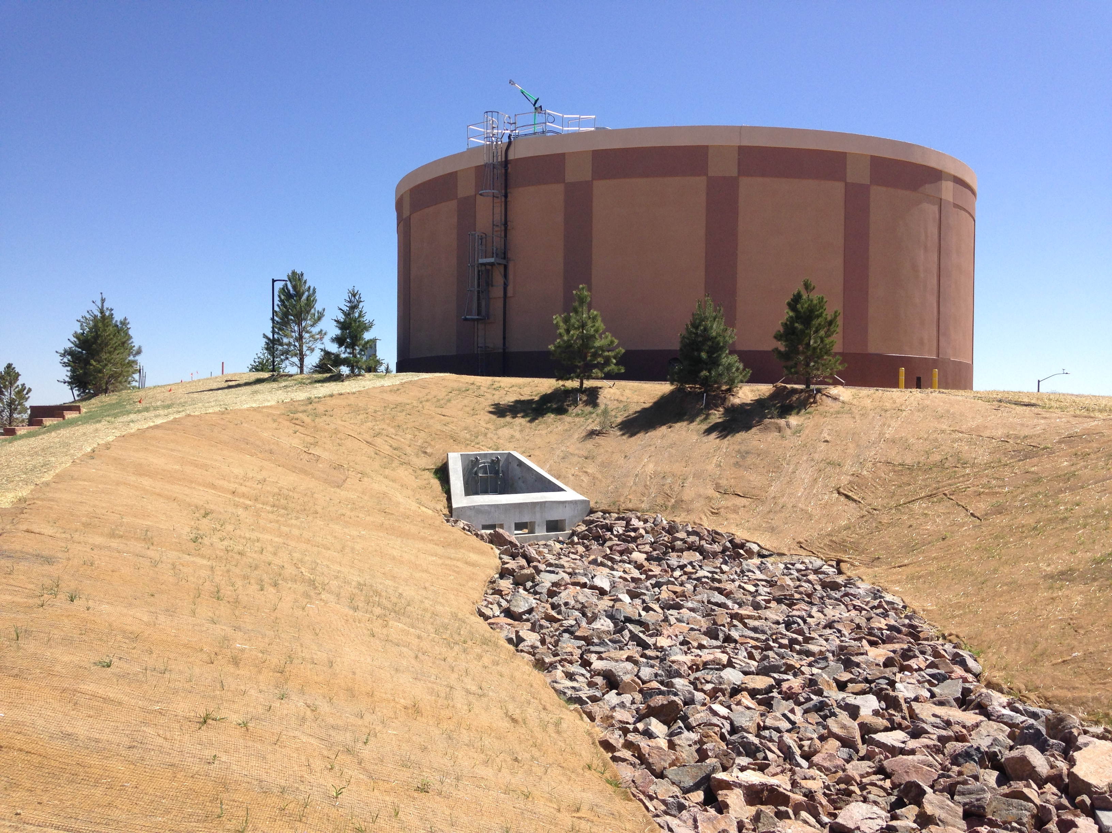
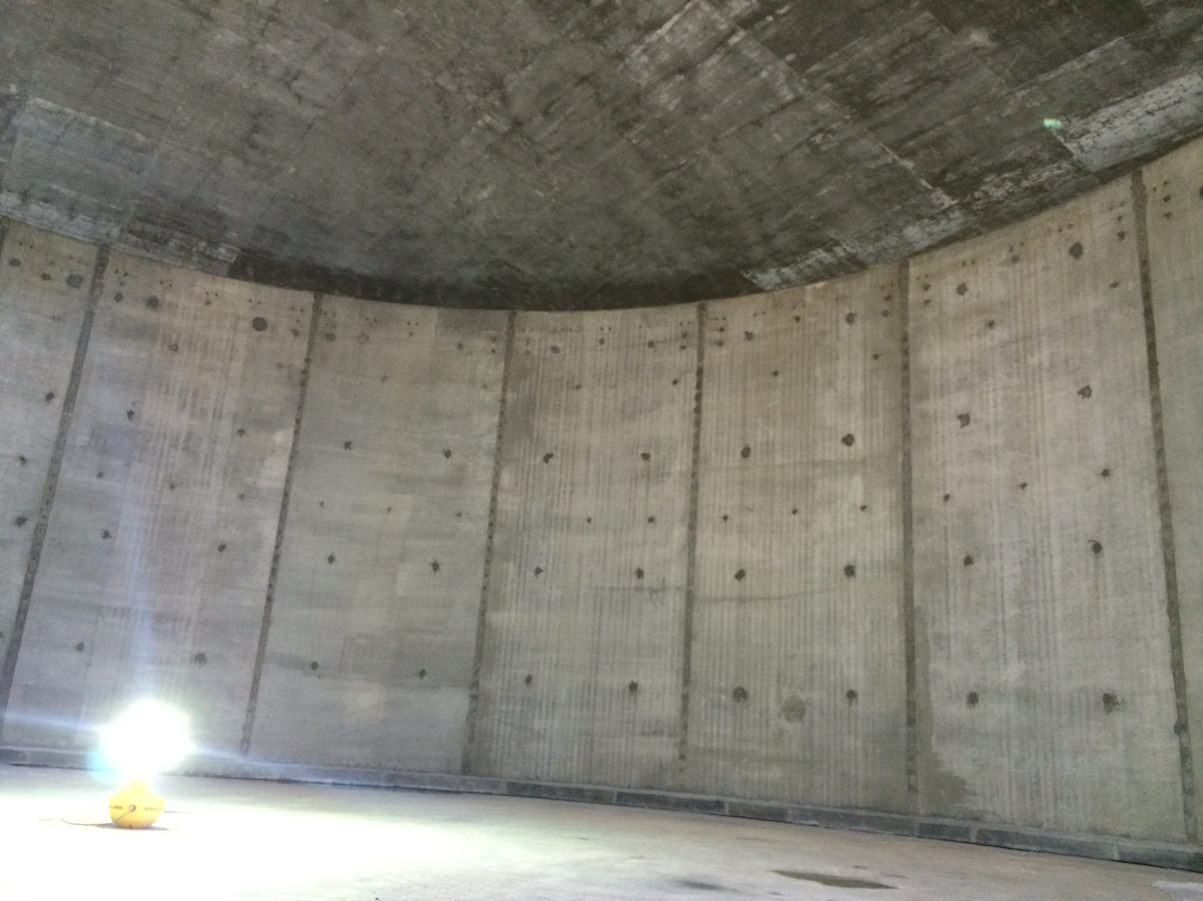
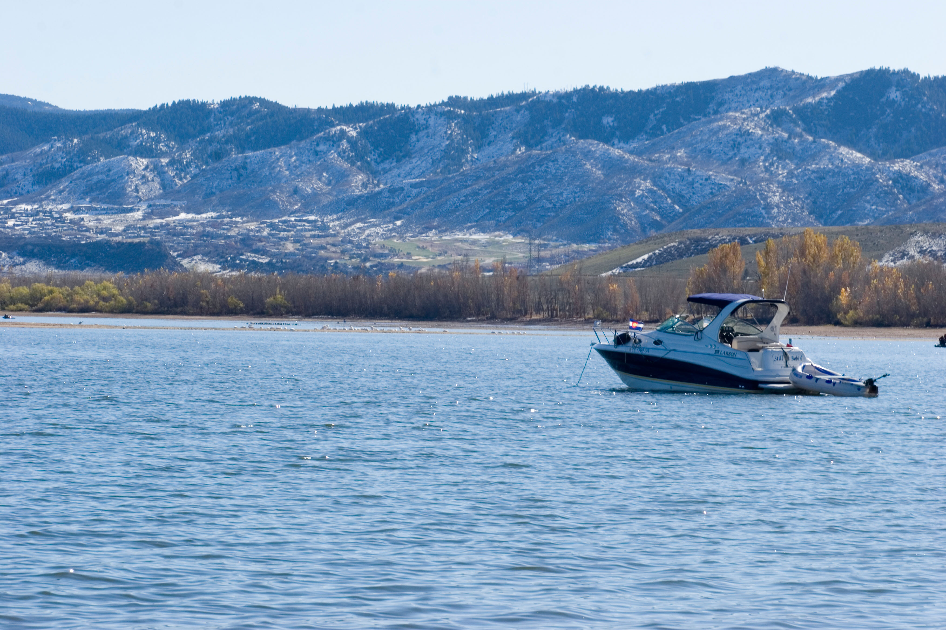
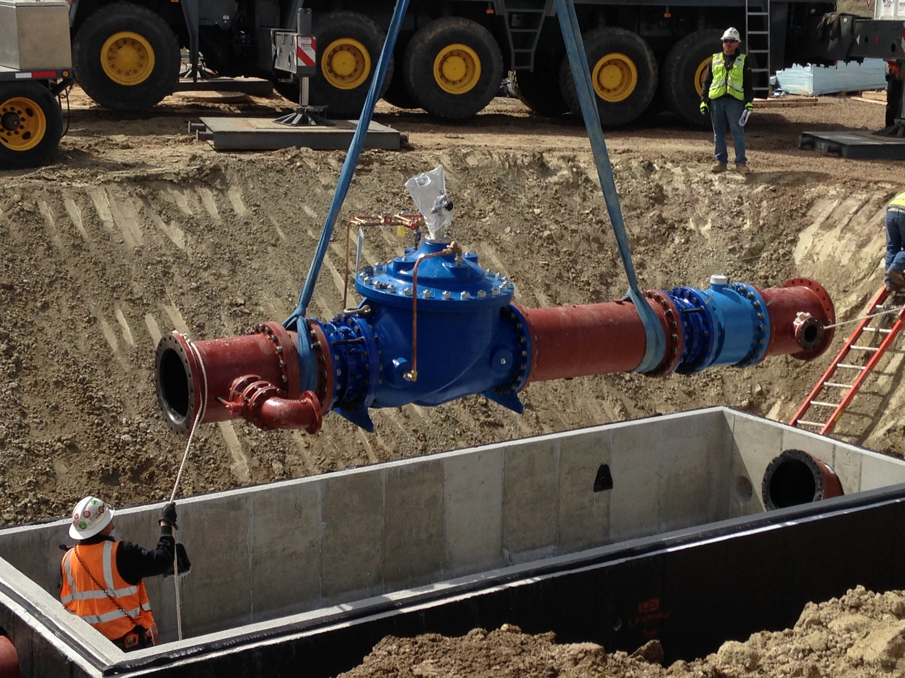
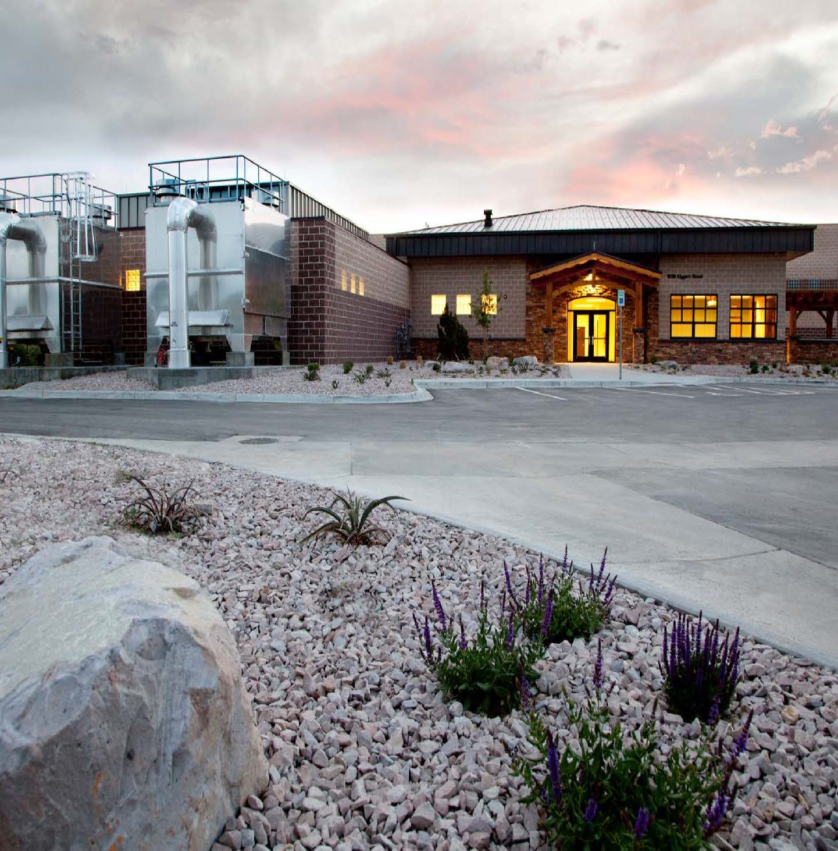
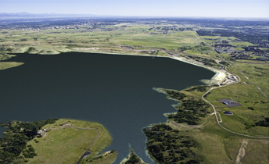
Progress: Projects
ECCV Northern Project
ACWWA/ Cottonwood Joint Water Purification Facility
WISE Project: Quebec St. Water Purification Facility
WISE Project: Smoky Hill Tank
Chatfield Reallocation Project
WISE Project: Aurora Temporary Connection
Plum Creek Water Purification Facility
Rueter-Hess Reservoir
Notes:
This progress is the result of a number of regional projects and initiatives that the SMWSA and its members have invested in, including:
The Chatfield Reallocation Project – where storage will be repurposed to water supply storage
Reuter Hess Reservoir – Parker’s reservoir is the backbone of their transition from groundwater to surface supplies
The ACWWA/ECCV Northern Project -- Brining renewalbe water from the Barr Lake area near Brighton to ECCV and ACCWA
Castle Rock’s Plum Creek Water Purification Facility & ACCWA/Cottonwood Water Purification facility maximizing surface supplies on cherry creek and plum creek and giving them the ability to reuse their supplies.
And many more local projects.
Let me spend a bit more time talking about our most successful and largest regional project: the WISE Partnership.
Who has heard of the WISE project?

Slide 12
WISE: Water Supply Benefits
Aurora Water
Offset PWP costs (annual revenue of $10M)
Continued use of PWP for drought supply
SMWSA
Renewable supply for SMWSA (100KAF/10yr)
Allows use of Denver Basin aquifer for drought supply
Denver Water
Drought and emergency supplies for Denver
Opens the door to regional cooperation
Total Affected Population = 2 million
Notes:
Benefits for all parties
New regional infrastructure and opportunities for cooperation

Slide 13
The Path Forward: Our 4-Point Plan for the Future
Additional increment of supply: ~30KAF of additional renewable supplies by 2065
Storage (surface and ASR) to firm existing and new supplies
TDS management for new supplies and WISE supplies: Blend water or RO
Conservation: Individual member’s efforts and regional
Notes:
Despite the region’s tremendous progress, we continue to have future unmet needs. And this was the second focus of our Master Plan update.
While the region is on track to meet projected demand and renewable water supply goals as far out as 2065, more work is needed to ensure that happens and to ensure that we stay on the successful path that we are on.
We have identified these 4 priority areas: …
The updated Master Plan shows the region will need about 120,000 acre feet of water supplies by 2065 to meet projected demands. Our current planned projects will get us very close but more is needed. The region as a whole will need to developing approximately 30,000 acre-feet of additional renewable supplies by 2065.
Developing additional storage (both surface and underground) to help firm existing and future supplies;
Managing water quality so we can squeeze every drop out of the water we have; and
Doing even more to conserve water and use it efficiency.

Slide 14
The Bottom Line
Despite ongoing needs, our region is well on its way to a secure water future.
Notes:
So, the news is good. One of the fastest growing and most economically important regions in the state has taken control of its destiny and is on track to a secure water future.
The reasons I wanted to come here today to tell you this are simple. First, we are working hard to dispel those old headlines from 10 years ago. Memories of those still linger in our region so we are going out to leaders like you to make sure you know the progress we have made. Second, we have more work to do. We are well on our way but we need to move forward with our Four Point Plan for the future. We want to make sure we keep you apprised of our efforts on implementing that plan because if we run into any bumps, we may need your help.

Slide 15
Platte Valley Water Partnership
Pioneering a Collaborative and Sustainable Water Future
Notes:
Thank you and Introductions (Ron)

Slide 16
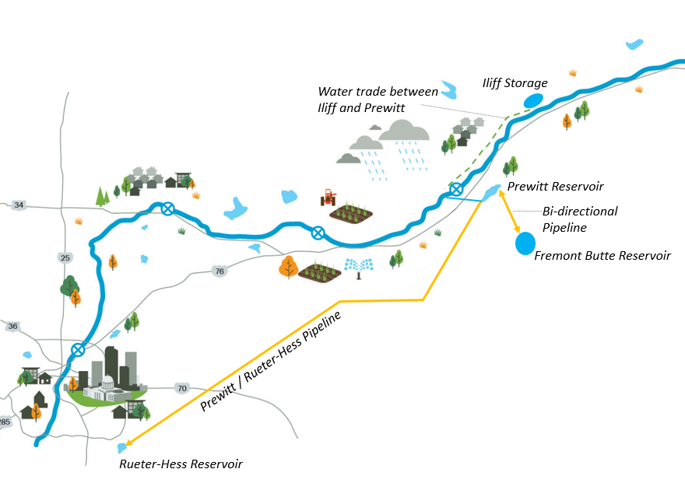
PROJECT OVERVIEW
Iliff Reservoir –6,500 ac-ft
Prewitt Reservoir – 6,500 ac-ft forebay utilizing existing infrastructure
Trade between Iliff and Prewitt Reservoirs.
~125 Miles of Pipe
Salinity Treatment Plant
Rueter-Hess Reservoir
Fremont Butte Reservoir – 72,000 ac-ft, up to 250 cfs pumped and piped from Prewitt Reservoir (Phase II).
Notes:
Joe

Slide 17
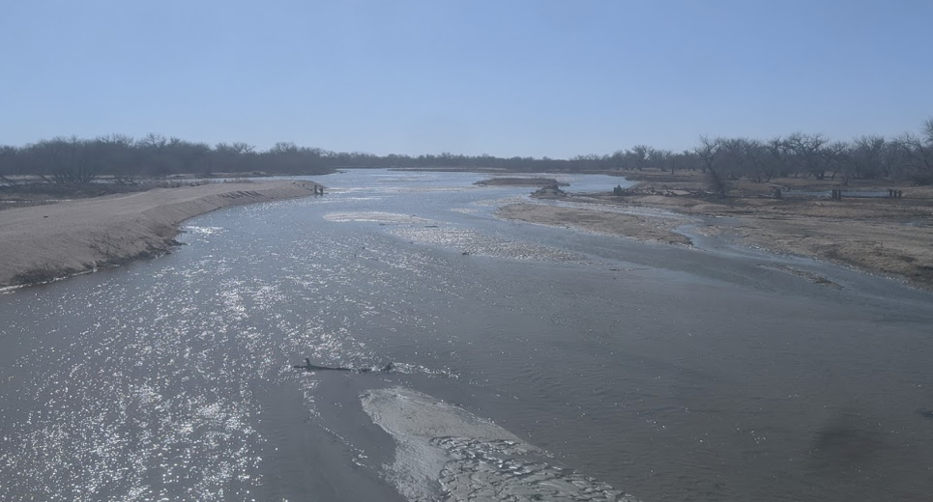
Project Vision
Addresses PWSD Supply Gap
75% Renewable by 2035
Demand shortage in 2035-2040
Avoids “Buy and Dry”
Optimizes available water
Sets parameters for Municipal/ Agricultural partnership
Establishes guidelines "types of water" in system
Provides Additional LSPWCD Water Supply
Addresses local needs
Develops critical habitat
Optimizes Existing Infrastructure
Benefitting both worlds
Notes:
Rebecca

Slide 18
President
John F. Kennedy
Pueblo High School Stadium
August 17, 1962

