Slide 1
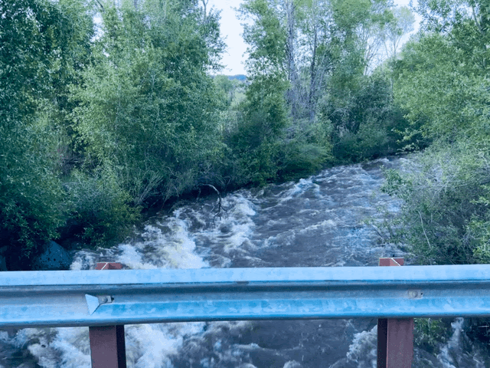

Colorado Water Risk Briefing:
What you need to know.
James Eklund

Slide 2
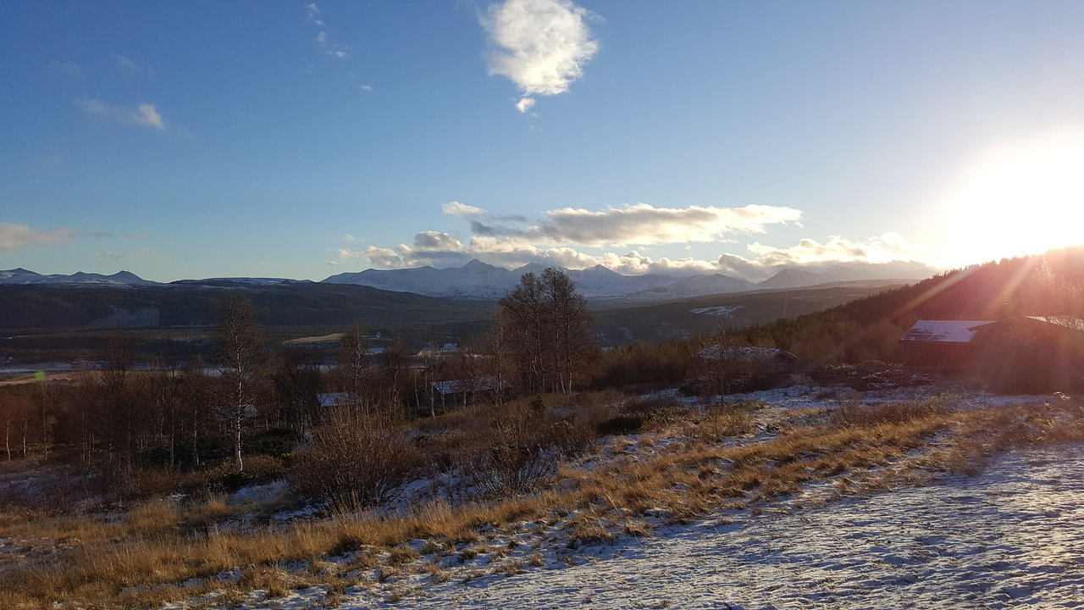
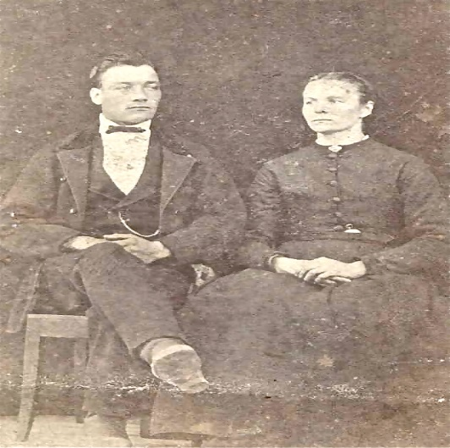

Slide 3
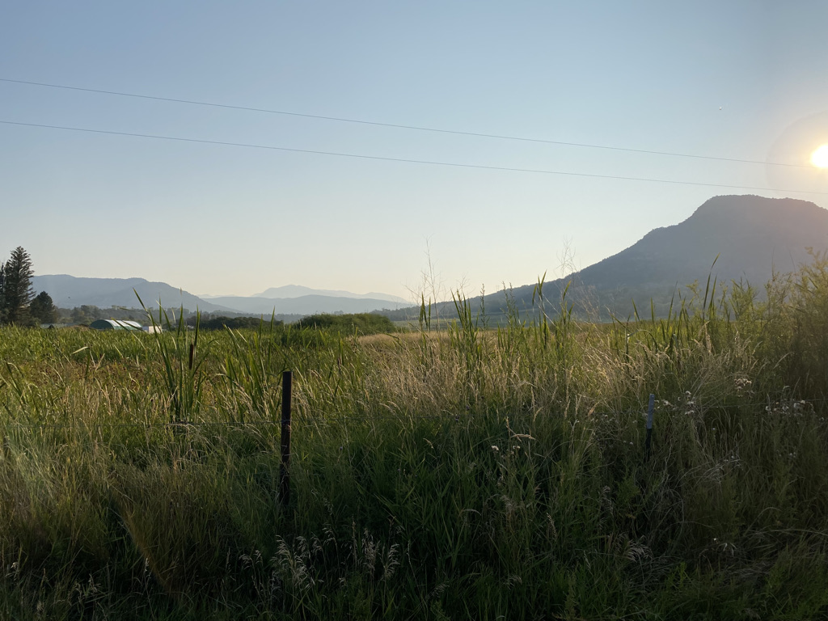
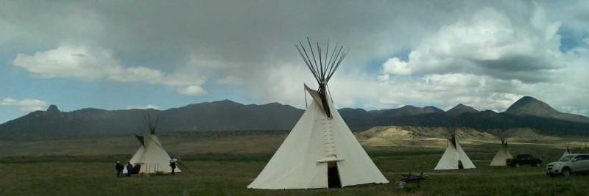
Norse Sky Ranch

Slide 4
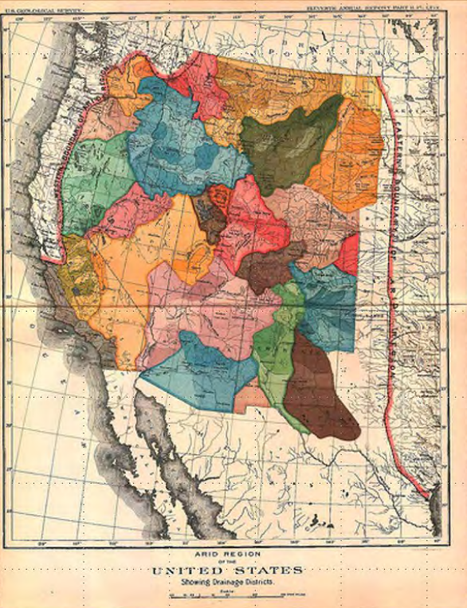

Slide 5
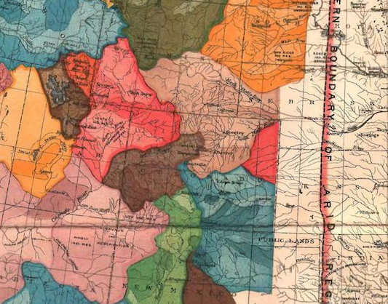


Slide 6
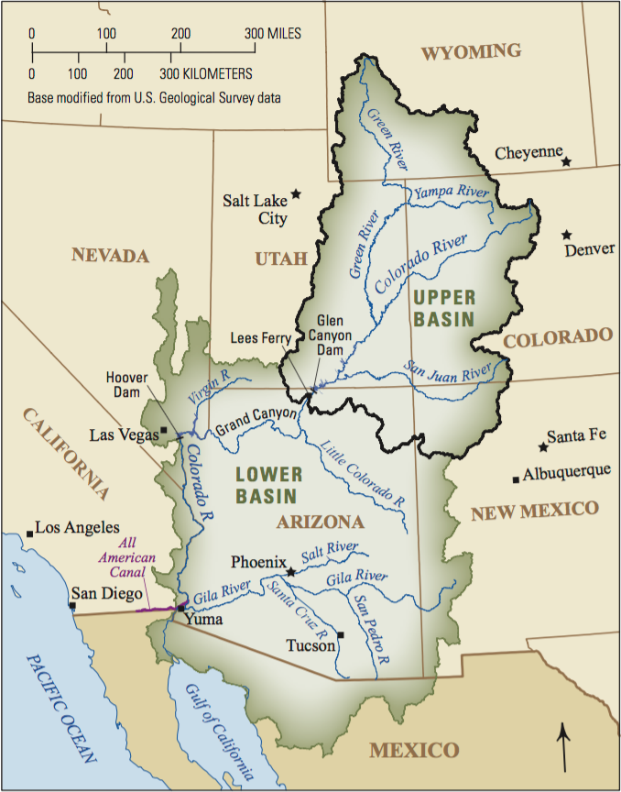
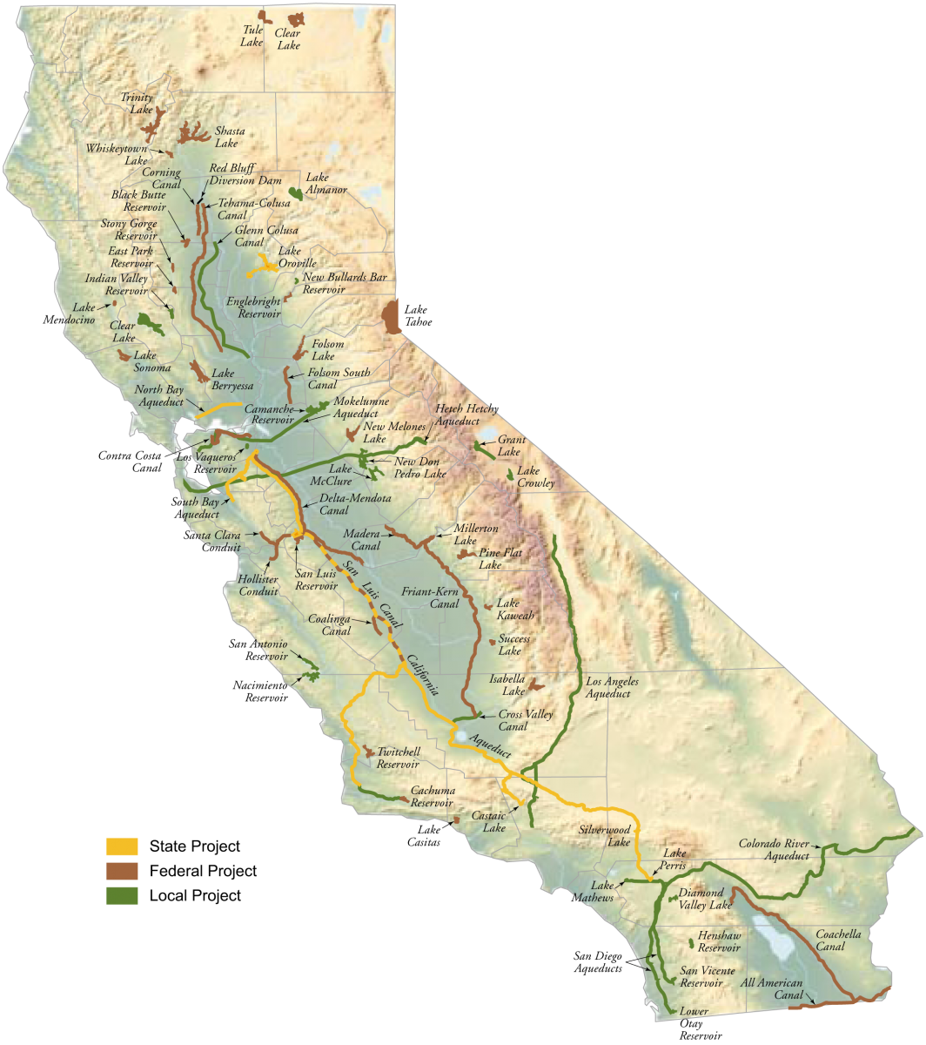
Colorado River Basin
243,000 miles²
40 million people
5th largest economy
National food security
20 years of aridification
50 years of rapid growth
100-year-old Law of the River
Upper Basin
Powell
7.5 maf
Lower Basin
7.5 maf
Mead
Mexico
1.5 maf

Slide 7
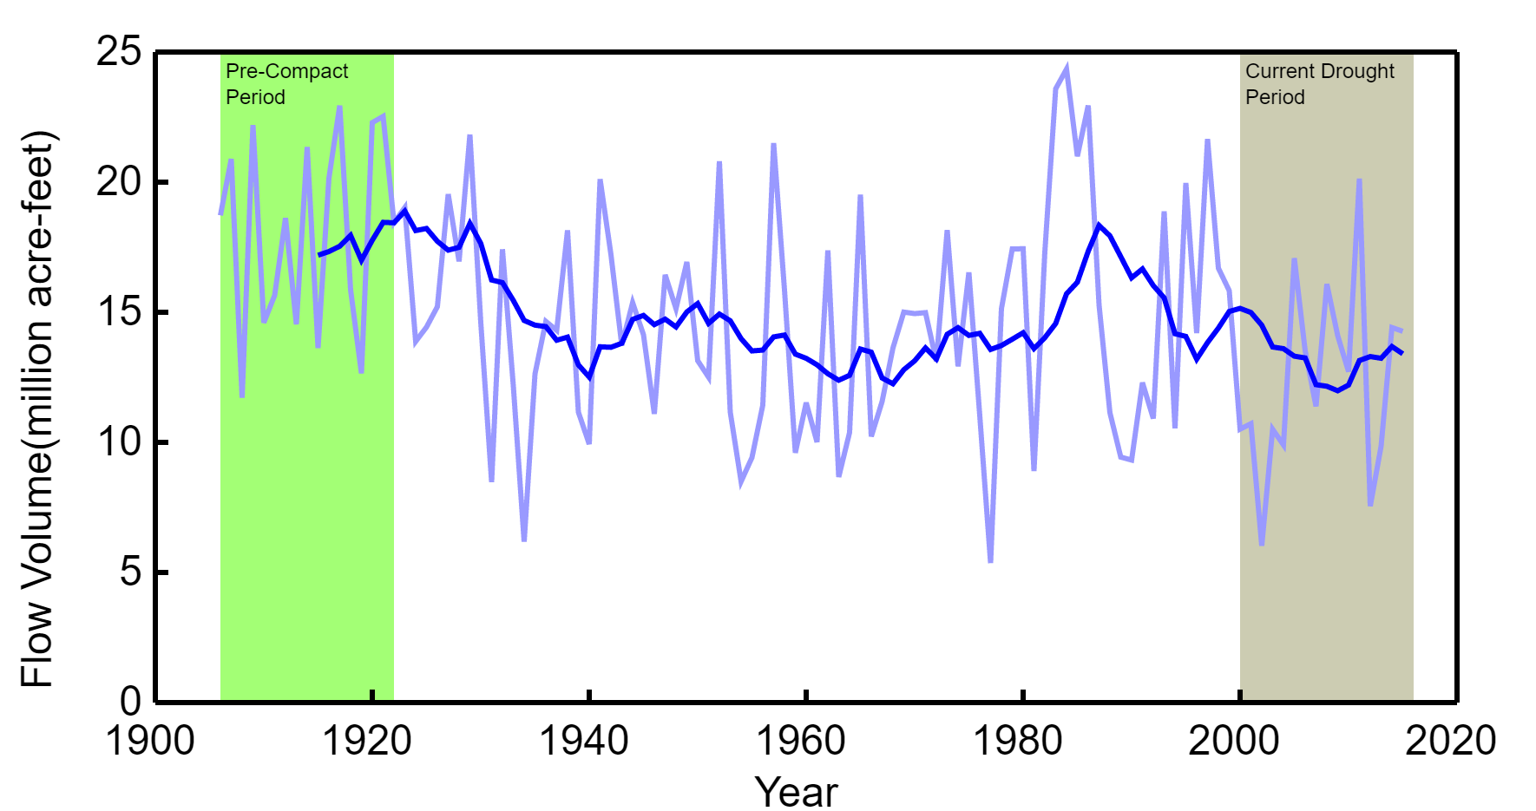
18 vs 10?

Slide 8
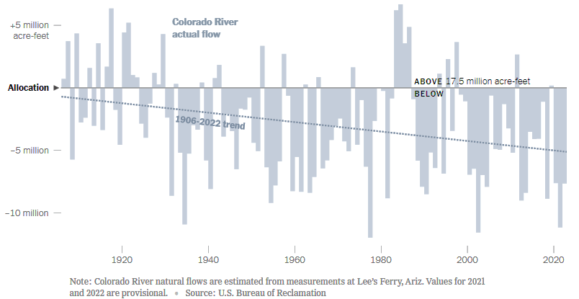
Source: NY Times

Slide 9
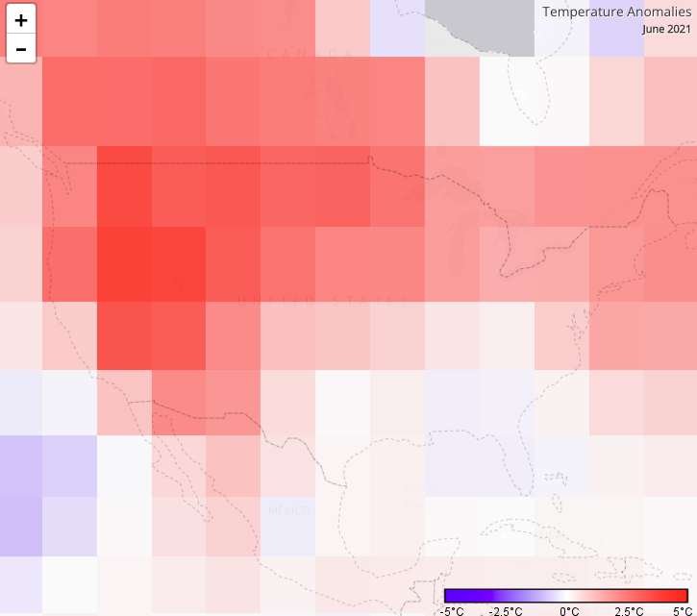

Slide 10
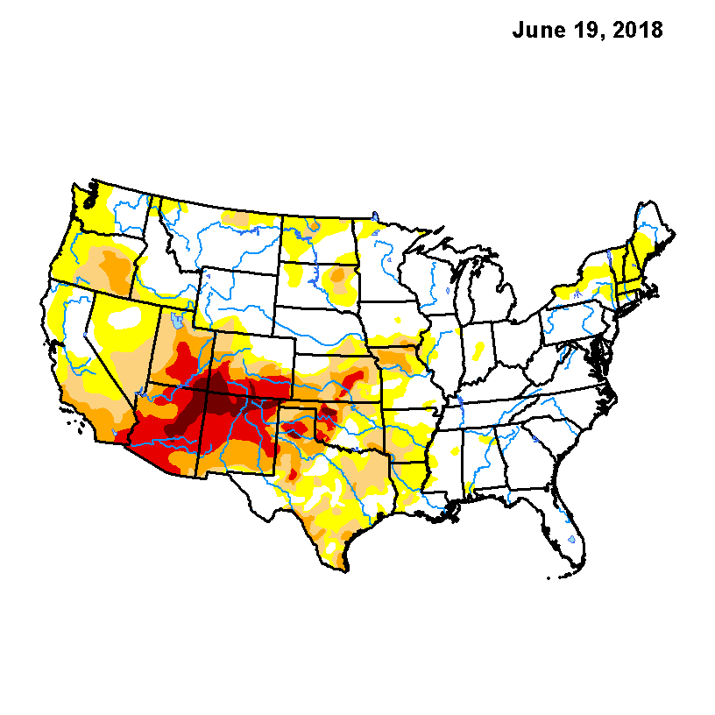
2018
Notes:
2018 June drought monitor. D4 drought in the basin

Slide 11
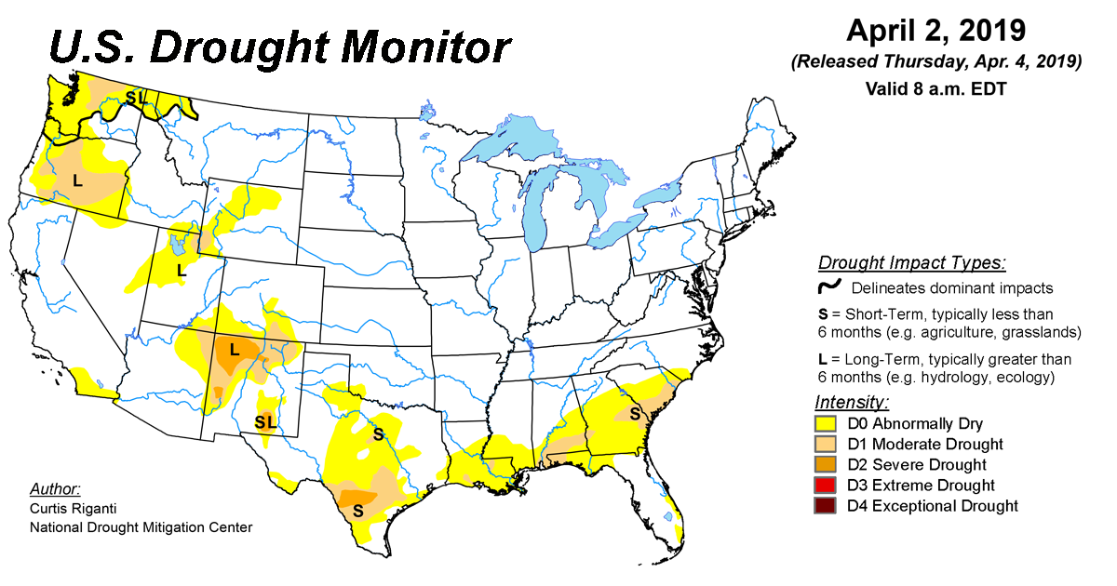
2019
Notes:
2018 June drought monitor. D4 drought in the basin

Slide 12
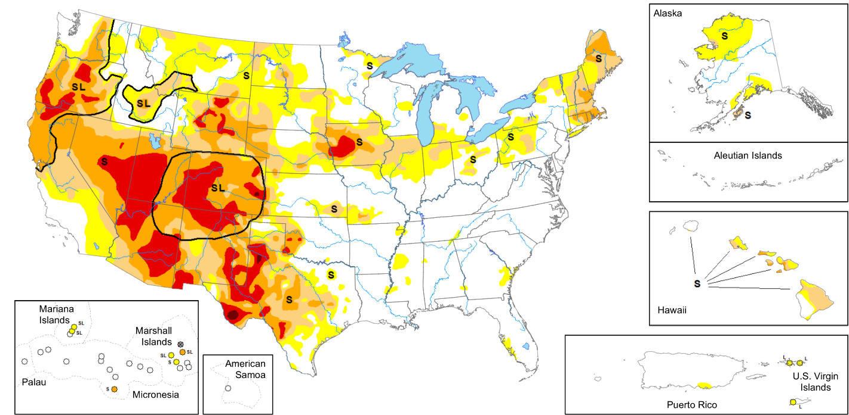
2020
Notes:
2018 June drought monitor. D4 drought in the basin

Slide 13
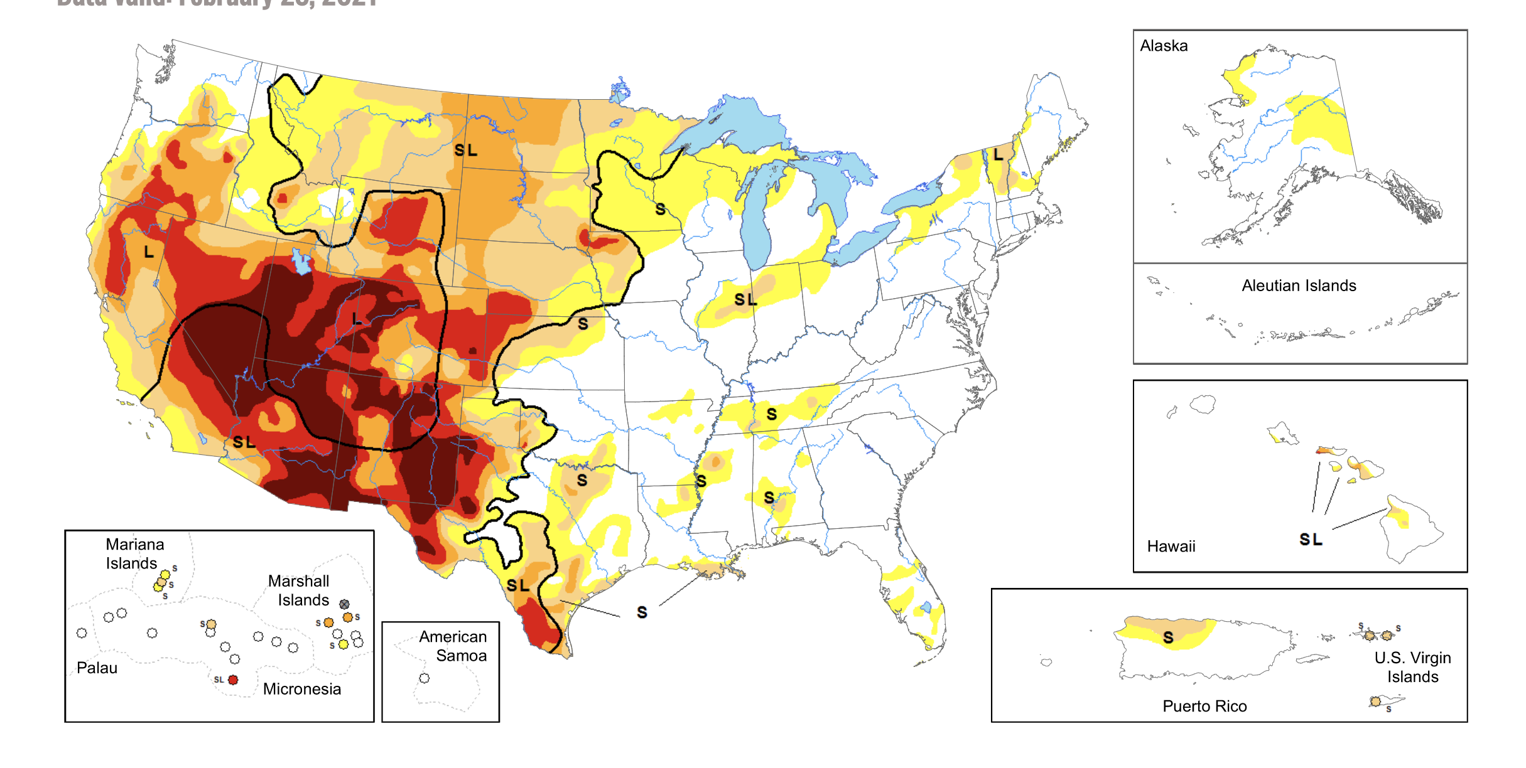
2021
Notes:
2018 June drought monitor. D4 drought in the basin

Slide 14
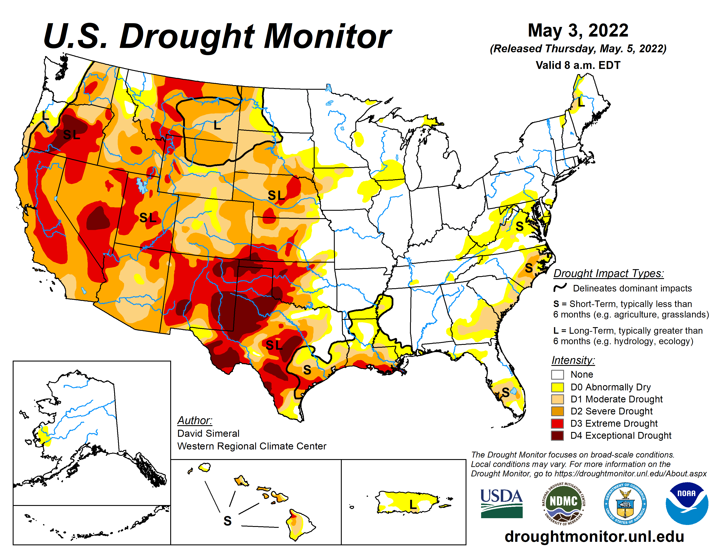
2022
Notes:
2018 June drought monitor. D4 drought in the basin

Slide 15
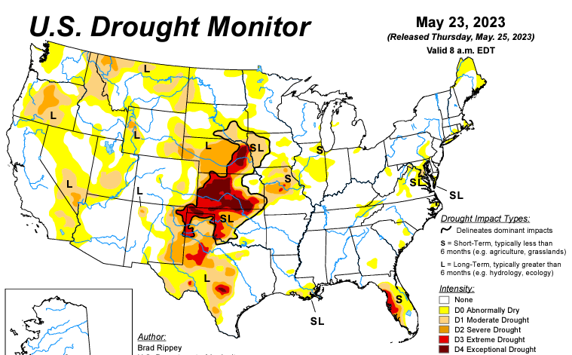
Notes:
2018 June drought monitor. D4 drought in the basin

Slide 16
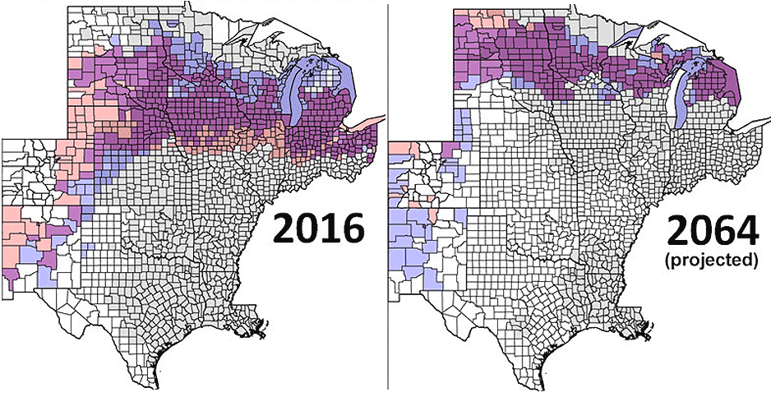

Slide 17
Source: Jim Prairie

Slide 18
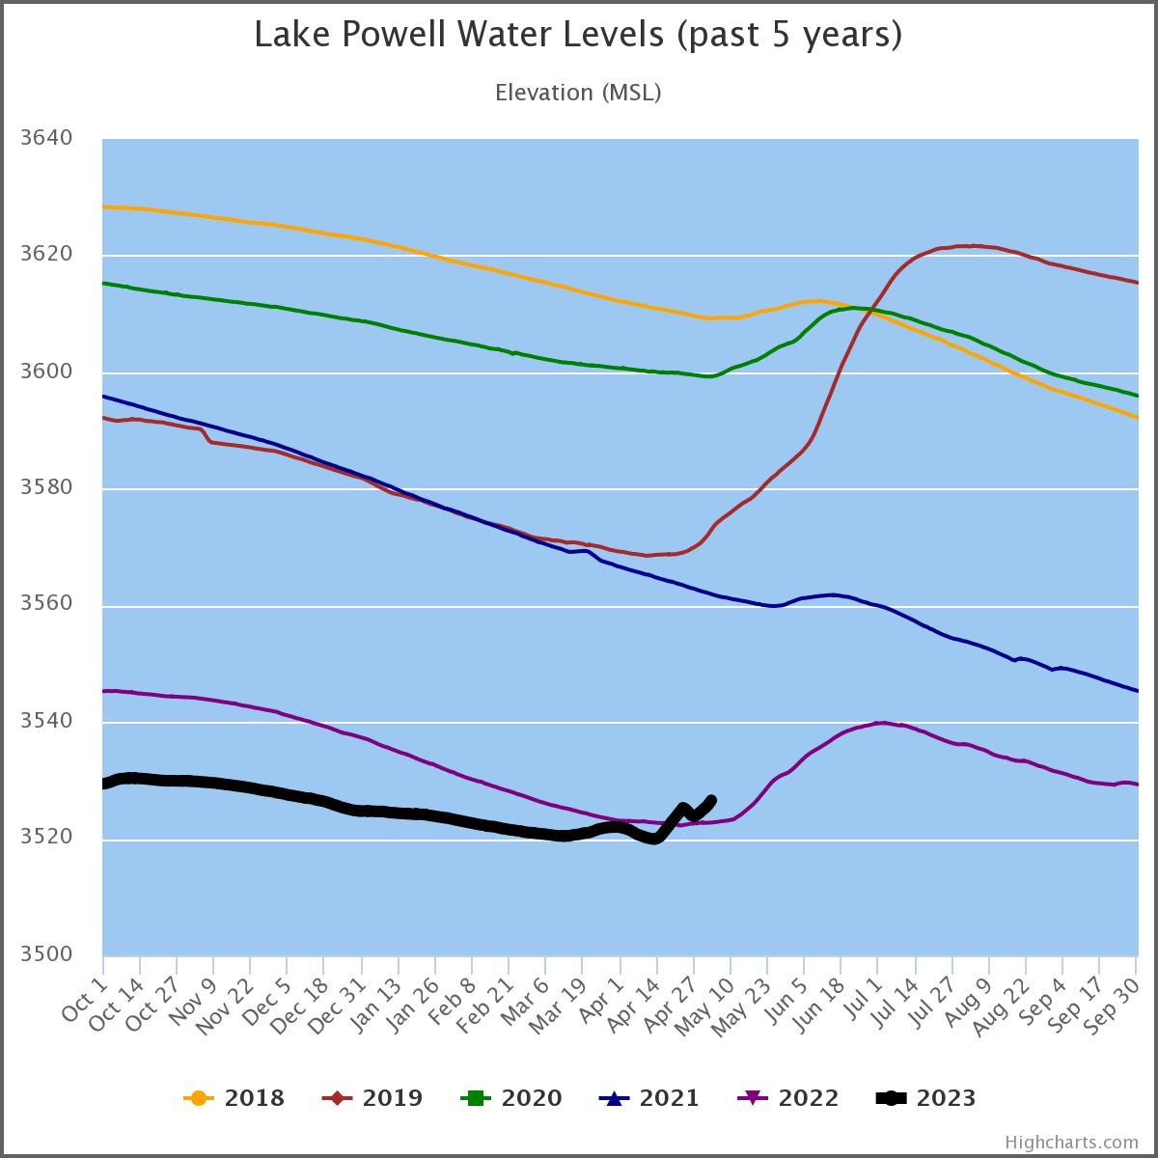
Powell
23%
3526.81’

Slide 19
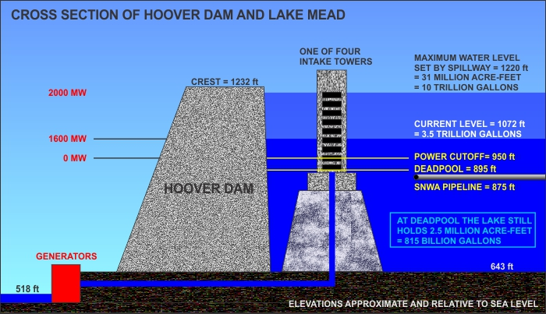

Slide 20
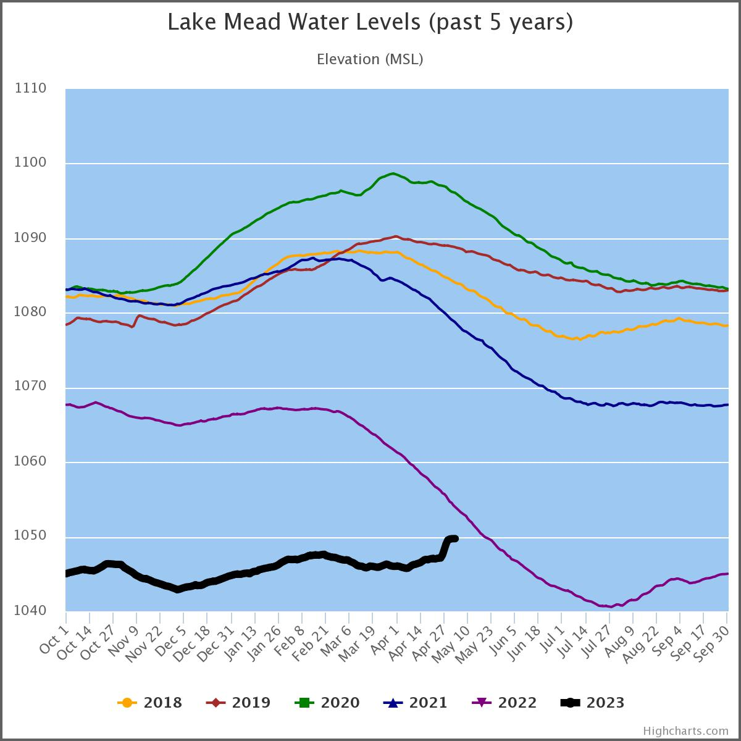
Mead
30%
1049.74’

Slide 21
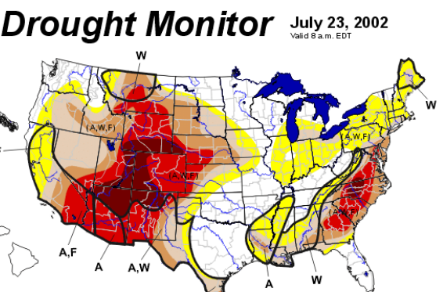


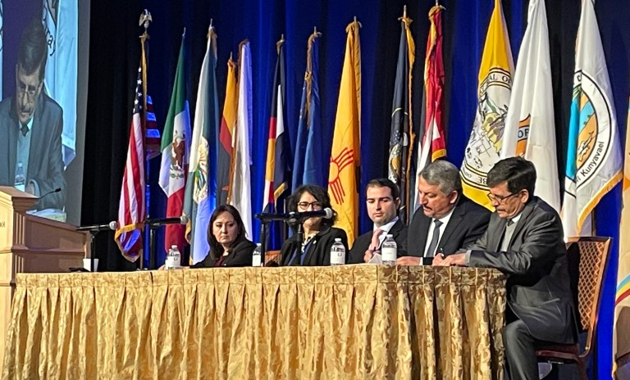
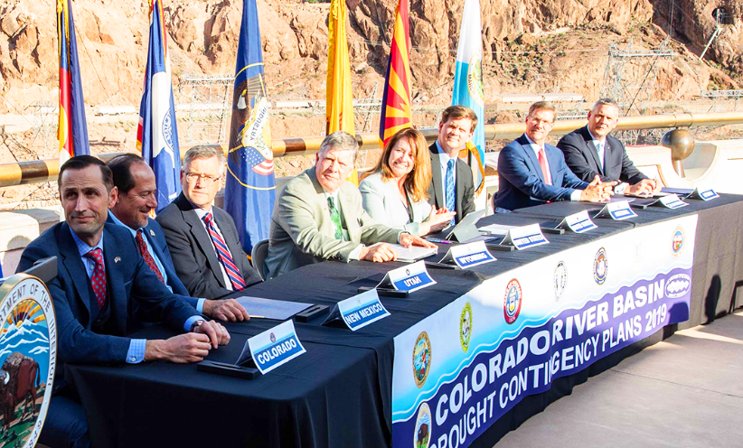

2007 Interim Guidelines
2019 Contingency Plan
2023 ???
2002
2026

Slide 22
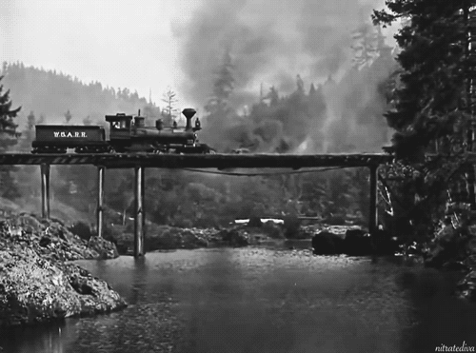


Slide 23
Upper Basin’s “5 Points”
Dust off the System Conservation Pilot Program. (6,000 af)
Release water from higher reservoirs. (~500,000 af)
Consider an Upper Basin Demand Management program as interstate and intrastate investigations are completed. (0 af)
Accelerate enhanced measurement, monitoring, and reporting. (0 af)
Continue water administration. (0 af)

Slide 24
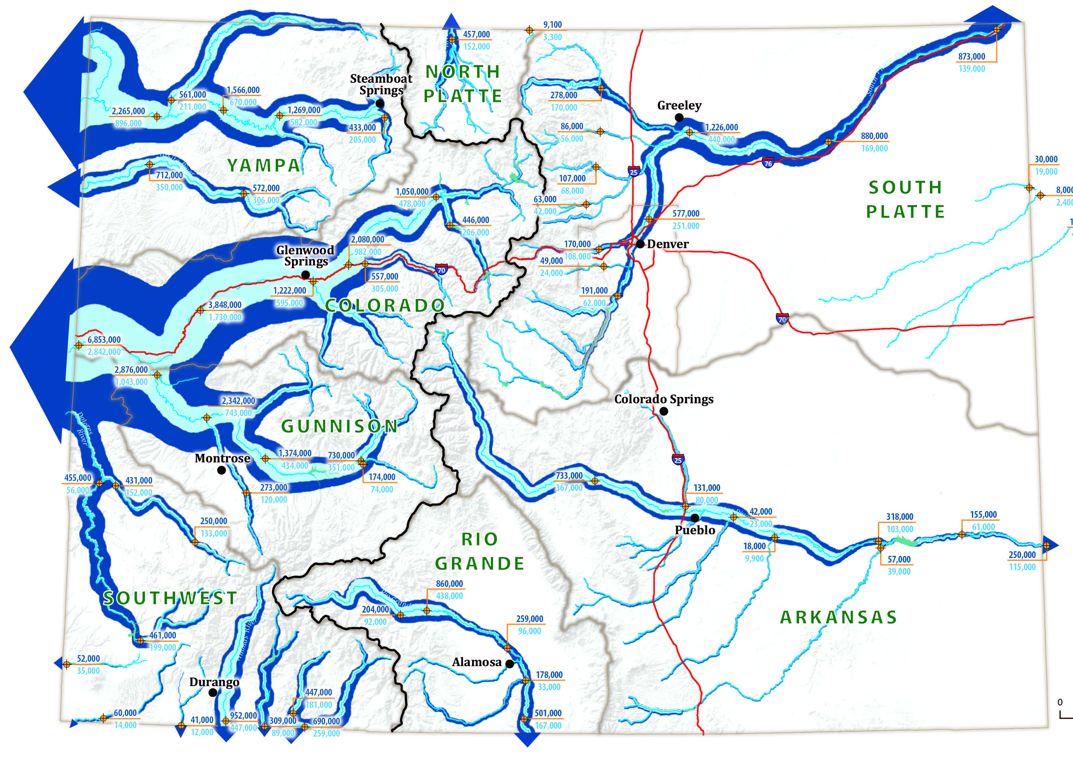
80%
90%

Slide 25
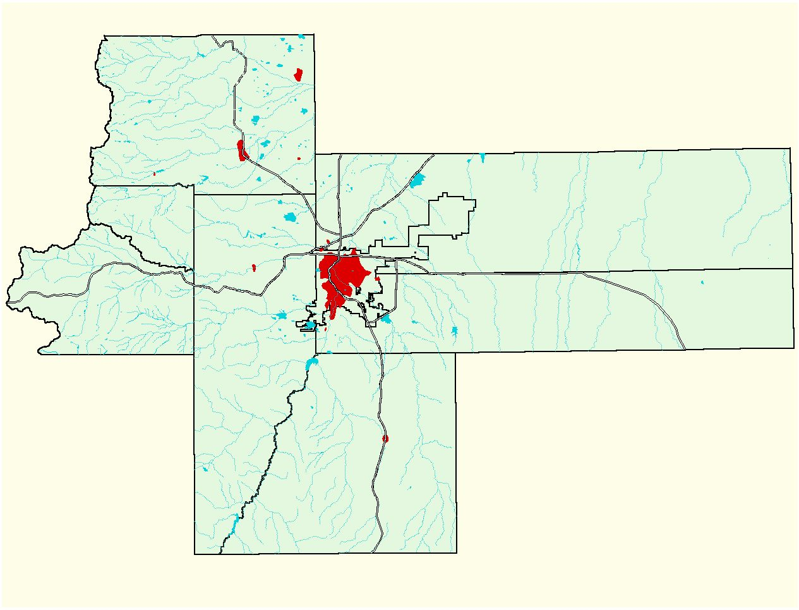
Denver Metro Region
1920
1920
53.8 sq.miles
3,500,000
3,000,000
2,500,000
2,000,000
Population
1,500,000
1,000,000
500,000
0
1920
1940
1960
1980
2000
2020
Year

Slide 26
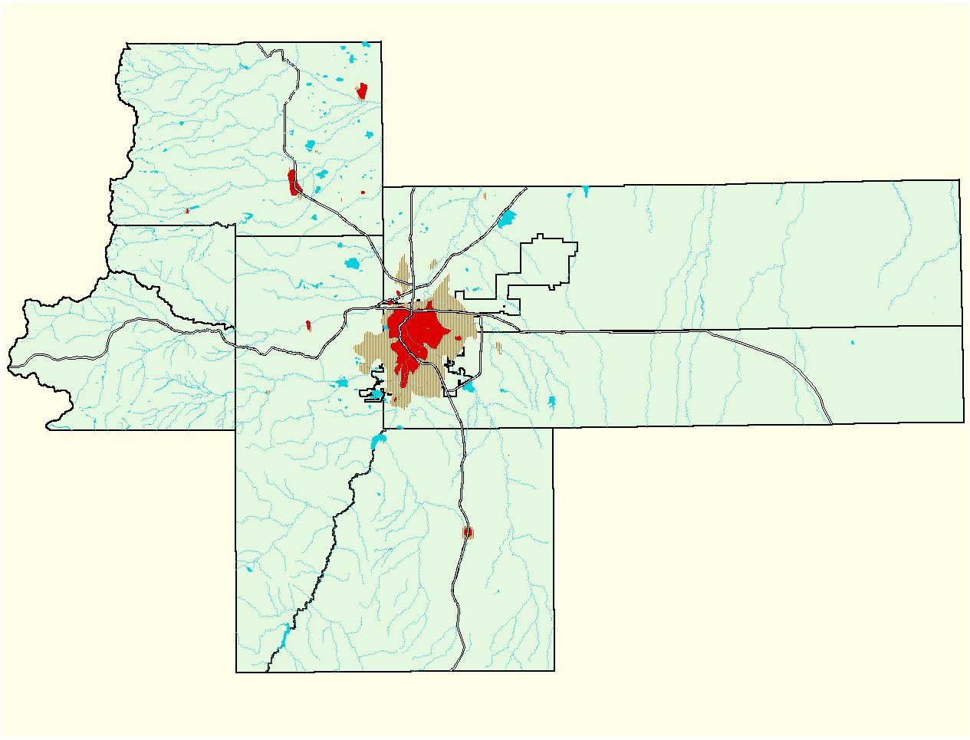
Denver Metro Region
1940
95.9 sq.miles
3,500,000
3,000,000
2,500,000
2,000,000
Population
1,500,000
1,000,000
500,000
0
1920
1940
1960
1980
2000
2020
Year

Slide 27
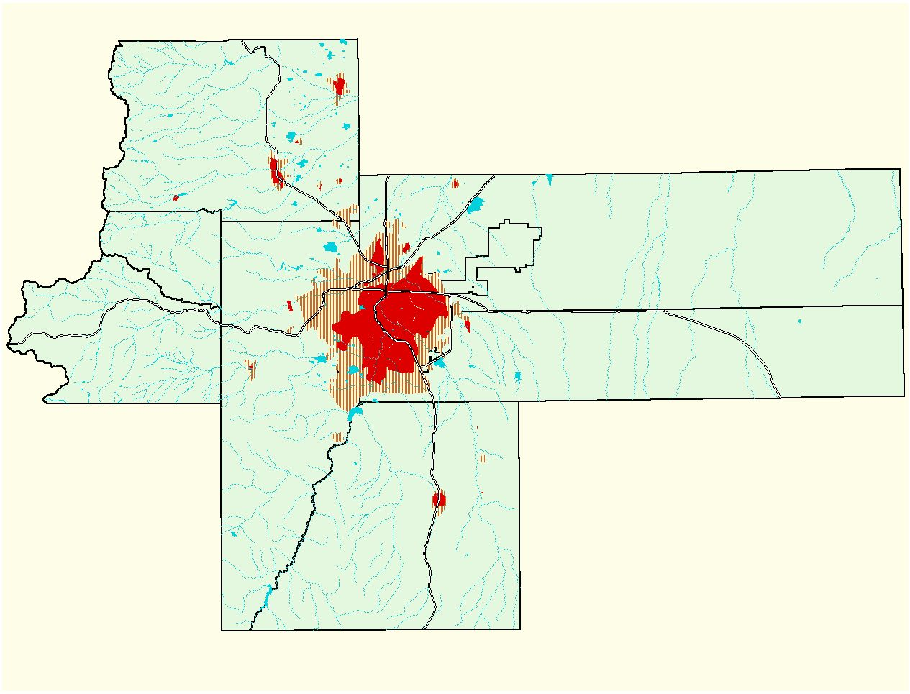
Denver Metro Region
1960
149.7 sq.miles
3,500,000
3,000,000
2,500,000
2,000,000
Population
1,500,000
1,000,000
500,000
0
1920
1940
1960
1980
2000
2020
Year

Slide 28
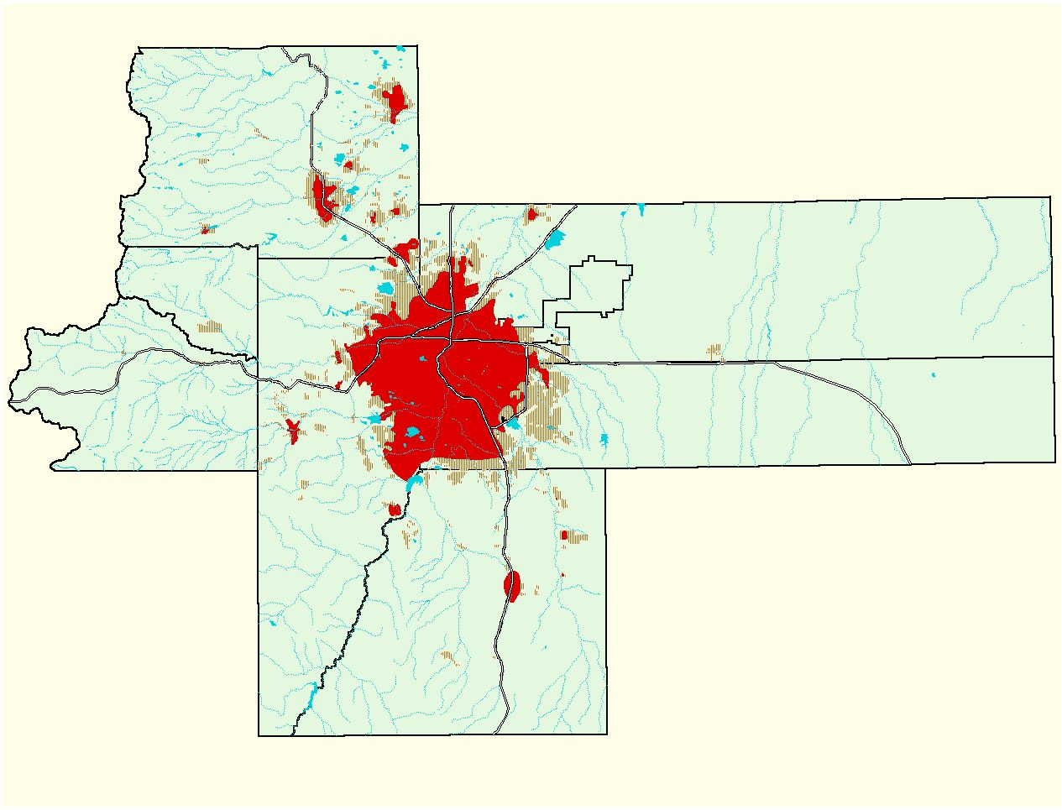
Denver Metro Region
1990
343.8 sq.miles
3,500,000
3,000,000
2,500,000
2,000,000
Population
1,500,000
1,000,000
500,000
0
1920
1940
1960
1980
2000
2020
Year

Slide 29
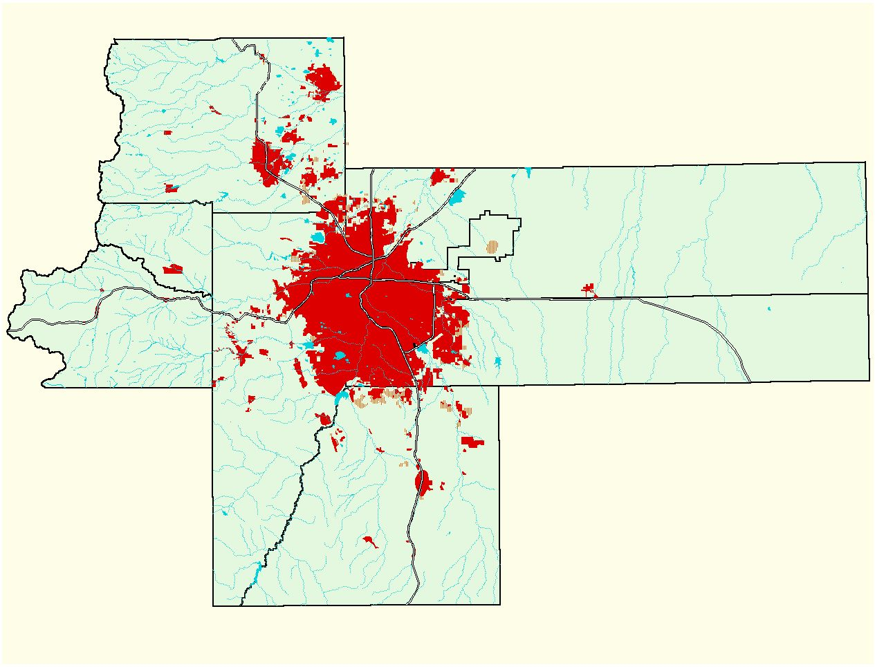
Denver Metro Region
1995
464.0 sq.miles
3,500,000
3,000,000
2,500,000
2,000,000
Population
1,500,000
1,000,000
500,000
0
1920
1940
1960
1980
2000
2020
Year

Slide 30
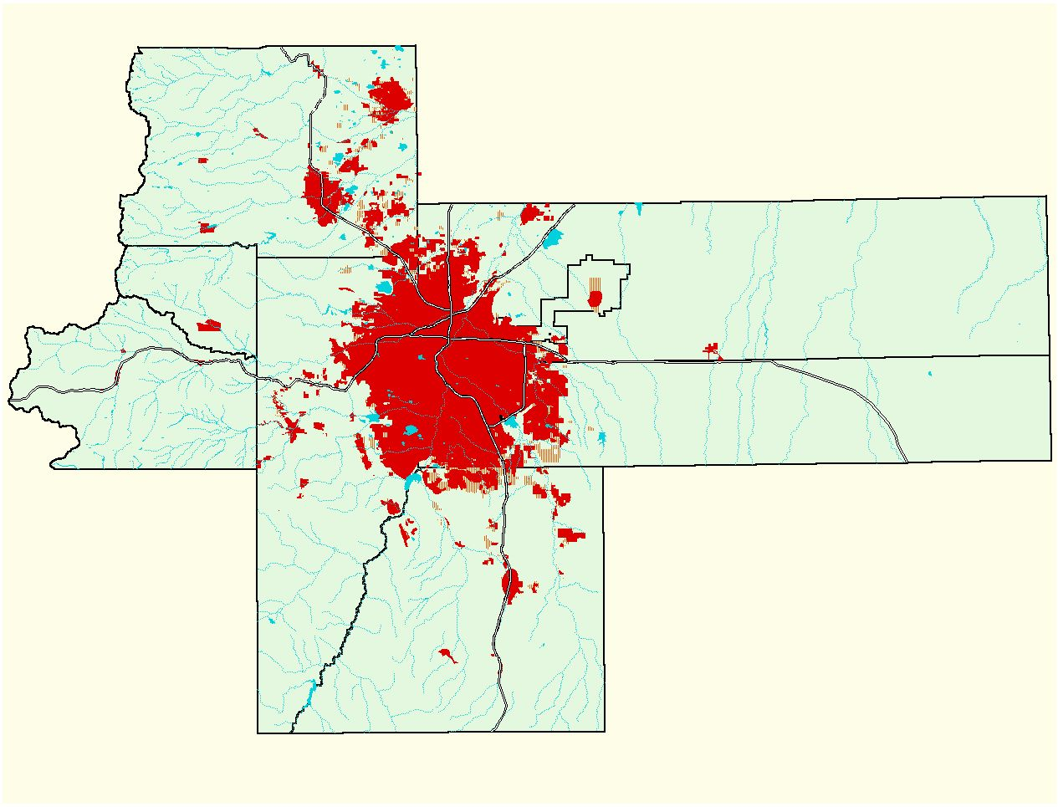
Denver Metro Region
2000
537.1 sq.miles
3,500,000
3,000,000
2,500,000
2,000,000
Population
1,500,000
1,000,000
500,000
0
1920
1940
1960
1980
2000
2020
Year

Slide 31
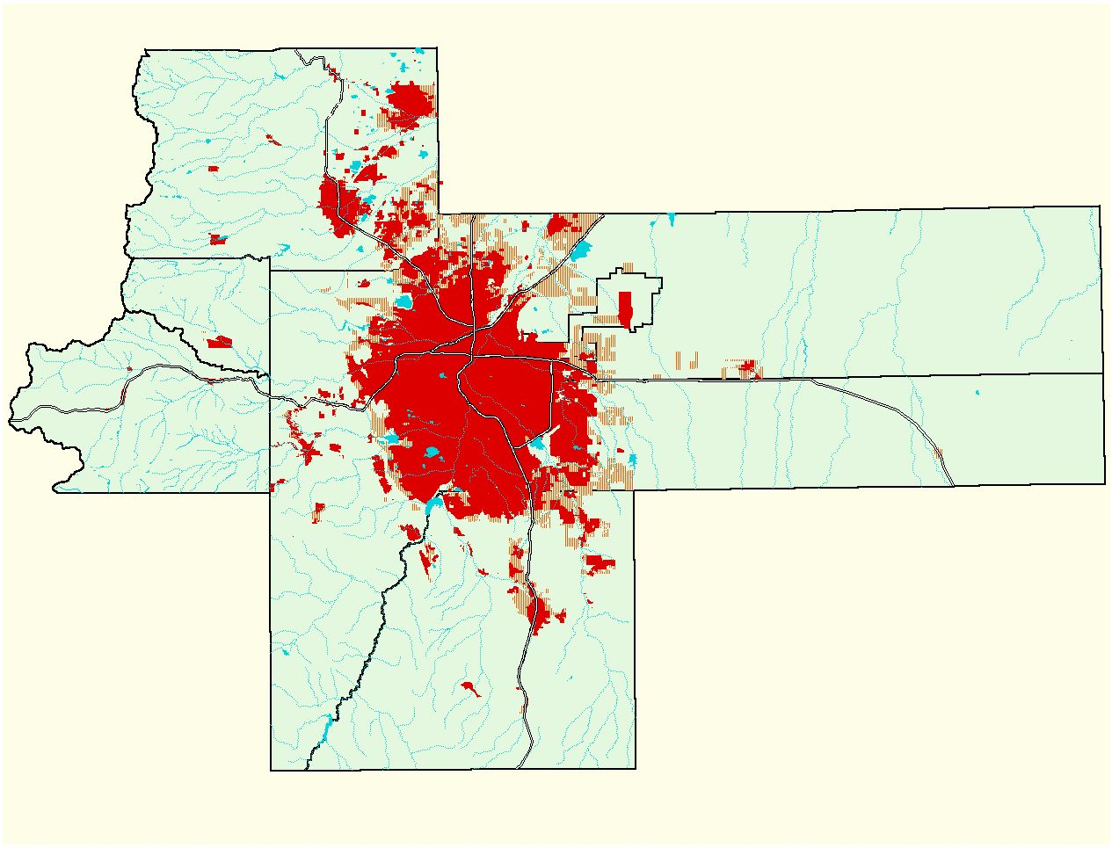
Denver Metro Region
2020 UGB
734.5 sq.miles
3,500,000
3,000,000
2,500,000
Forecast
2,000,000
Population
1,500,000
1,000,000
500,000
0
1920
1940
1960
1980
2000
2020
Year

Slide 32
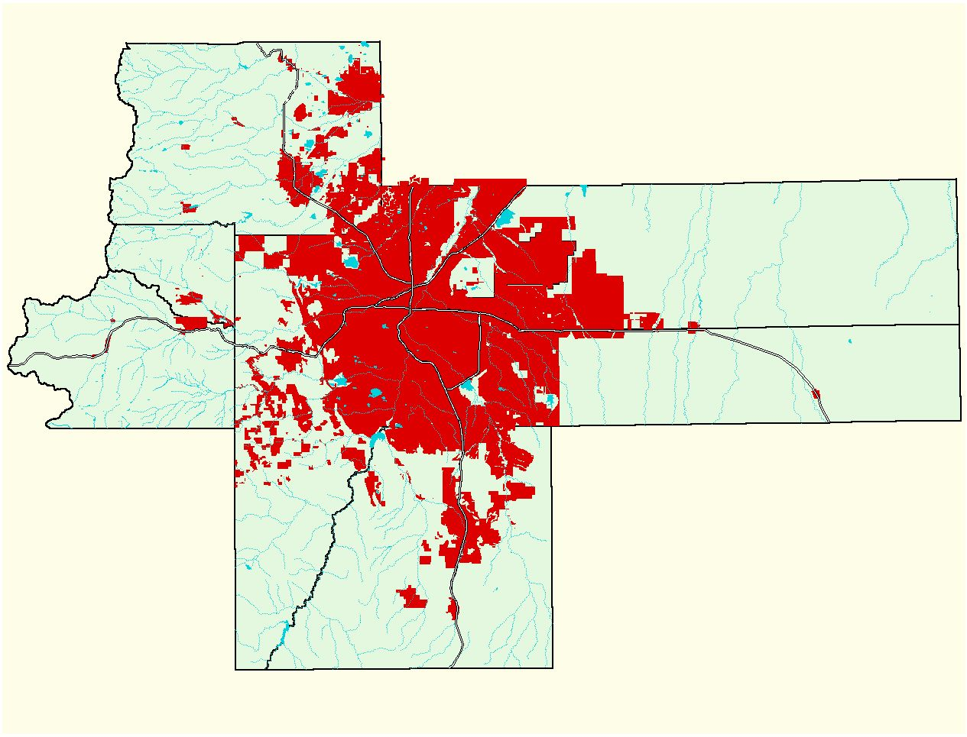
Denver Metro Region
Comprehensive Plan Build Out
1047 sq.miles
3,500,000
3,000,000
2,500,000
Forecast
2,000,000
Population
1,500,000
1,000,000
500,000
0
1920
1940
1960
1980
2000
2020
Year

Slide 33
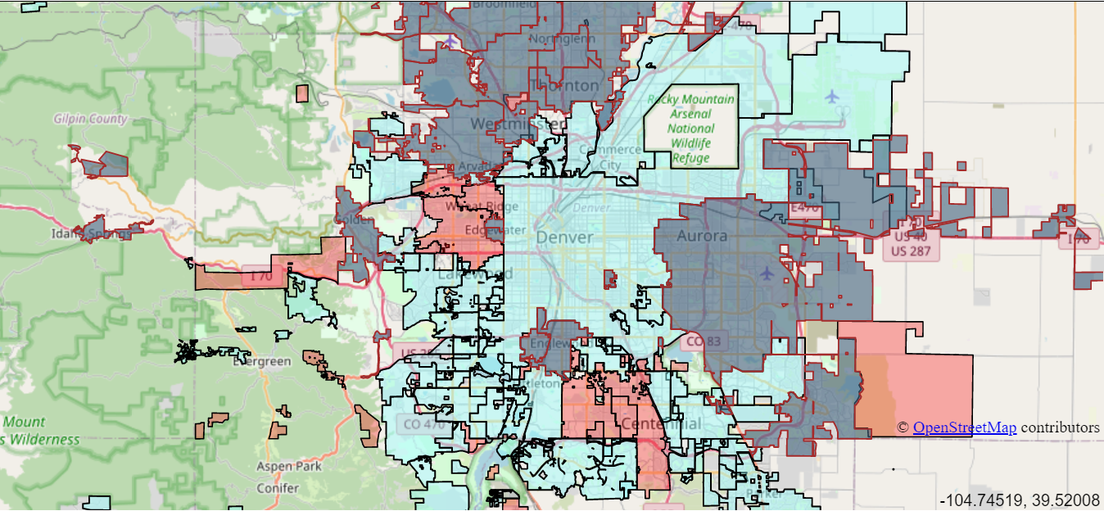

Slide 35
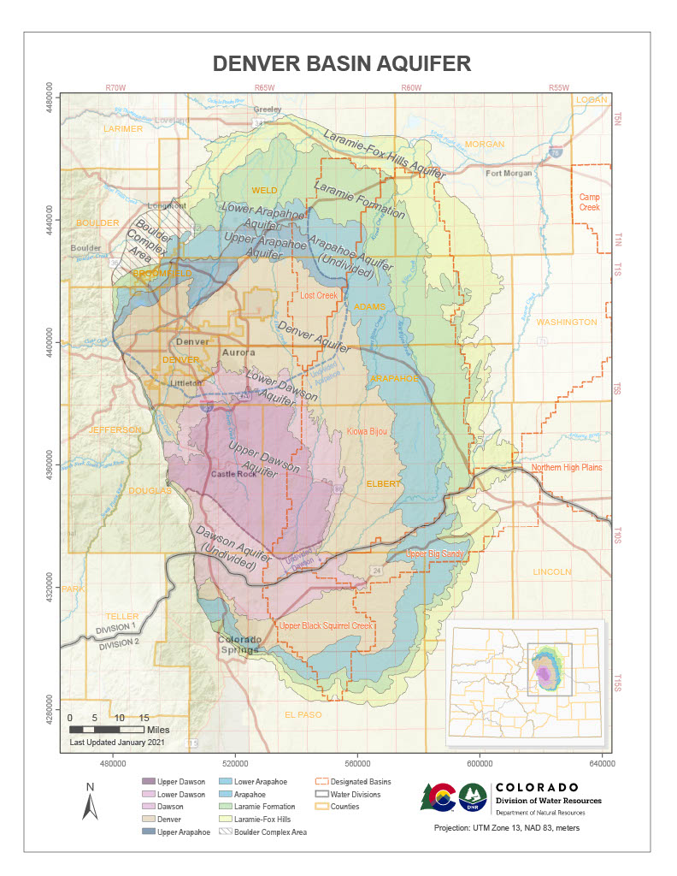
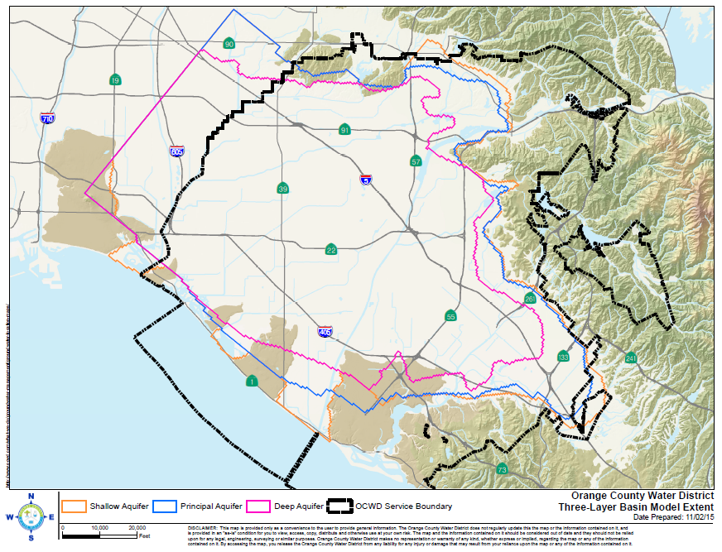

Slide 36
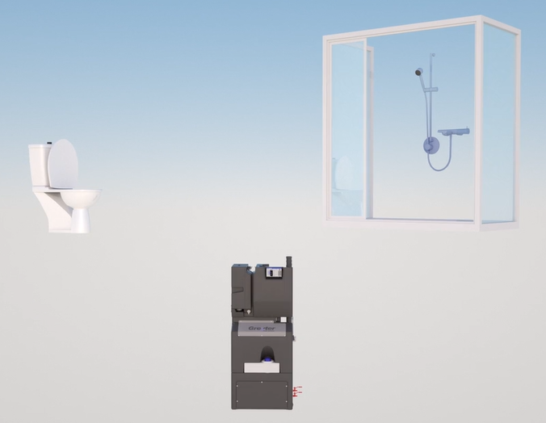
Graywater
20-25%

Slide 37
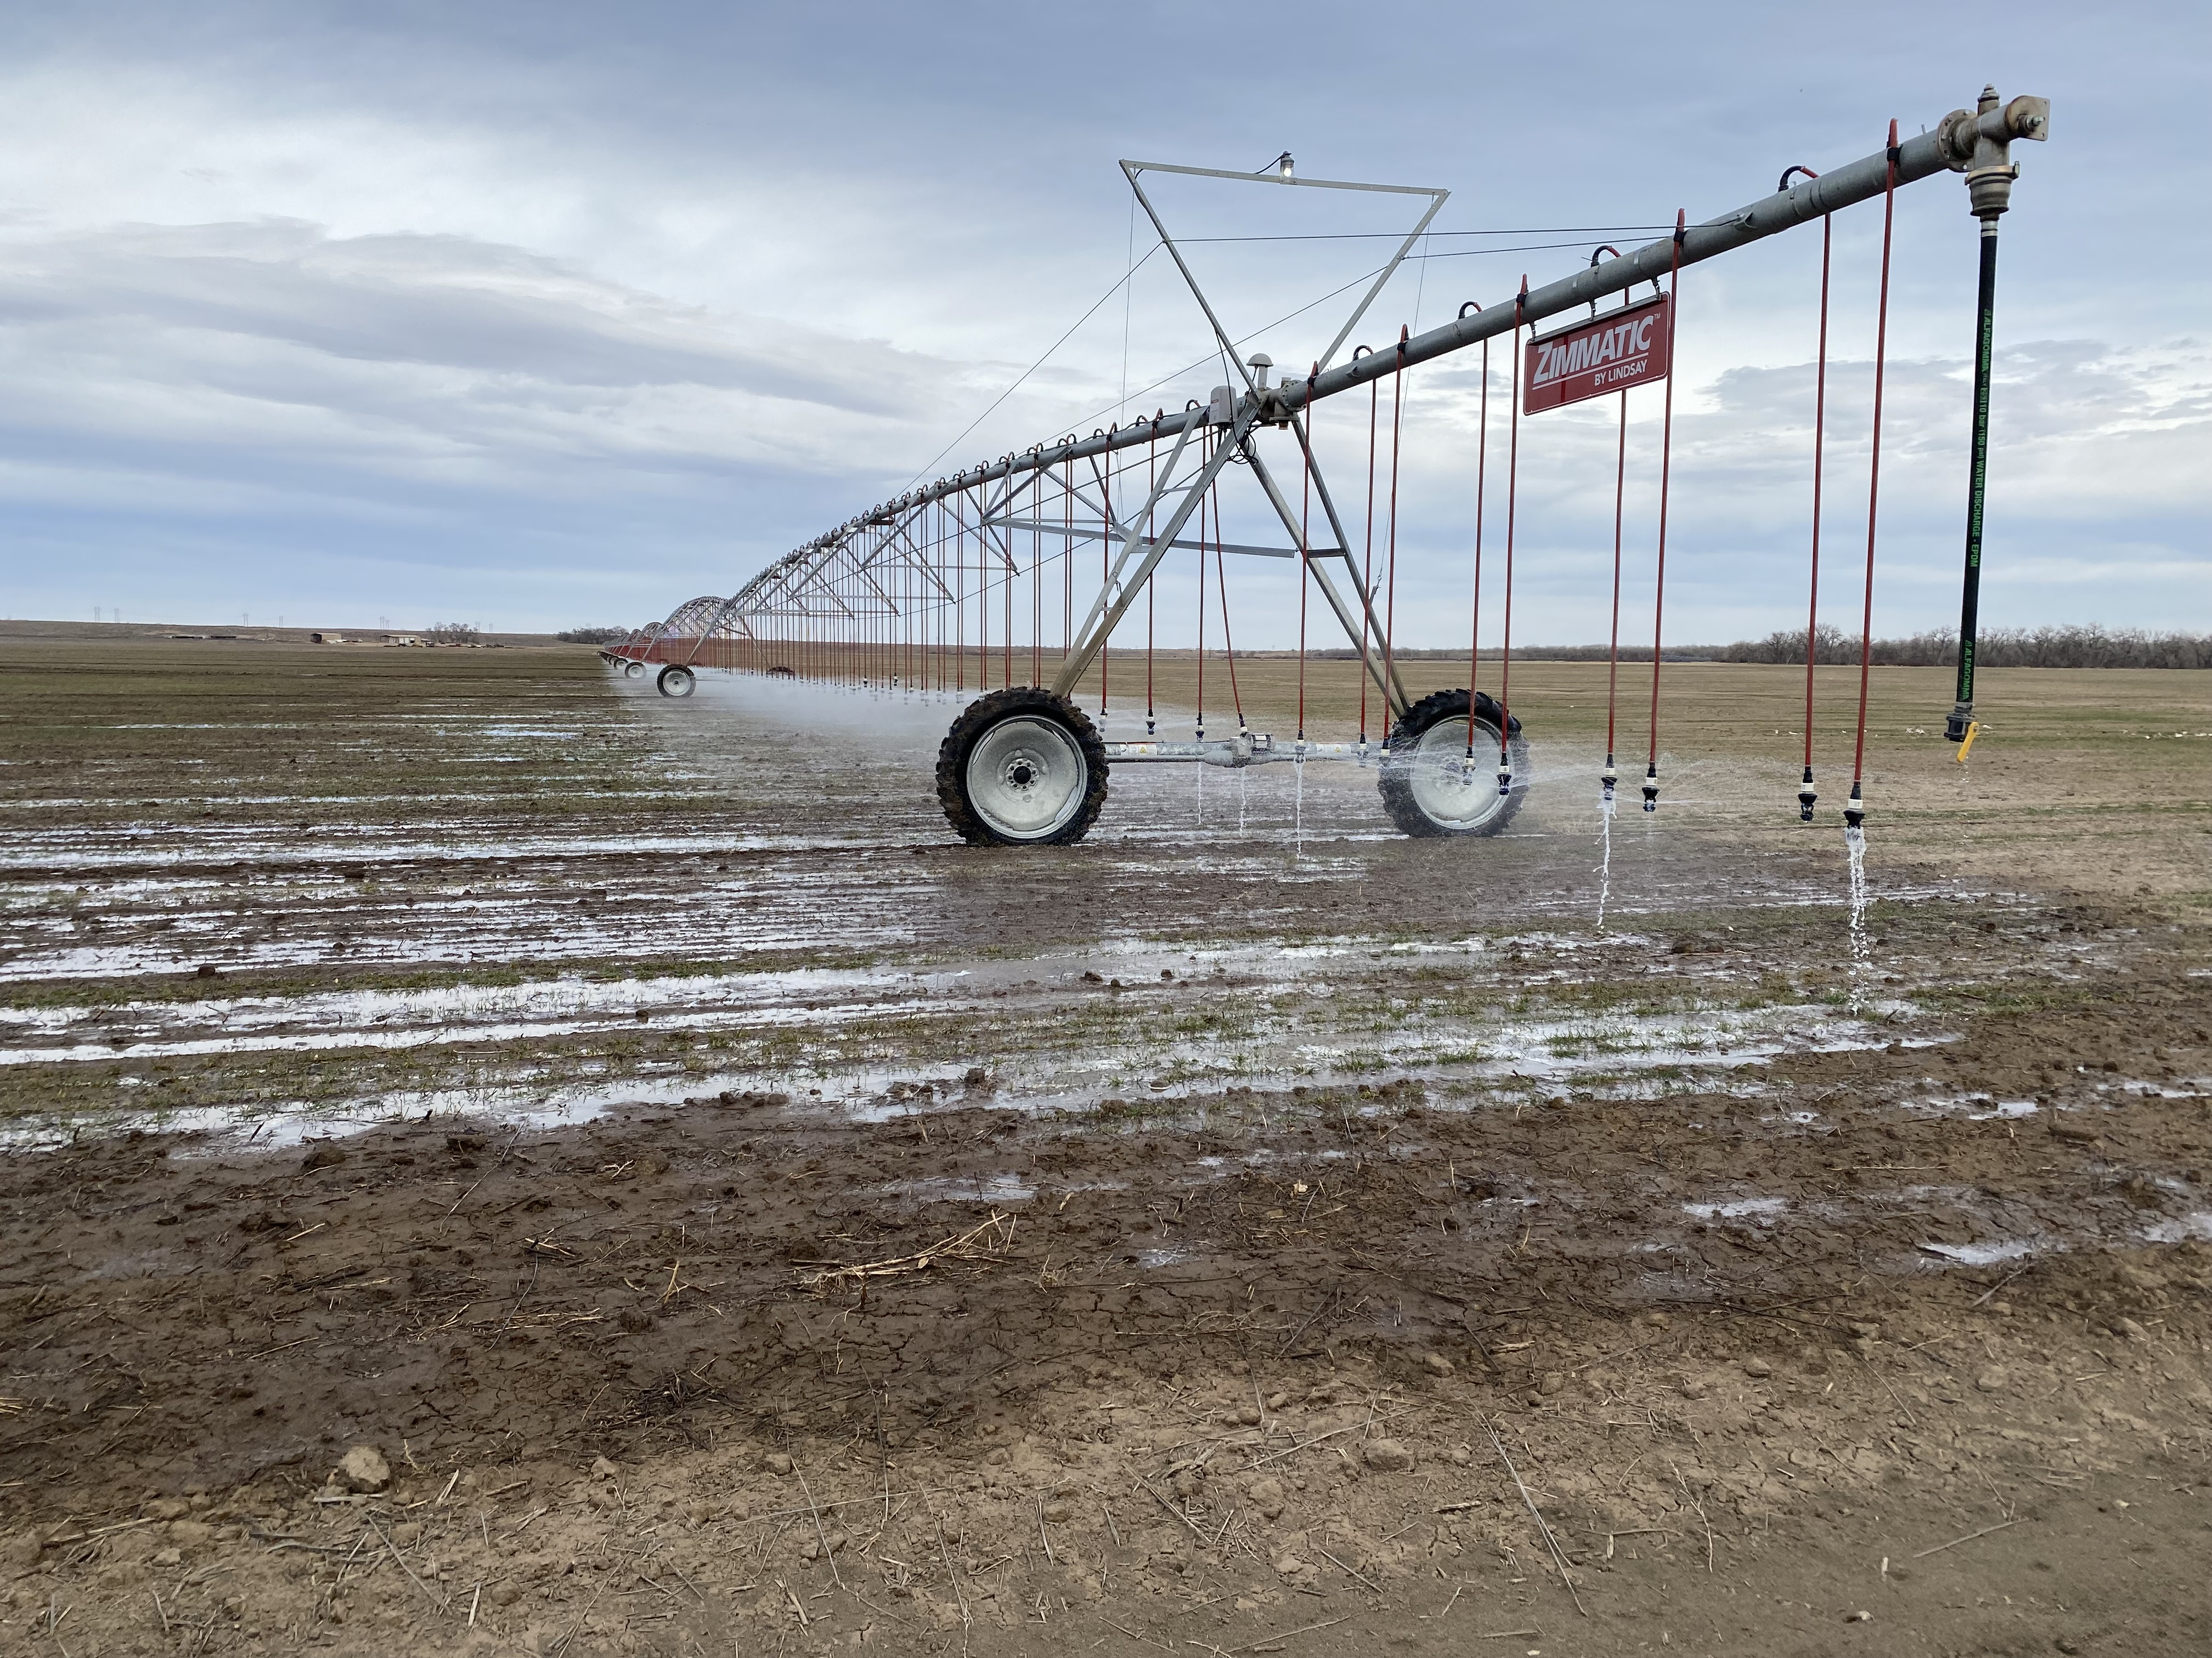

Slide 38
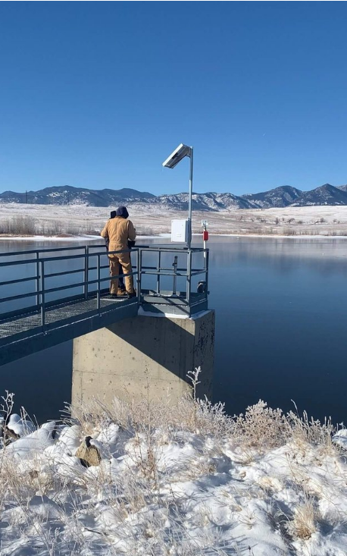
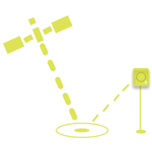

Remote sensors

