Slide 2
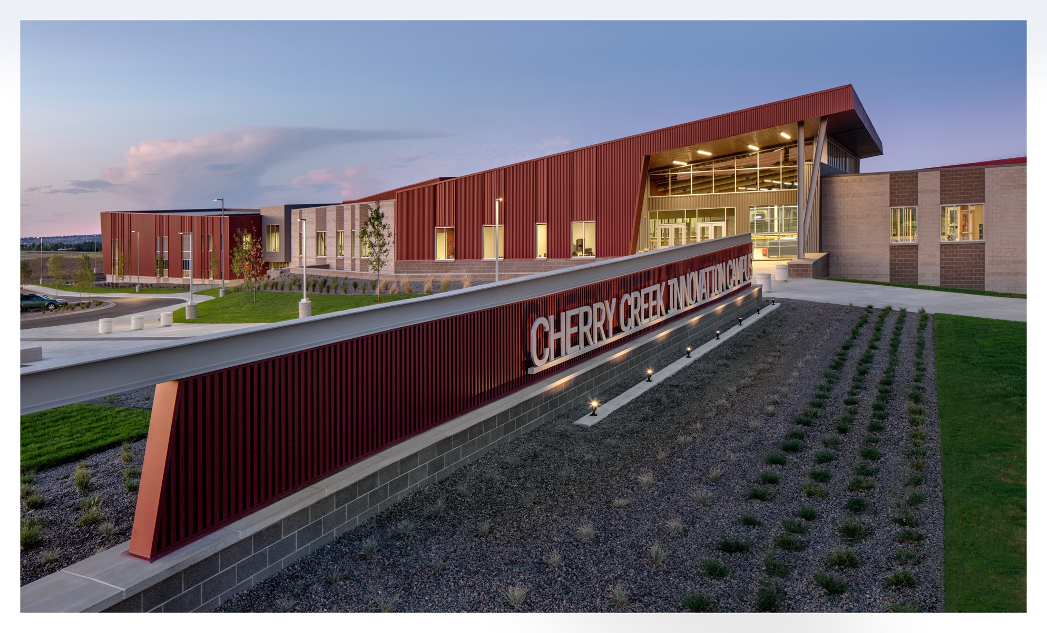
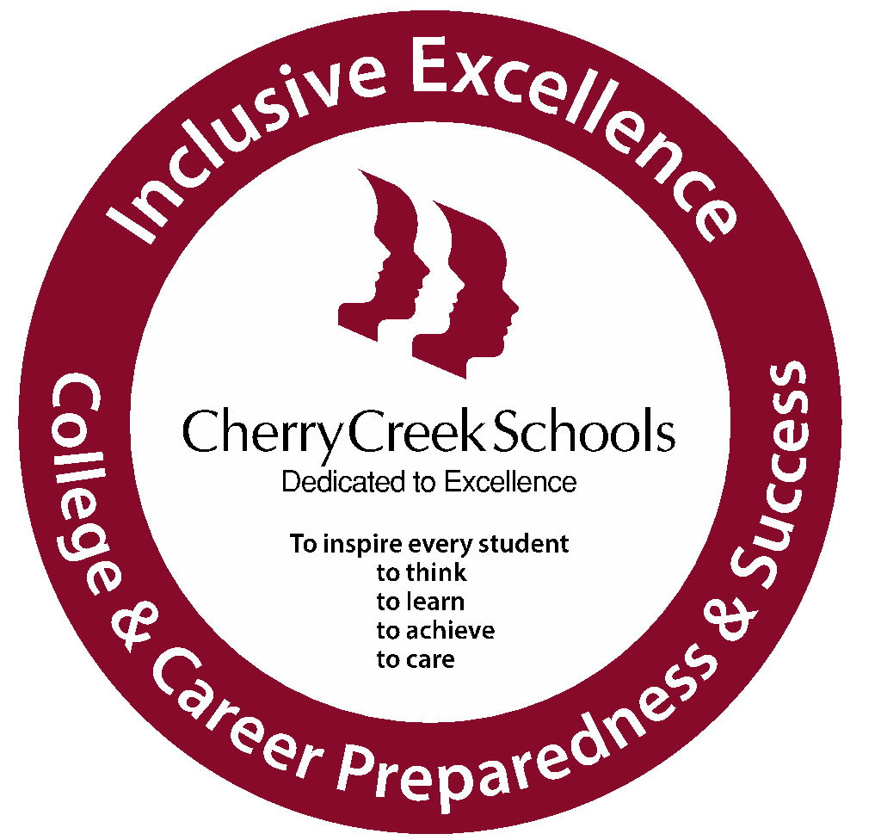
Overview
The CCIC is for all students:
Those who want to go to college.
Those who want to go right into the workforce or military after high school.
Those who are unsure of what they want to do after high school.
The CCIC:
Is available to 10th, 11th, and 12th graders in CCSD.
Provides innovative education in seven career pathways.
Seeks to serve those who are historically underserved in our communities.

Slide 3
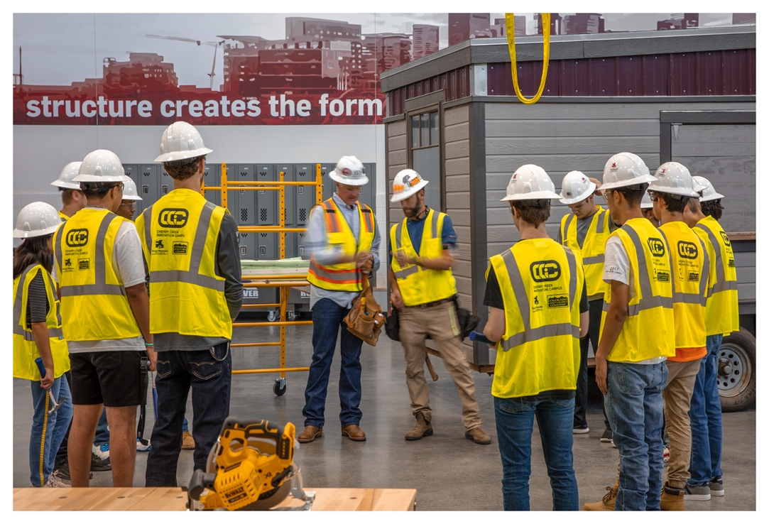
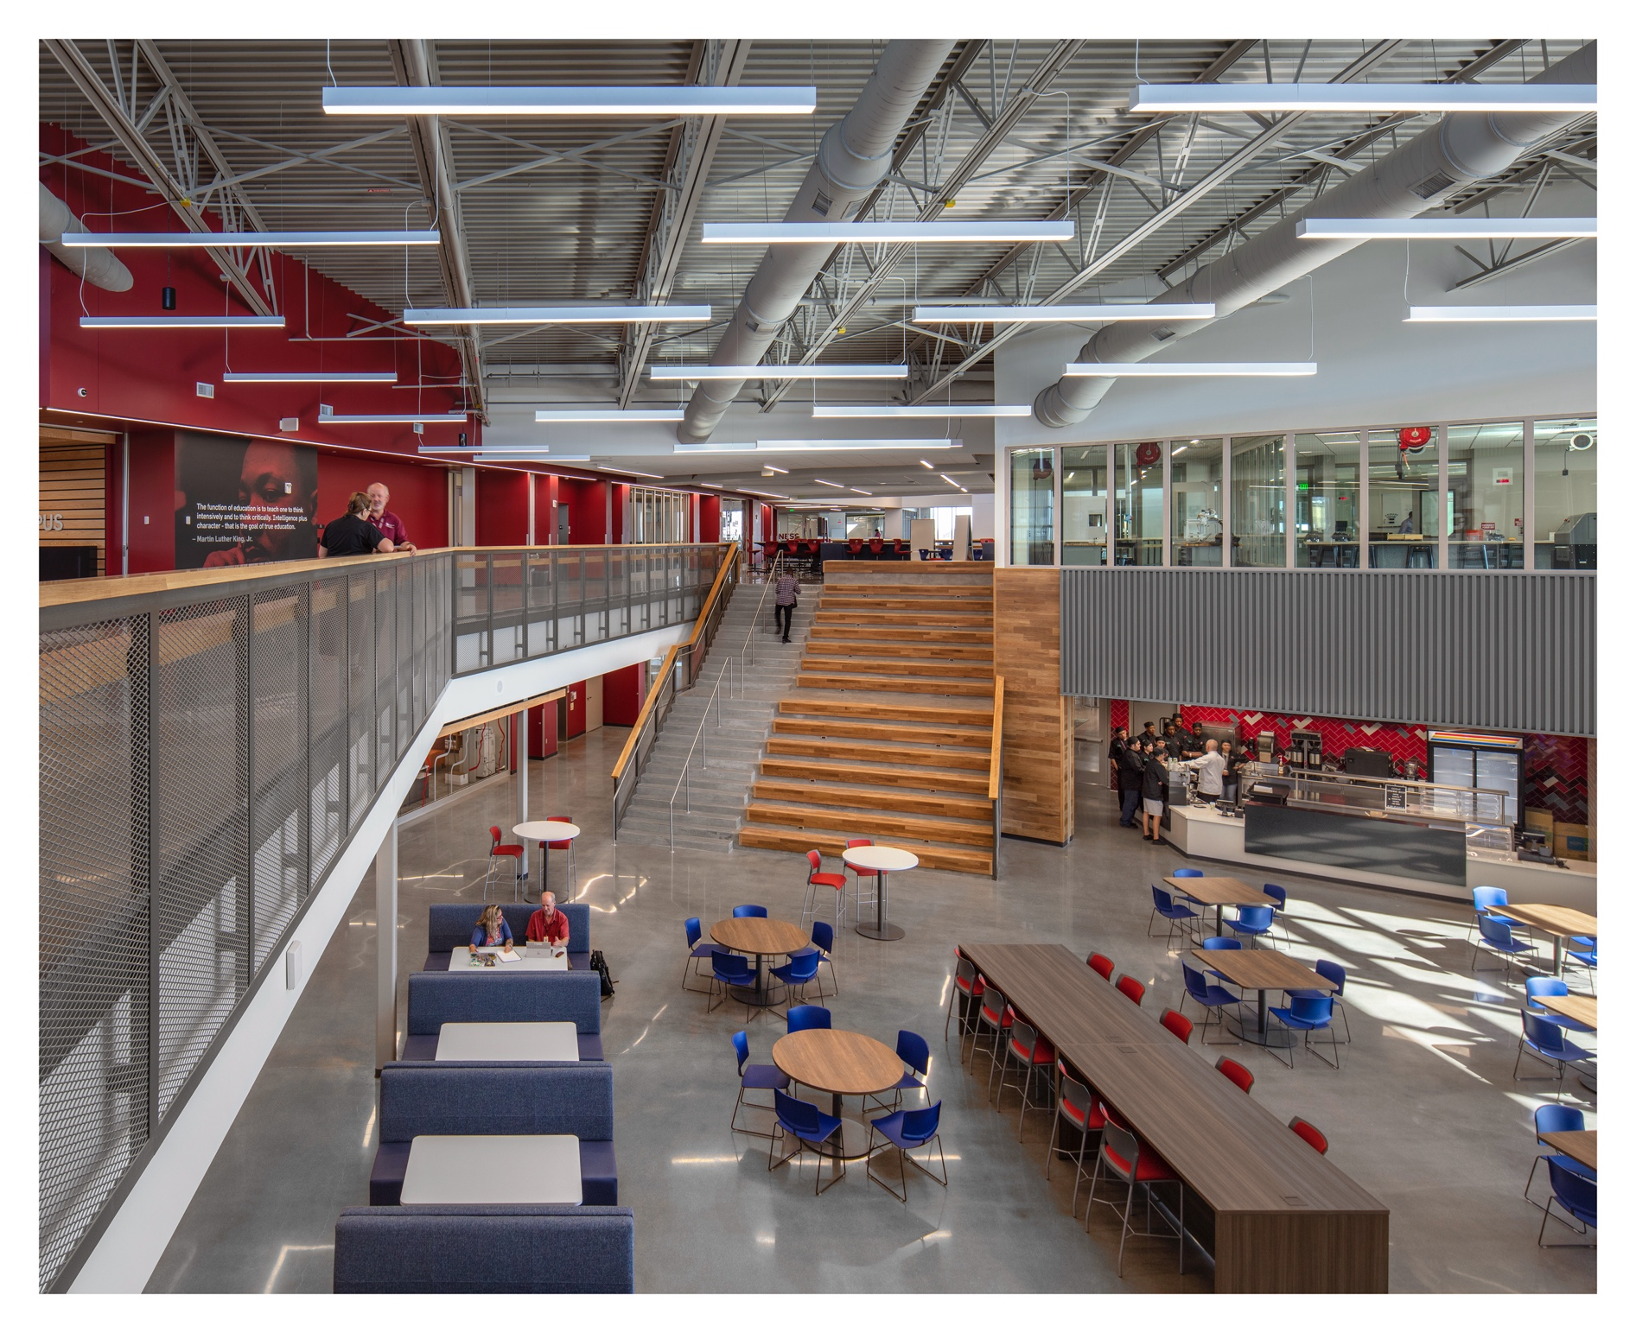
CCIC Pathways
Advanced Manufacturing
Fabrication
Production
Machining
Business Services
Entrepreneurship
Business Marketing
Project Management
Health & Wellness
Pharmacy Tech
CNA
OT/PT
Behavioral Mental Health
Hospitality & Tourism
Student Café
ProStart
Event Planning
Resort Management
Infrastructure Engineering
Construction Management
Big-Build Concept
I.T. & STEAM
Cybersecurity
Data Science
Design Thinking
Virtual Reality/Augmented Reality
Robotics
Transportation
Auto Tech
Aviation Maintenance
Aviation Fundamentals
Drone Piloting
Notes:
7 programs →

Slide 4
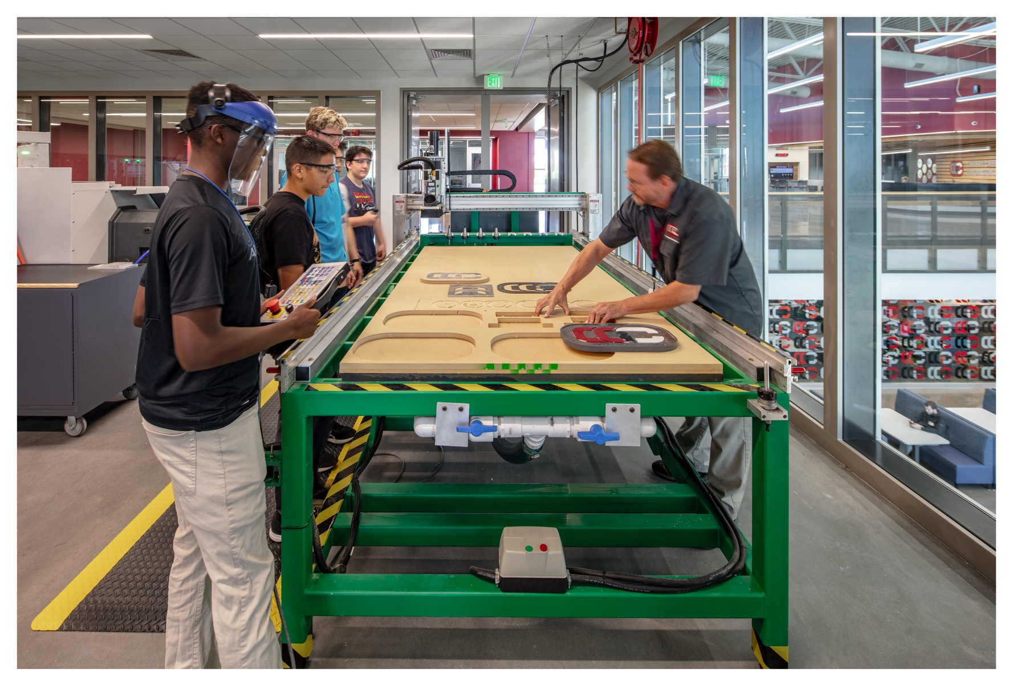
Advanced Manufacturing Pathway
The Advanced Manufacturing pathway helps fill industry’s skills gap by giving students unique opportunities to be trained on manufacturing trends. Whether it be computer numerical control (CNC) manufacturing systems, materials processing, or precision measurement, students engage in hands-on learning with state-of-the-art CNC equipment including mills, lathes, water jets, routers, and plasma cutters.
Future Careers/Certifications
Careers
CNC Machinist
CNC Programmer
Electromechanical Technician
Manufacturing Technician
Production Technician
Quality Inspector
Material Handler
Tool & Die Maker
Industry Certifications
National Institute of Metalworking Skills (NIMS) Job Planning, Benchmark & Layout Credential
National Institute of Metalworking Skills (NIMS) Measurement, Materials & Safety Credential
Stratasys Additive Manufacturing
Partners

Slide 5
Business Services Pathway
In a collaborative, startup-style learning environment, the Business Services pathway gives students an opportunity to cultivate an entrepreneurial mindset and develop skills to build and manage their own businesses. With a focus on building project management and leadership skills, students engage in digital marketing, customer relationship management, sales, and small business management projects.
Future Careers/Certifications
Careers
Project Manager
Sales Associate
Social Media Specialist
Marketing Associate
Human Resource Specialist
Every great dream begins with a dreamer.
Harriet Tubman
Industry Certifications
Certified Associate Project Manager (CAPM)
RISE Up Customer Service and Sales Professional
Partners

Slide 6
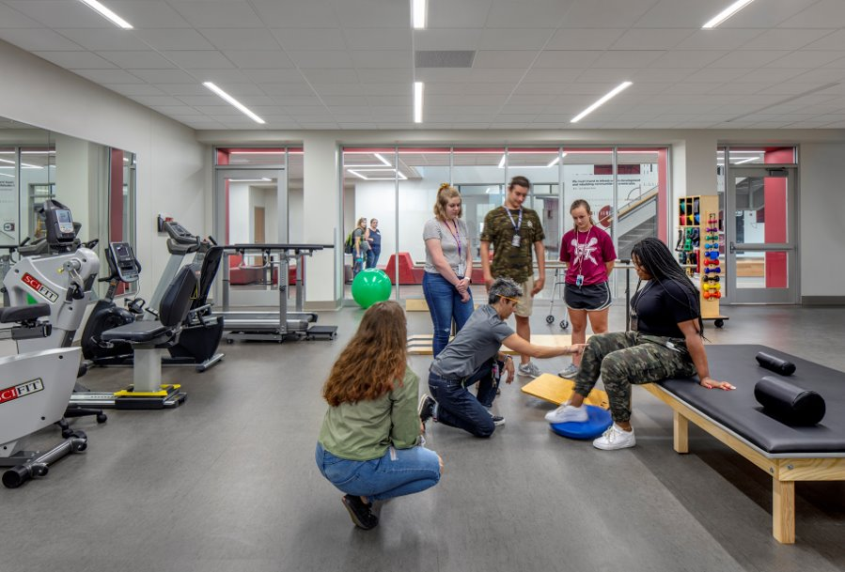
Health & Wellness Pathway
Whether a student’s focus is physical or occupational therapy, behavioral health, nursing, or pharmacy, the Health & Wellness pathway provides students opportunities to explore various Allied Health professions at the aide/technician level. In these courses, students meaningfully integrate their knowledge and skills with hands-on labs, authentic clinical settings, and industry-grade equipment.
Future Careers/Certifications
Careers
Physical Therapist
Registered Nurse
Counselor
Psychiatrist
Pharmacist
Social Worker
Occupational Therapist
Health Science Educator
Industry Certifications
Behavioral Health Technician Certificate
Certified Nurse Aide Certificate (CNA)
AHA CPR/First Aid & AED Certificate
Certified Pharmacy Technician (CPhT)
Partners

Slide 7
Hospitality & Tourism Pathway
With a focus on leadership development, students in the Hospitality & Tourism pathway are able to develop the skills to manage, market, and operate food-service establishments, hotels, and resorts. Whether through guest visits, site tours, or apprenticeships (running the CCIC café!), students have engaging and unique opportunities to advance their culinary skills and deepen their understanding of business operations and world-wide tourism.
Future Careers/Certifications
Careers
Executive Chef
Food Stylist
Marketing Director
General Manager
Catering Director
Executive Housekeeper
Restaurant Owner
Pastry Chef
Industry Certifications
ProStart National Certificate of Achievement
ServSafe National Restaurant Association
Certifications
American Hotel & Lodging Educational Institute
(AHLEI) Certifications
American Culinary Federation (ACF)
Fundamentals Cook Certification
Partners

Slide 8
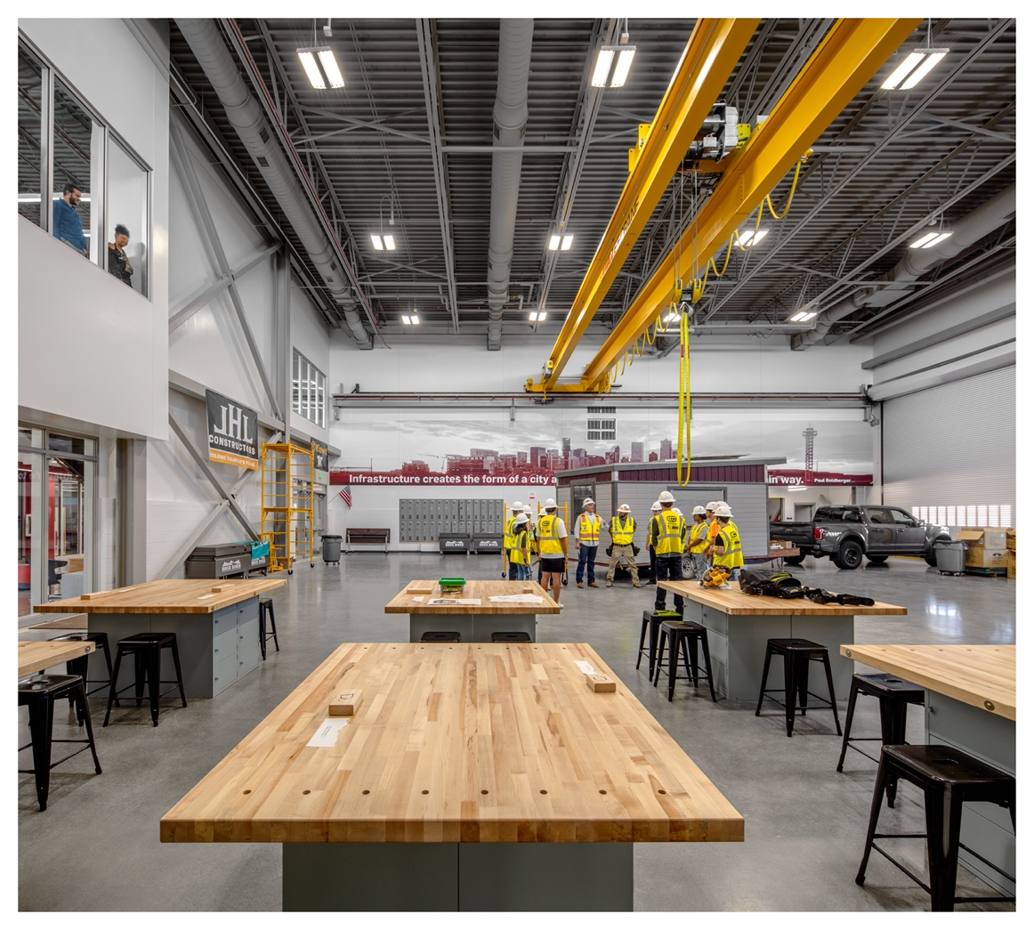
Infrastructure Engineering Pathway
From the framing to the HVAC to the drywall, it takes many different kinds of skilled workers to make a new building habitable! The Infrastructure Engineering pathway gives students a chance to explore several careers in building trades. With opportunities to operate cranes and/ or forklifts, pour concrete, and framing buildings, students get a chance to work with their hands and experience “on the job” training to build structures (perhaps a tiny home!).
Future Careers/Certifications
Careers
HVAC Technician
Forklift Operator
Electrician
Carpenter
Plumber
Roofer
Landscaper
Drywaller
INFRASTRUCTURE
Industry Certifications
Occupational Safety and Health Administration (OSHA) 10-Hour Card
Home Builders Institute (HBI) Pre-
Apprenticeship Certificate Training (PACT)
ENGINEERING
Partners

Slide 9
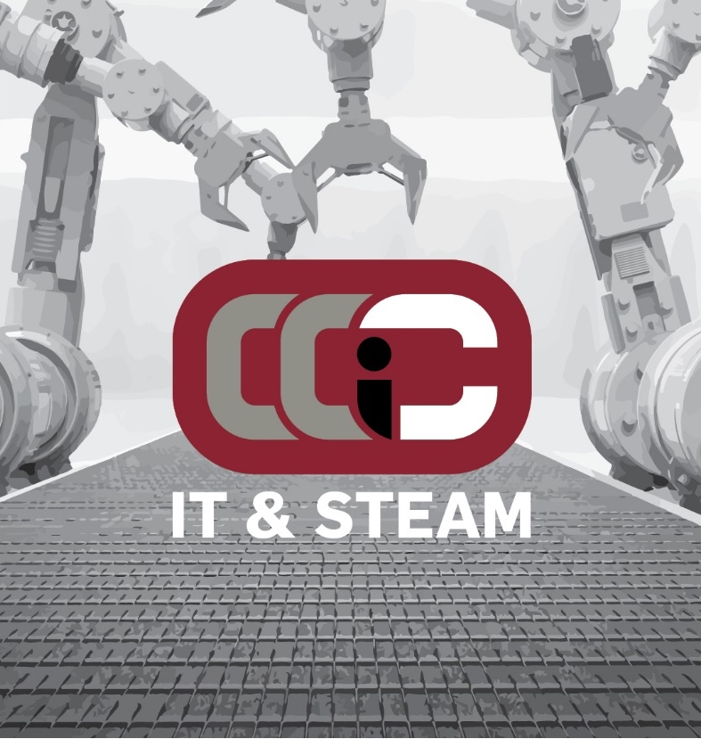
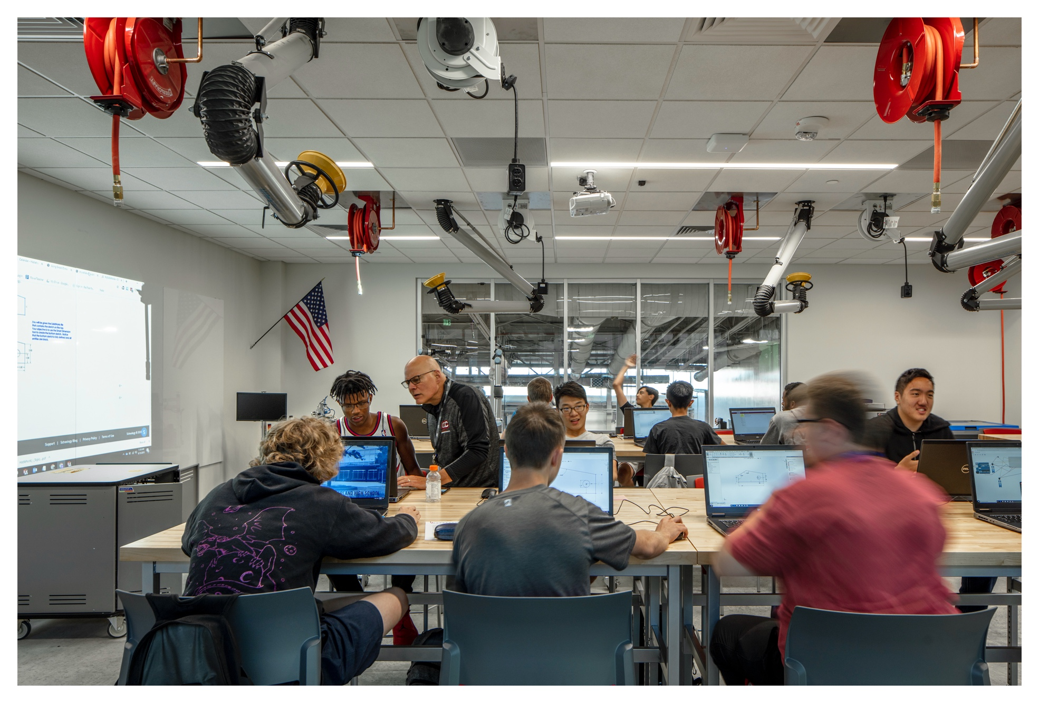
I.T. & STEAM Pathway
From virtual reality to cybersecurity to robotics, the IT & STEAM pathway gives students opportunities to use, learn, and create cutting edge technologies to tackle the challenges the future may bring. Through hands-on experiences, students can take ideas from conception to reality, learn to troubleshoot any kind of personal computing device or computer network, or build their own virtual reality environments.
Future Careers/Certifications
Careers
Network Administrator
IT or STEAM Educator
Mechanical Engineer
Computer Engineer
Product Designer
Data Analyst
Game Designer
IT Support Specialist
Industry Certifications
SOLIDWORKS Associate (CSWA)
Additive Manufacturing Associate
(CSWA-MA)
CompTIA A+, Network+
Google Certifications
Unity Programmer or Developer
TestOut PC Pro, Network Pro
Partners

Slide 10
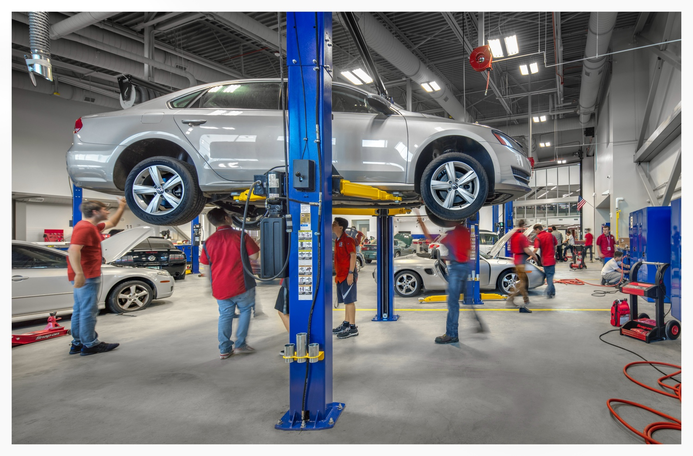
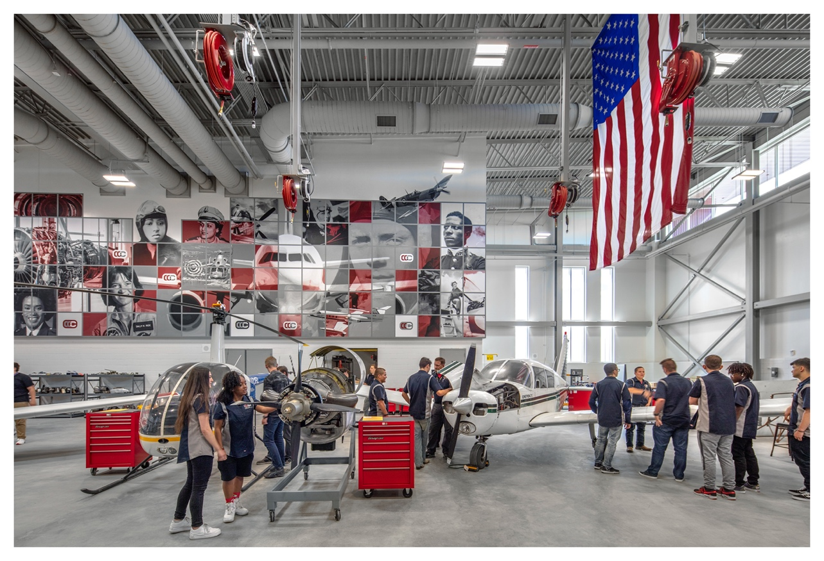
Transportation Pathway
The Transportation pathway gives students a unique opportunity to get hands-on experience learning to inspect, service, and repair automobiles and aircraft. Whether it be diving into the electrical circuits, tire alignments, and suspension repairs for cars or exploring the engine, landing gear, and hydraulic systems on airplanes, students have a one-of-a-kind opportunity to build invaluable skills with industry-standard tools and equipment.
Future Careers/Certifications
Careers
Automotive Technician: local repair shop,
dealerships, fleet maintenance, specialty shops
Aircraft Mechanic: major airlines, flight school, cargo aircraft, corporate jets
Industry Certifications
Snap-on: Multimeter, Torque, Precision Measurement, Scanner & Diagnostics, Wheel & Alignment, Starting & Charging, Pro-Cut Rotor Machining
Automotive Service Excellence (ASE) Entry-Level Certifications: Maintenance & Light Repair, Automobile Service & Technology
Federal Aviation Administration (FAA): Mechanic Certificate with Airframe & Powerplant Ratings
FAA Part 107 Drone Pilot License
Partners

Slide 11
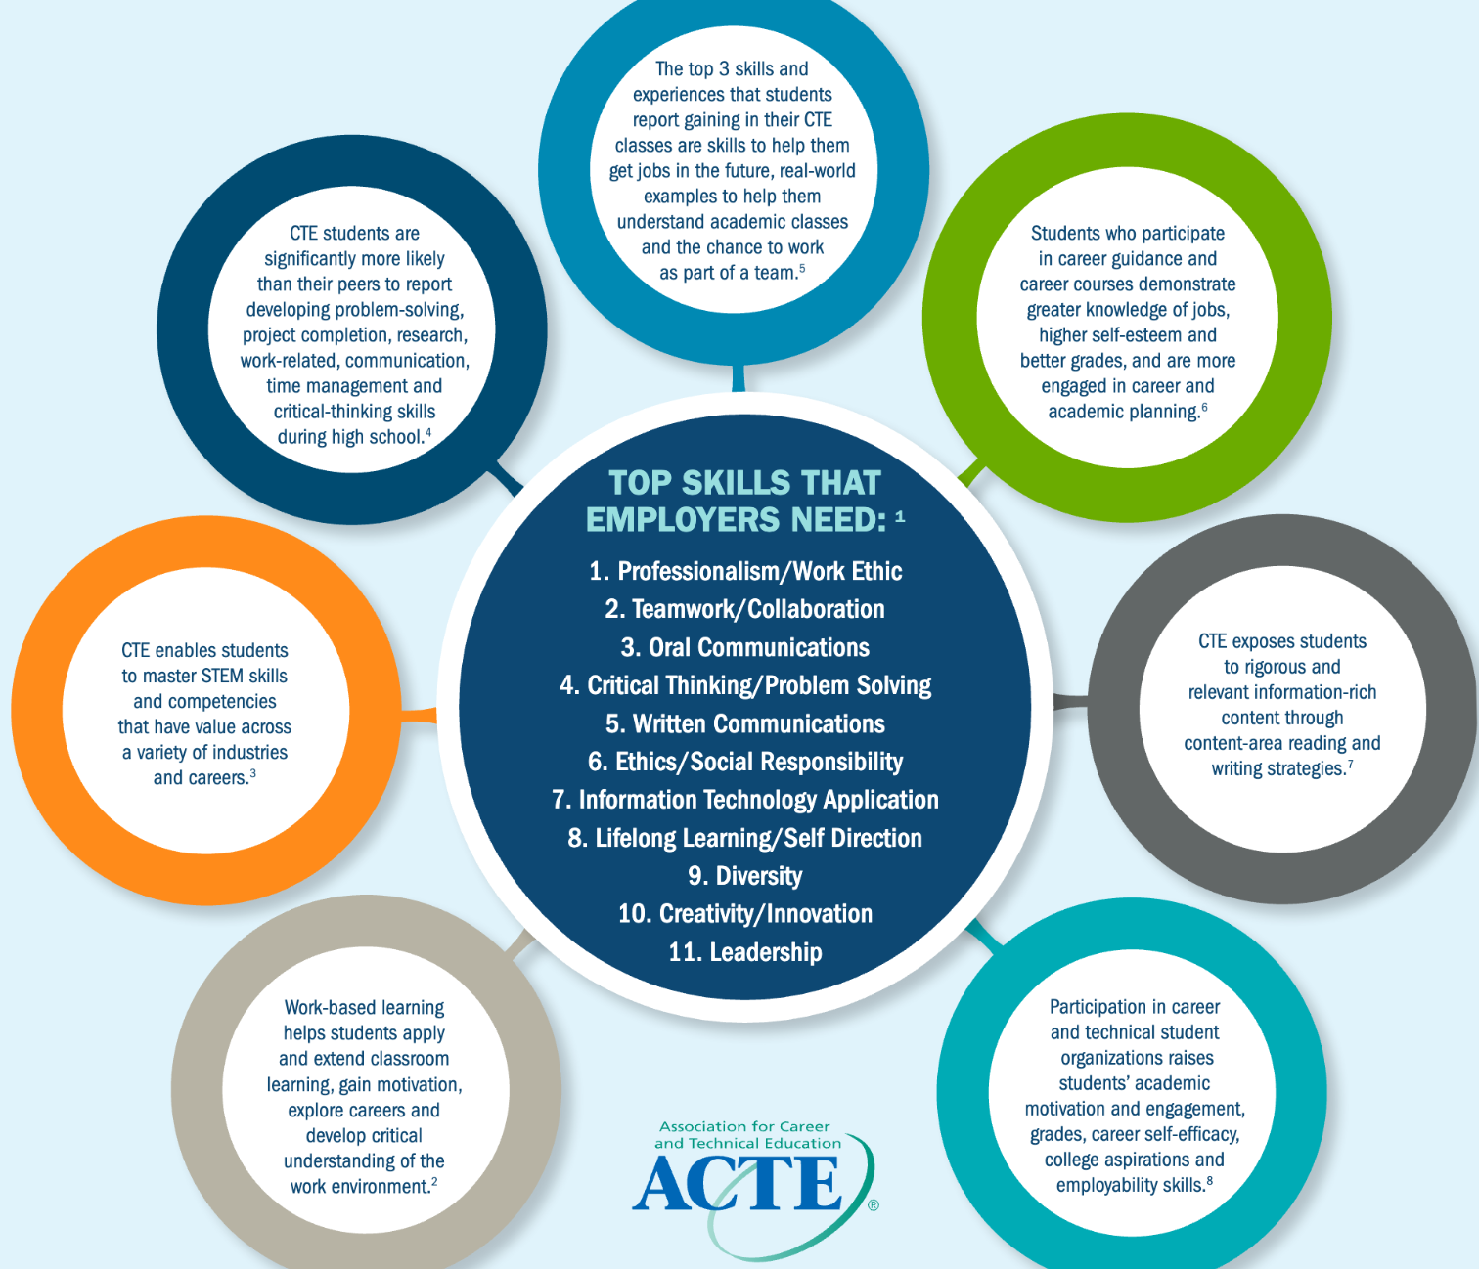
Essential Skills

Slide 12
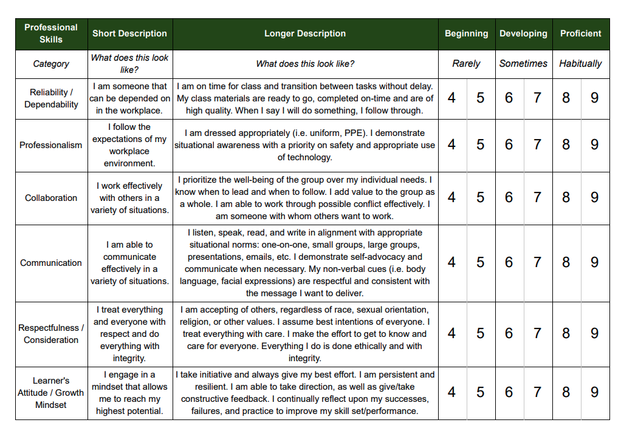

Slide 14
CCIC Community Partners
Advanced Manufacturing
Health and Wellness
Business Services
Transportation: Automotive and Aviation
Infrastructure Engineering
Hospitality and Tourism
IT and STEAM

Slide 15
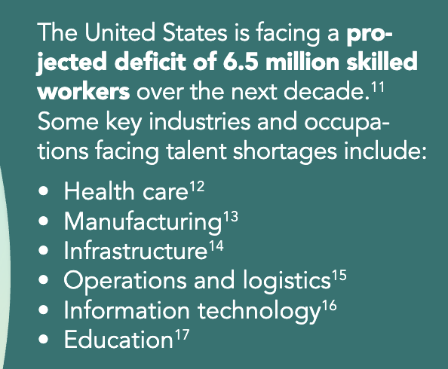
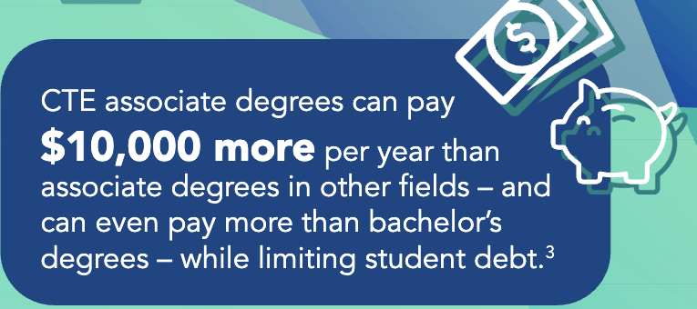
Trends in Career and Technical Education (CTE)
23
Number of states that require CTE curriculum for graduation requirements
6 in 10 students are planning to pursue a career related to the CTE area they are exploring in high school.
Notes:
Pam Sarah CTE as part of competency

Slide 16
CCIC 2.0 Planning

Slide 17
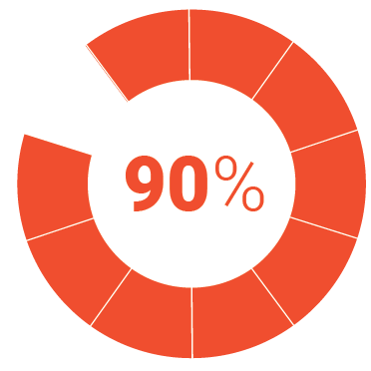
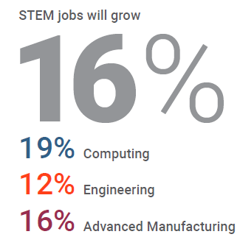
Trends in Career and Technical Education (CTE)
A BOLD METAVERSE VISION
6 in 10 students are planning to pursue a career related to the CTE area they are exploring in high school.
or more of CTE students are planning to continue with post-secondary education.
Graduates report wishing they had more real-world opportunities in high school.
23
According to The National Science Foundation of the jobs created in the next decade will require some form of math and science skills.
Number of states that require CTE curriculum for graduation requirements
Notes:
Pam Sarah CTE as part of competency

Slide 18
