Slide 2
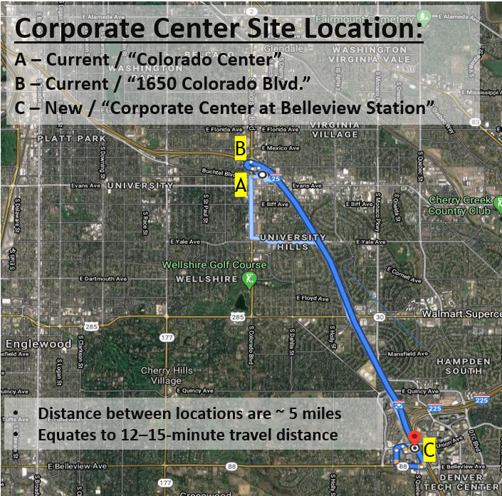
BUILDING OVERVIEW
Belleview Station (I-25 & Belleview)
Building is 120,000 RSF
4 Floors of Office
4 Floors of Parking
1 Floor Retail/Parking
Consolidating 3 leased locations
Approximately 175 employees relocating in December
Builds brand visibility and recognition
Talent attraction and retention

Slide 3
PROJECT PARTNERS
DEVELOPER:
CONFLUENT DEVELOPMENT
ARCHITECT:
OPEN STUDIO ARCHITECTURE
CORE & SHELL
GENERAL CONTRACTOR:
THE WEITZ COMPANY
INTERIOR
GENERAL CONTRACTOR:
PROVIDENT CONSTRUCTION CO.
INTERIOR FURNITURE:
OFFICESCAPES
TECHNOLOGY & AV:
LINX
Notes:
With a project of this size it is important that we surround ourselves with great talent.
We are excited to announce our selected partners to date.
Confluent Development was brought on board last August to serve as our developer and they will oversee everything from due diligence, entitlements, timeline, vendor selection and finally, manage the construction.
Not only are they a great client of Vectra’s but they have an amazing team assembled to guide us through our project.
Also on the team…
Open Studio Architecture they were chosen to be the architect for both the core and shell and the interiors. This group ceative professionals get all the credit for the stunning design! – at a recent Belleview Station architectural review session, one of the committee members said “this will be the finest building in Belleview Station” OSA definitely brings the wow factor to the table.
Lastly, Weitz Construction has been brought onboard to manage the preconstruction portion of the project.
If you are contacted by a client or a 3rd party interested in offering their services for this project, please pass their contact information along to me and I’ll pass along to Confluent to review as part of the selection process.
Ashley ..

Slide 4
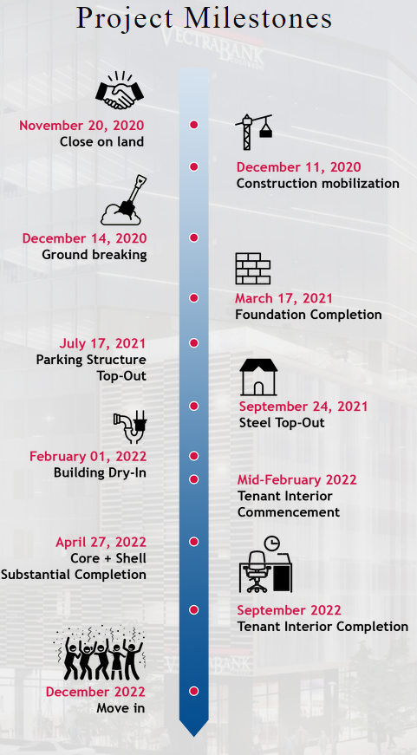
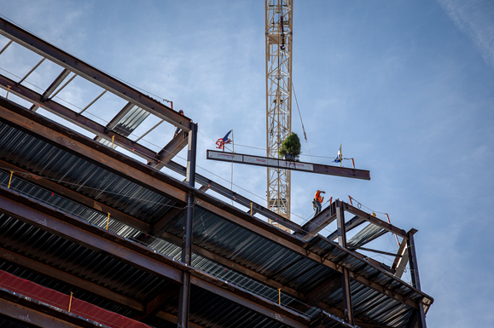
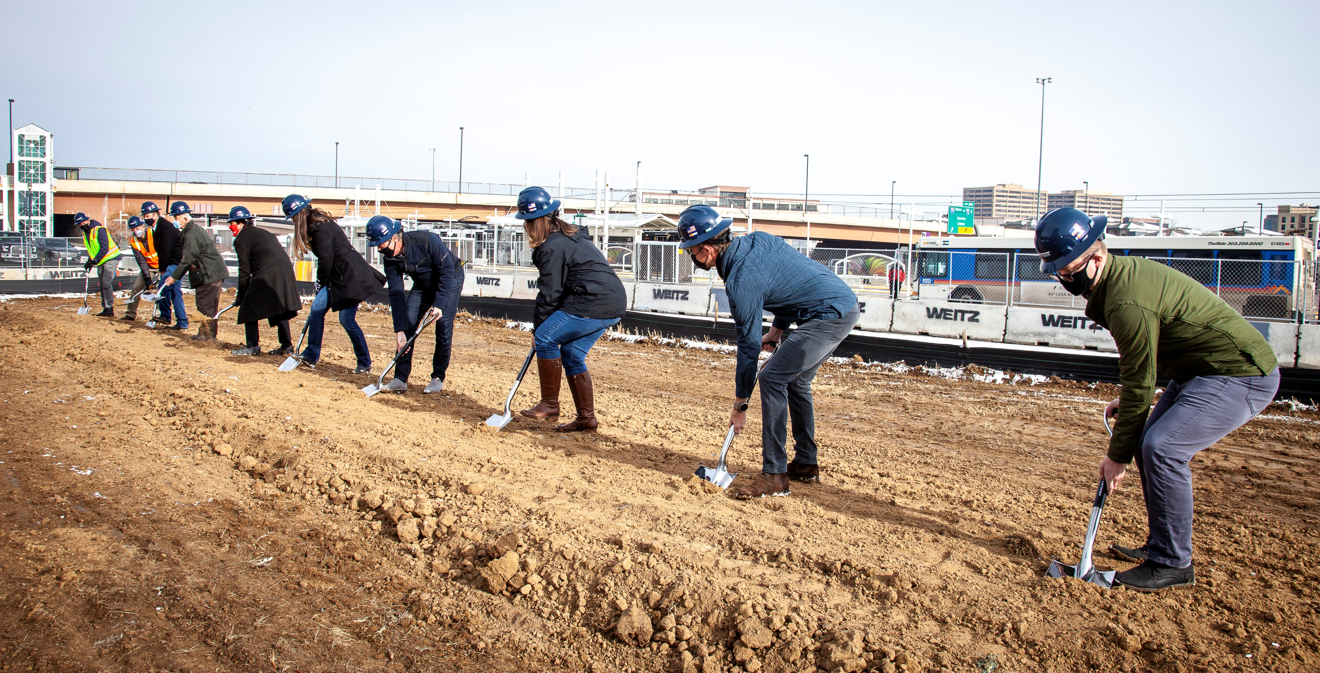
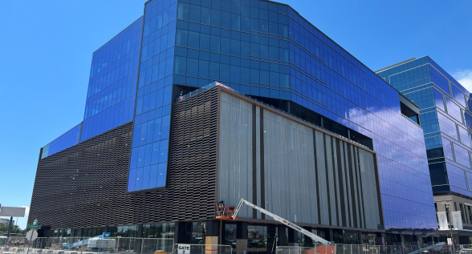
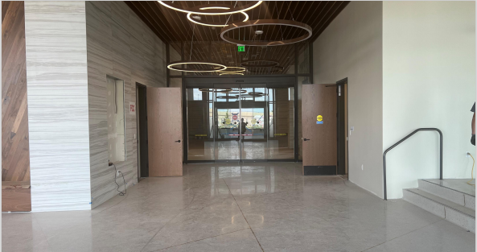
PROJECT MILESTONES

Slide 5
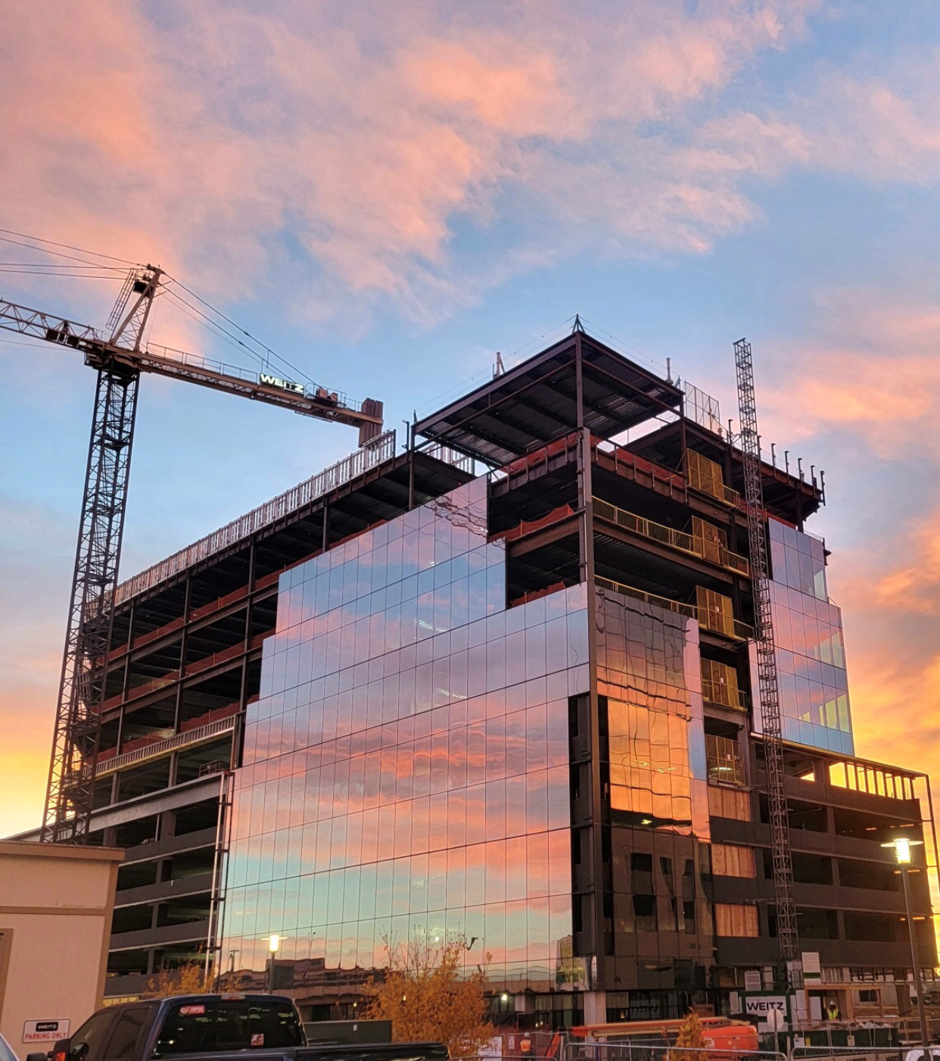
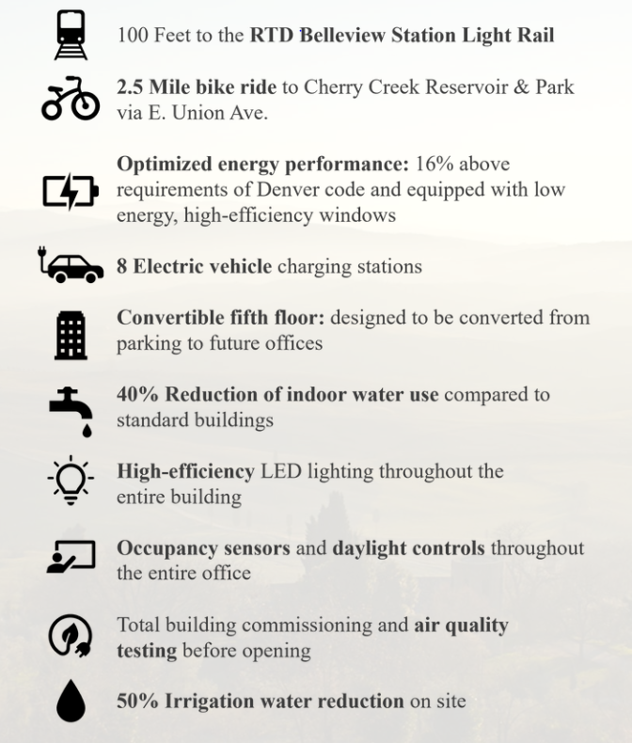
SUSTAINABILITY

Slide 6
VIDEO
Link: Vectra Corporate Center Video
Source https://www.youtube.com/watch?v=IDhpscpQQIA

Slide 7
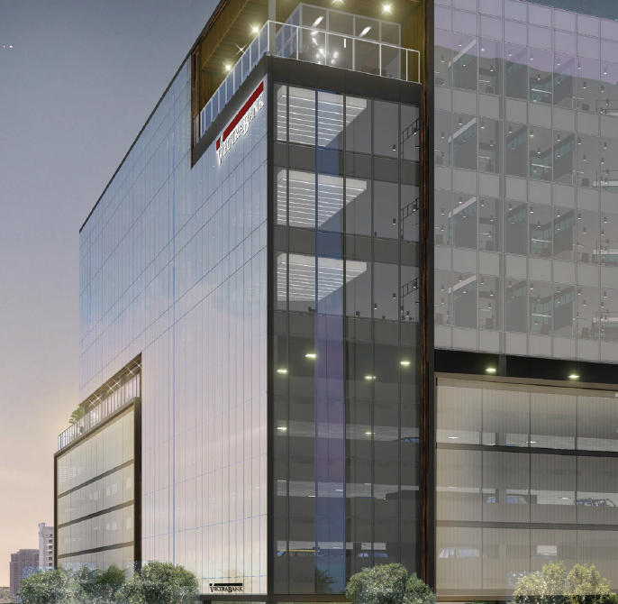
QUESTIONS ?

