Slide 1
Denver South Partnership
Kelli Kelly – business development & Strategy Director

Slide 3
Facility Features
Two new buildings provide 400,000-sqare-feet of space, full-service amenities
Fitness Center
Cardio machine, weights, spin bikes and locker rooms
Meeting Space
Auditorium, training and conference rooms, huddle space and focus rooms
Café and Coffee Shop
Indoor and outdoor seating available

Slide 4
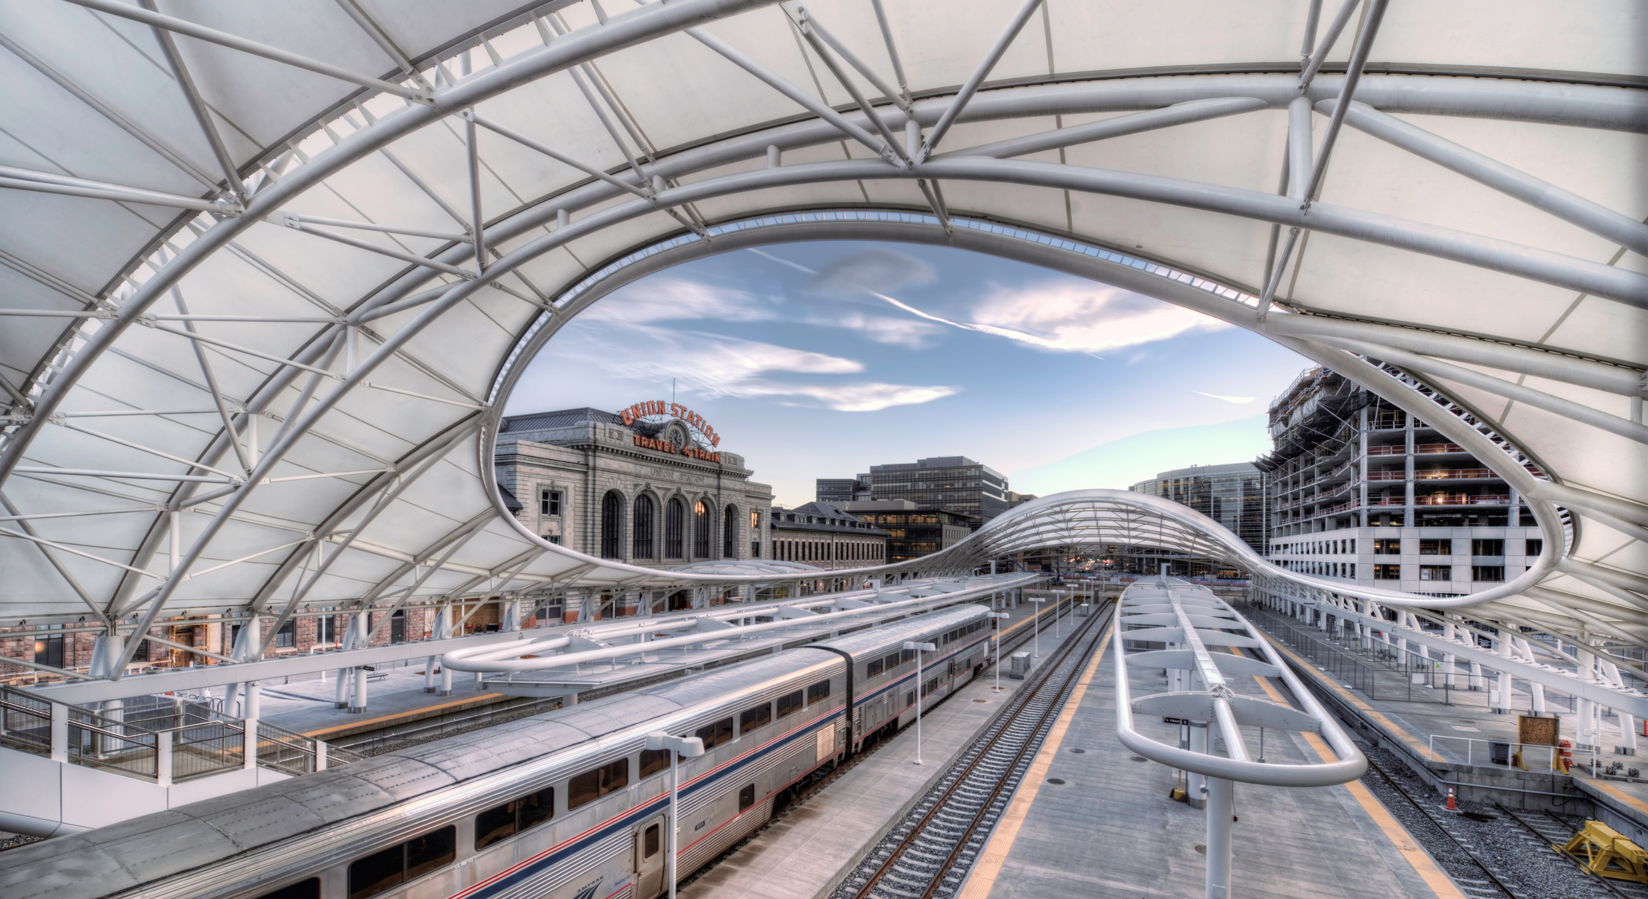
INDUSTRY LEADERSHIP
FORTUNE 500 Company
Engineering News-Record Top 10 Contractor Since 1995
2022 ENR Top Rankings
No. 3 Overall Contractor
No. 18 Overall Designer

Slide 5
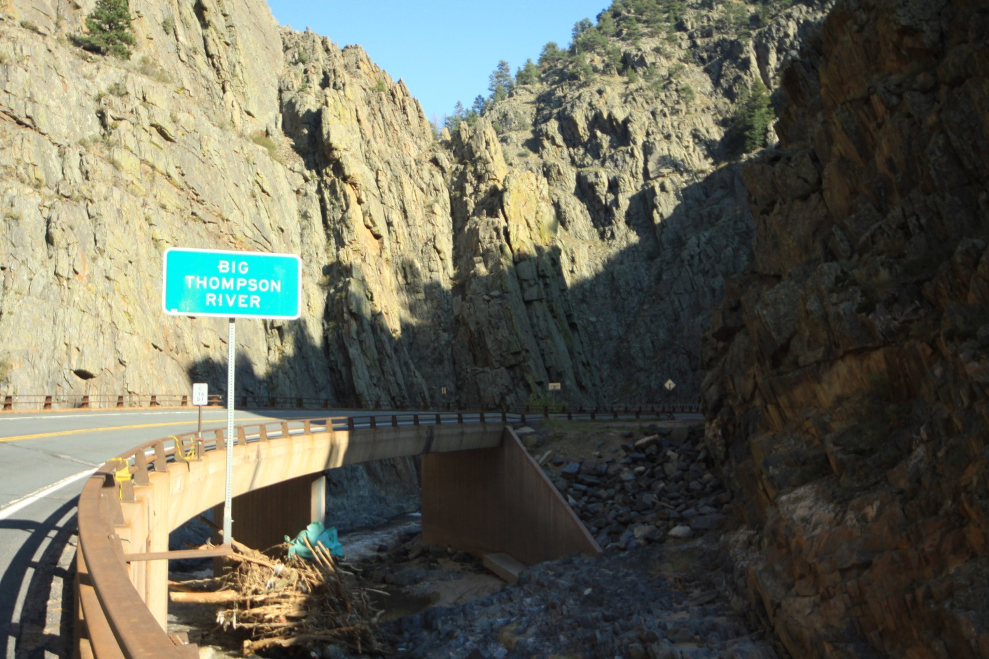
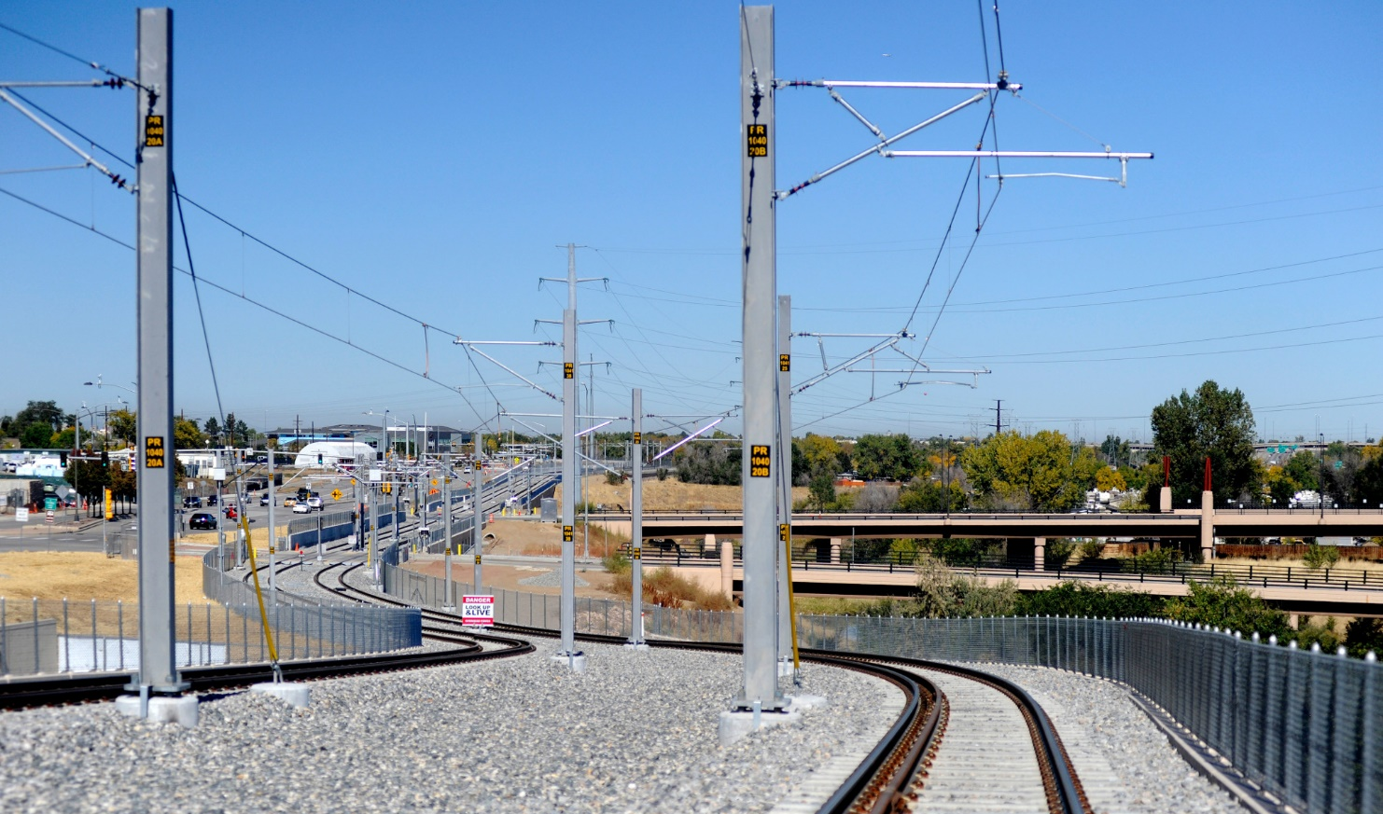
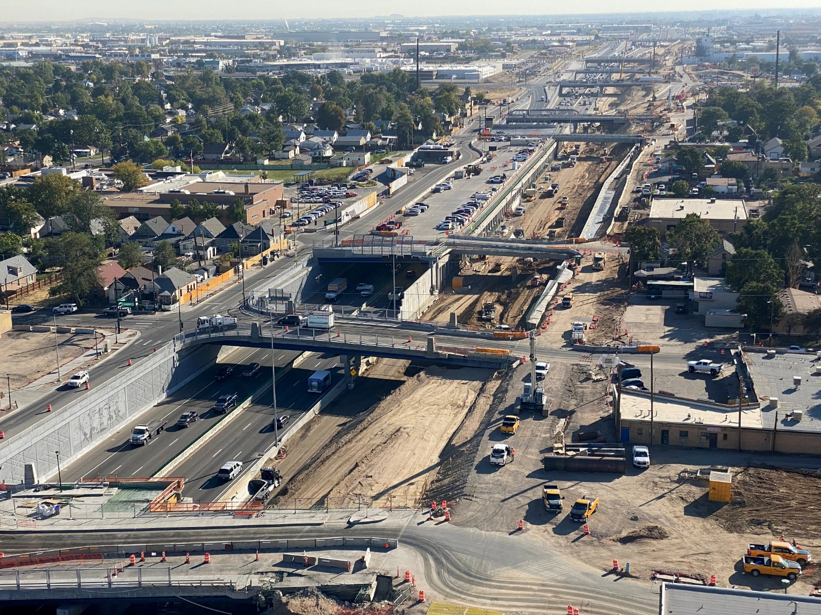
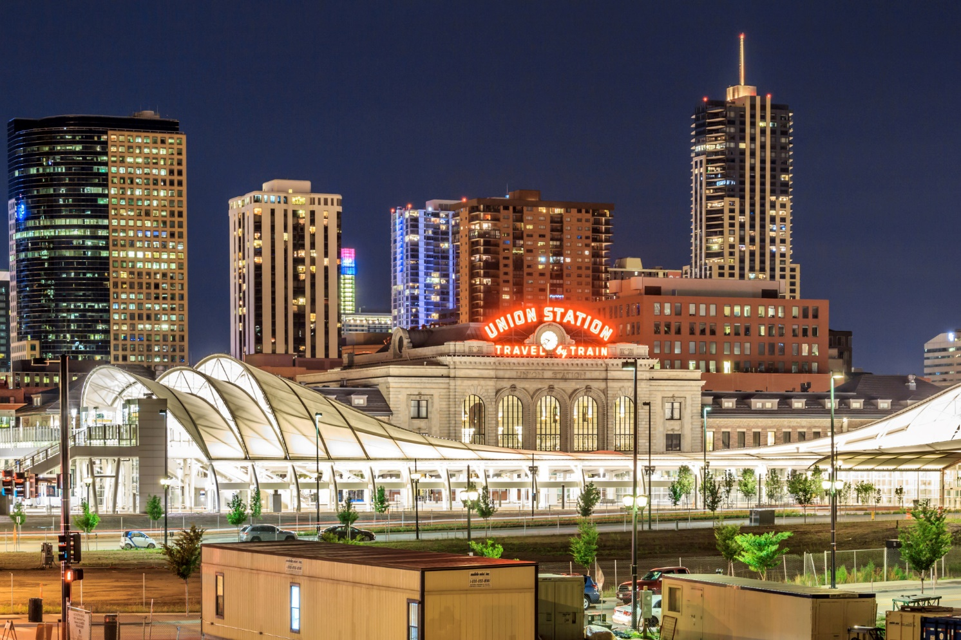
Big Thompson Canyon Repairs
I-225 Light Rail
Denver Union Station
Central 70 Project

